Slide 1
CPC PHS12-38442
Amanda Way
PGY-2

Slide 2
Clinical History
38 year old female with a several year history of blurry vision and intermittent eye pain
Had been using muro ointment and timolol with no improvement of vision
Patient unaware of any similar eye conditions in her family, but did remember her mother complaining of blurred vision as well

Slide 3
Clinical Exam
Vision: 20/40| 20/60
IOP: 18, 21
Color Vision: 13/13 OU
Visual Fields: full to confrontation
Anterior Exam: endothelial blisters OU with corneal edema
Fundus Exam: disc, macula, vessels and periphery within normal limits OU

Slide 4
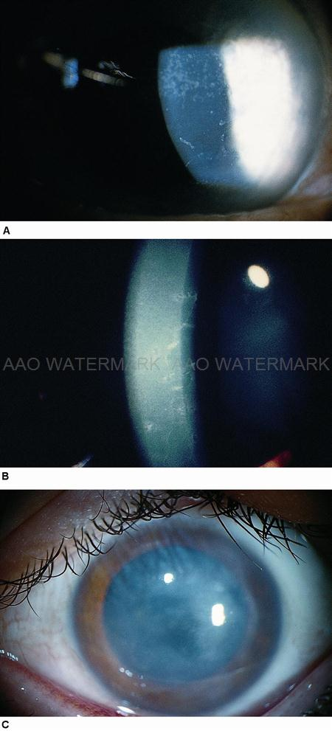
Anterior Segment Photos
Slit-lamp findings include bands and vesicles in the posterior cornea as well as a thickened Descemet's membrane
Secondary corneal edema and anterior synechiae
Note: This is a representative picture, not of our patient
AAO.org

Slide 5
Assessment and Plan
Patient diagnosed with posterior polymorphous membrane dystrophy (PPMD)
Given patient’s persistent corneal edema despite medical management, Descemet stripping automated endothelial keratoplasty (DSAEK) was performed on left eye

Slide 6
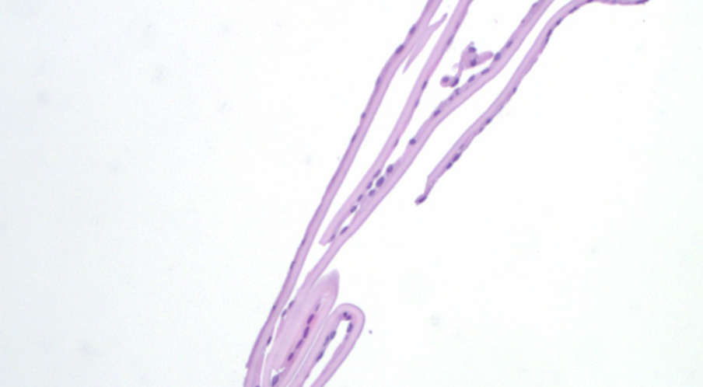
H & E
Descemet’s membrane, relatively thick for age

Slide 7
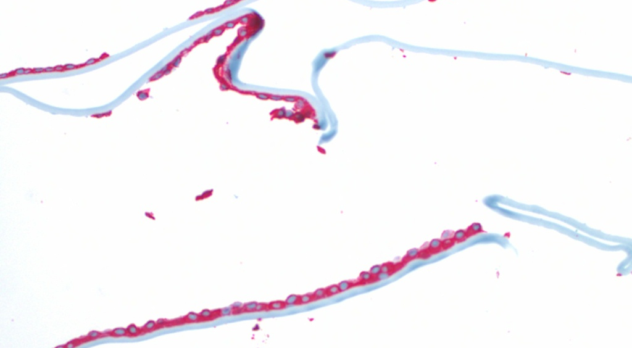
Cytokeratin Stain (CK7)
CK7: immunohistochemical stain that identifies keratin
Note CK7+ endothelium

Slide 8
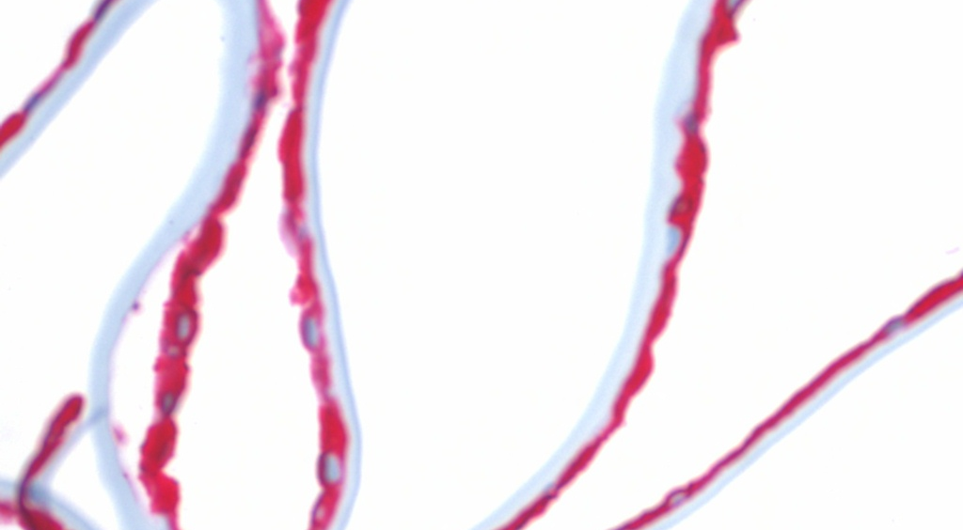
Cytokeratin Stain (CK7) – 40x
Light Blue: Descemet’s membrane
Red: Endothelium
Thickened Descemet’s
Endothelium appears stratified
Notes:
CK40

Slide 9
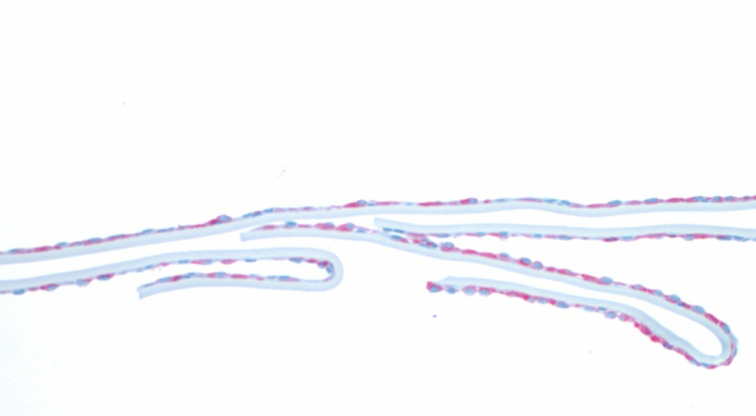
Vimentin Stain
Endothelium: red
Blue counterstain: Descemet’s membrane
Notes:
VIM 20

Slide 10
Discussion
Bilateral, nonprogressive, inheritable (autosomal dominant) corneal dystrophy with variable penetrance
Mutations in VSX1 homeobox (20q11) and COL8A2 (1p) have been described
Endothelium has epithelial-like characteristics
Microvilli (noted on electronic microscopy)
Decrease in total # of endothelial cells
Variable thickening of Descemet’s membrane
Sometimes associated with secondary glaucoma (open angle or associated with iridocorneal adhesions)
Héon et al. 2002
Notes:
Heon, et al, 2002; Biswas, et al, 2001)

Slide 11
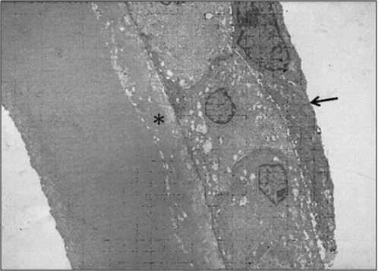
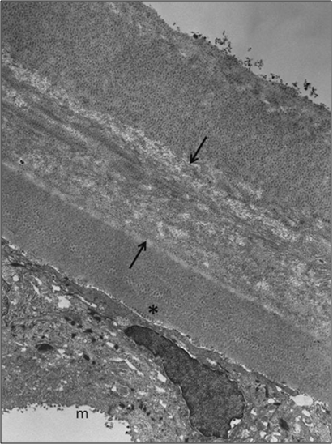
Differential Diagnoses
ICE
PPMD
ICE syndrome
In both conditions, endothelial cells may be multilayered and express cytokeratins
However, PPMD presents with wide-spaced collagen while ICE shows normal anterior banded and posterior nonbanded layers
Bromley et al. 2012

Slide 12
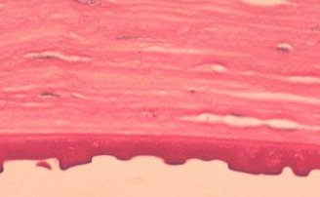
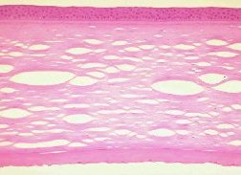
Differential Diagnoses
Fuchs endothelial dystrophy
Guttata in endothelial layer
Thickened Descemet’s
http://www.mrcophth.com

Slide 13
Other Clinical Pearls
Important to check intraocular pressure given the association with PPMD and glaucoma
Elevated pachymetry also associated with endothelial function
Examination of family may aid in diagnosis

Slide 14
References
AAO website, Feb 2013.
BCSC Section 8, External Disease and Cornea.American Academy of Ophthalmology 2011-2013.
Bromley JG, Randleman JB, Stone D, Stulting RD, Grossniklaus HE. Clinicopathologic Findings in Iridocorneal Endothelial Syndrome and Posterior Polymorphous Membranous Dystrophy After Descemet Stripping Automated Endothelial Keratoplasty. Cornea. 2012 Sept; 31(9):1060-1064.
Héon E, Greenberg A, Kopp KK, Rootman D, Vincent AL, Billingsley G, Priston M, Dorval KM, Chow RL, McInnes RR, Heathcote G, Westall C, Sutphin JE, Semina E, Bremner R, Stone EM. VSX1: a gene for posterior polymorphous dystrophy and keratoconus. Hum Mol Genet. 2002 May 1;11(9):1029-36.
http://www.mrcophth.com

