Slide 1
Supplementary photos for EyePath unknowns
Note: not all cases have supplementary photos.
Refer to EyePathUnknowns spreadsheet, Column E to see if one of these photos is relevant to your class session.

Slide 2
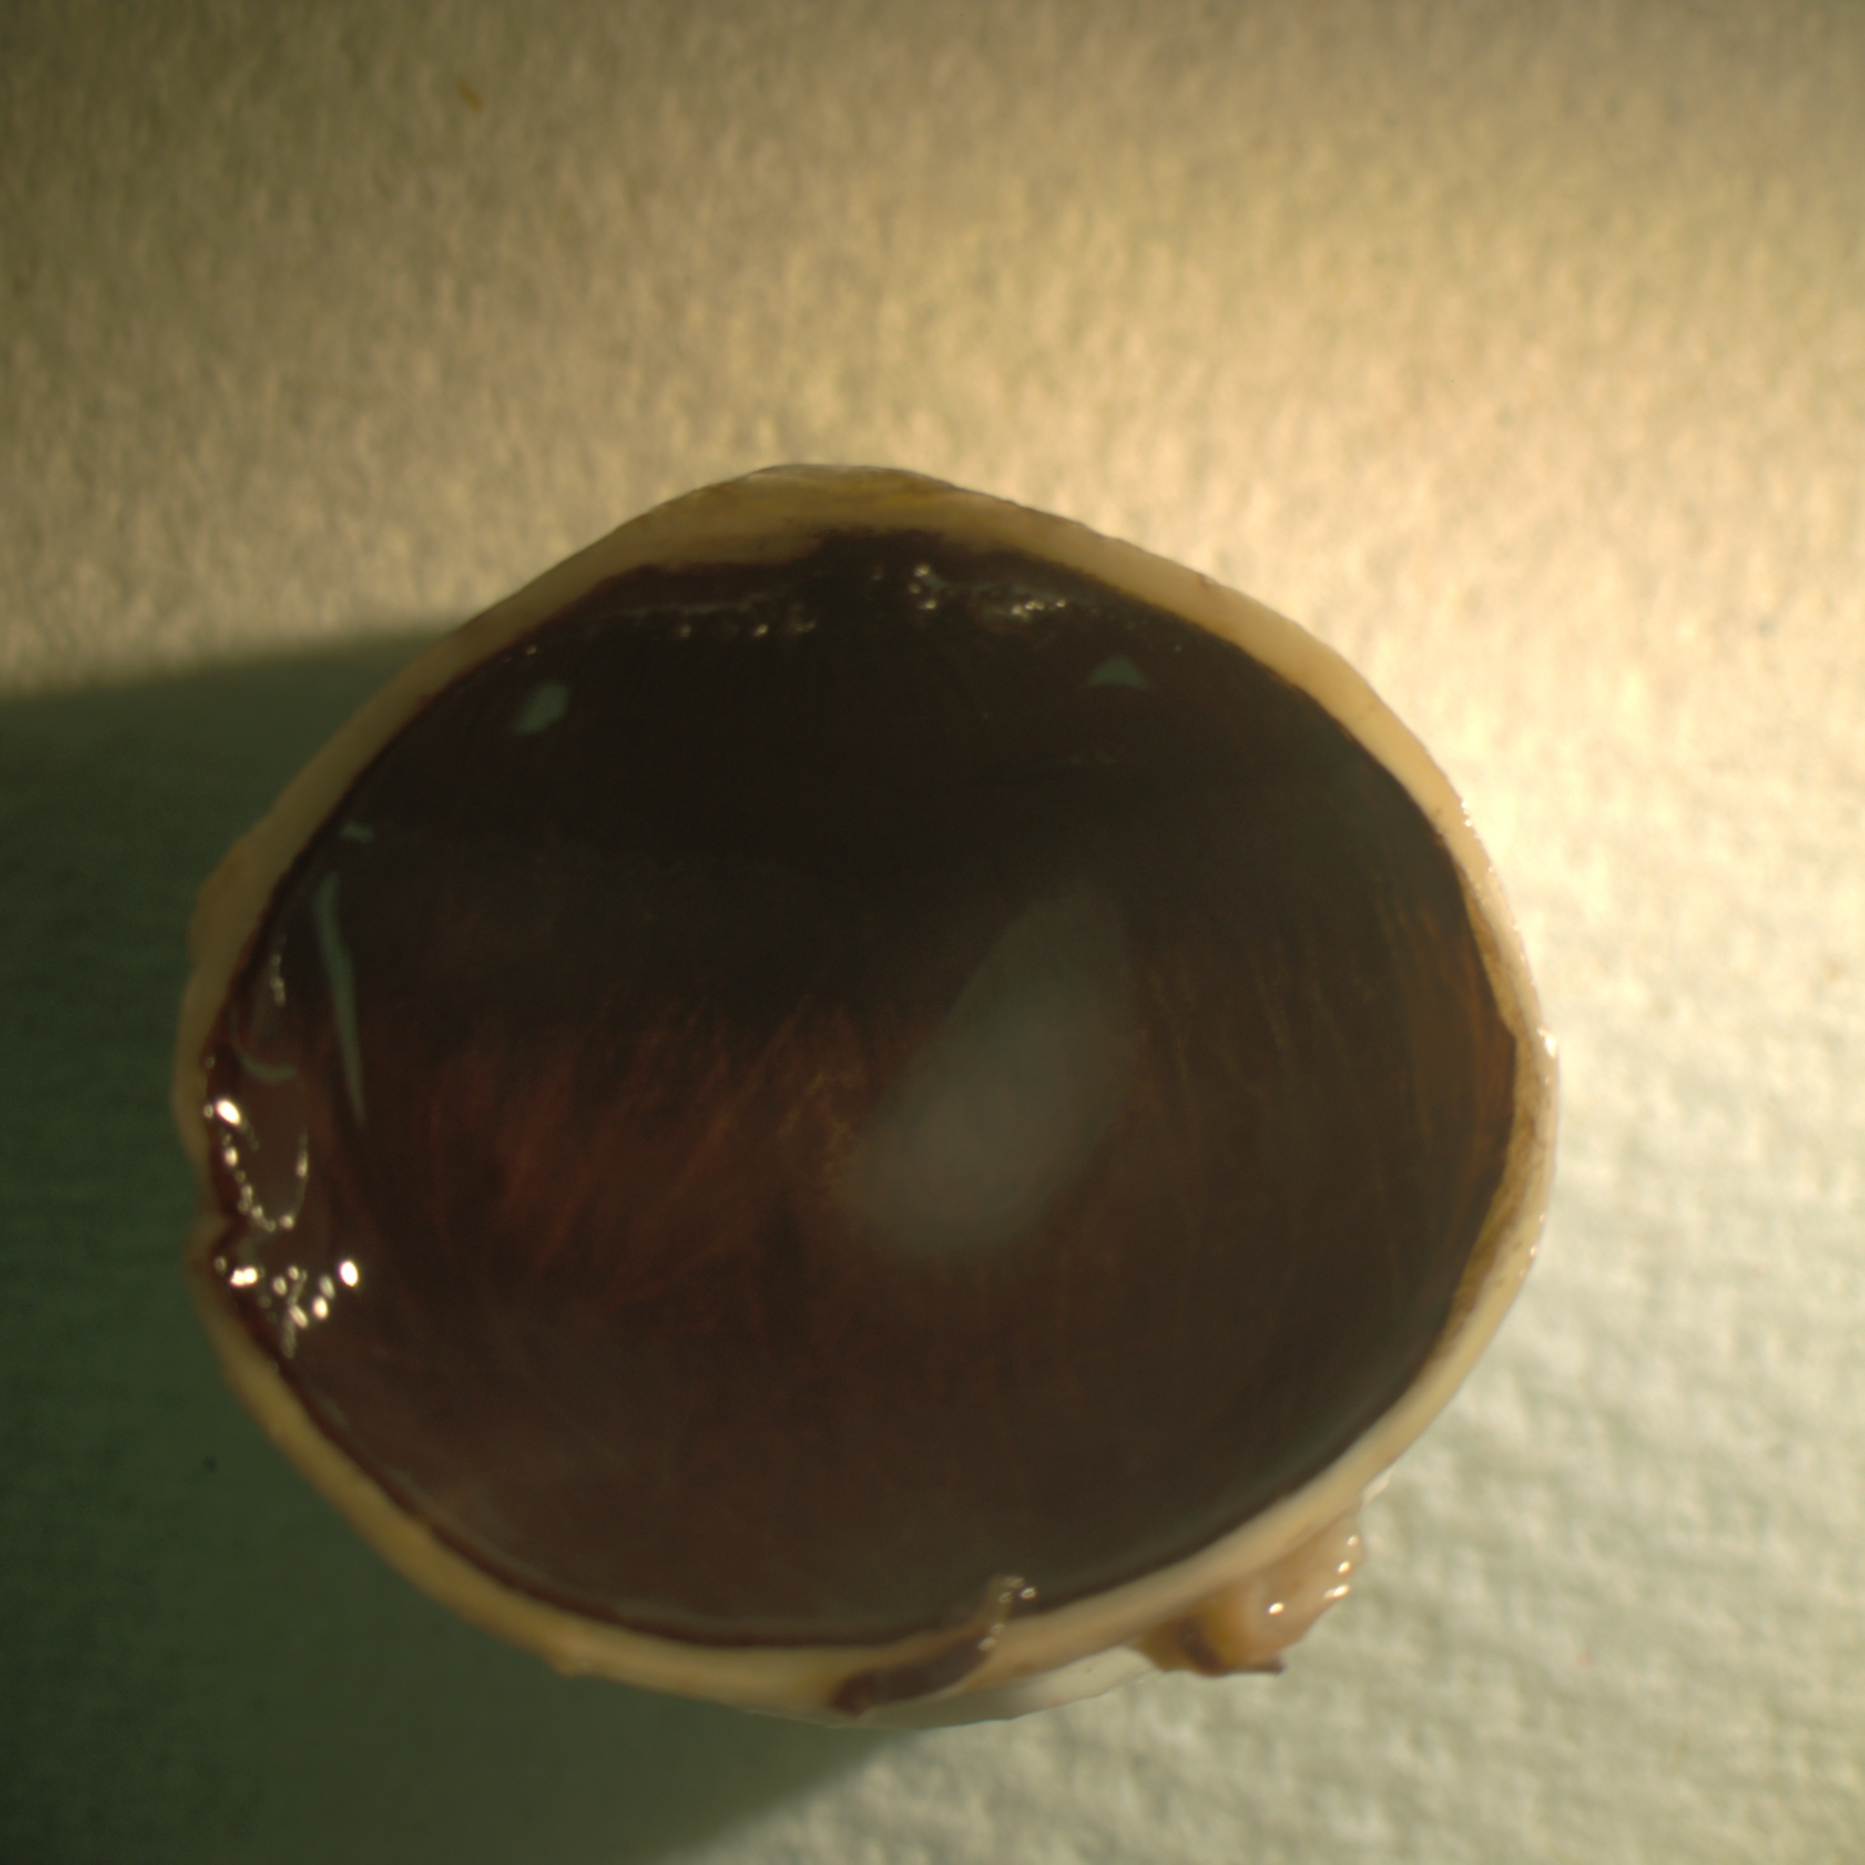
EP5.53

Slide 3
EP5.44-45

Slide 4
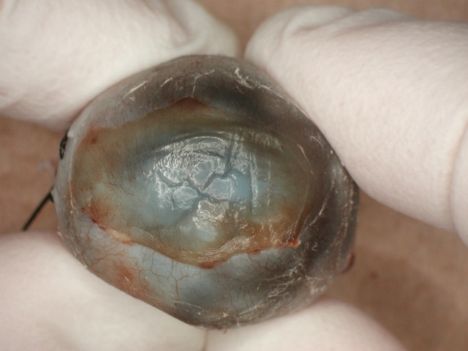
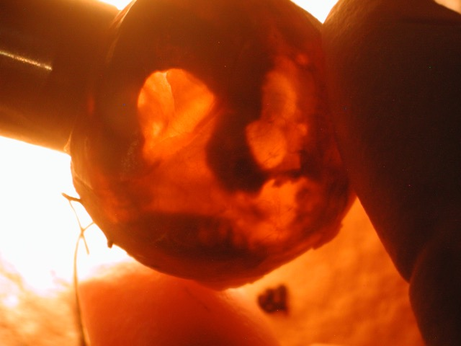
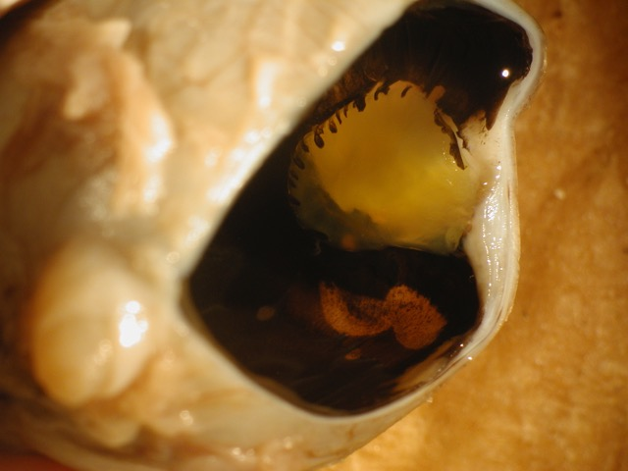
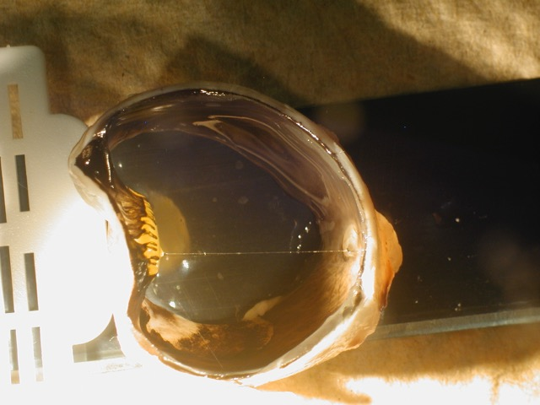
EP2-92

Slide 5
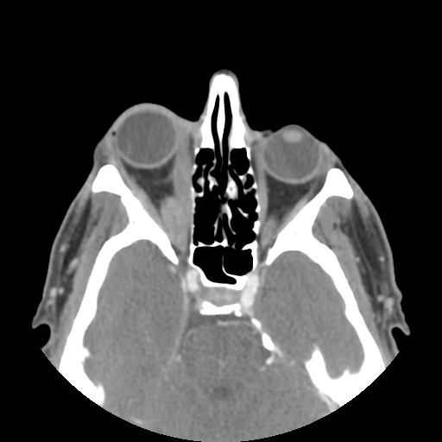
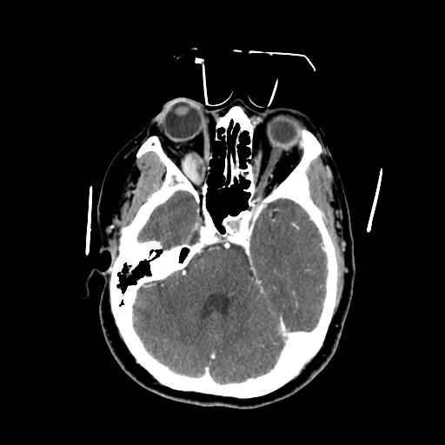
Two different patients with proptosis
EP7.30-EP7.31
EP7.32-EP7.40

Slide 6
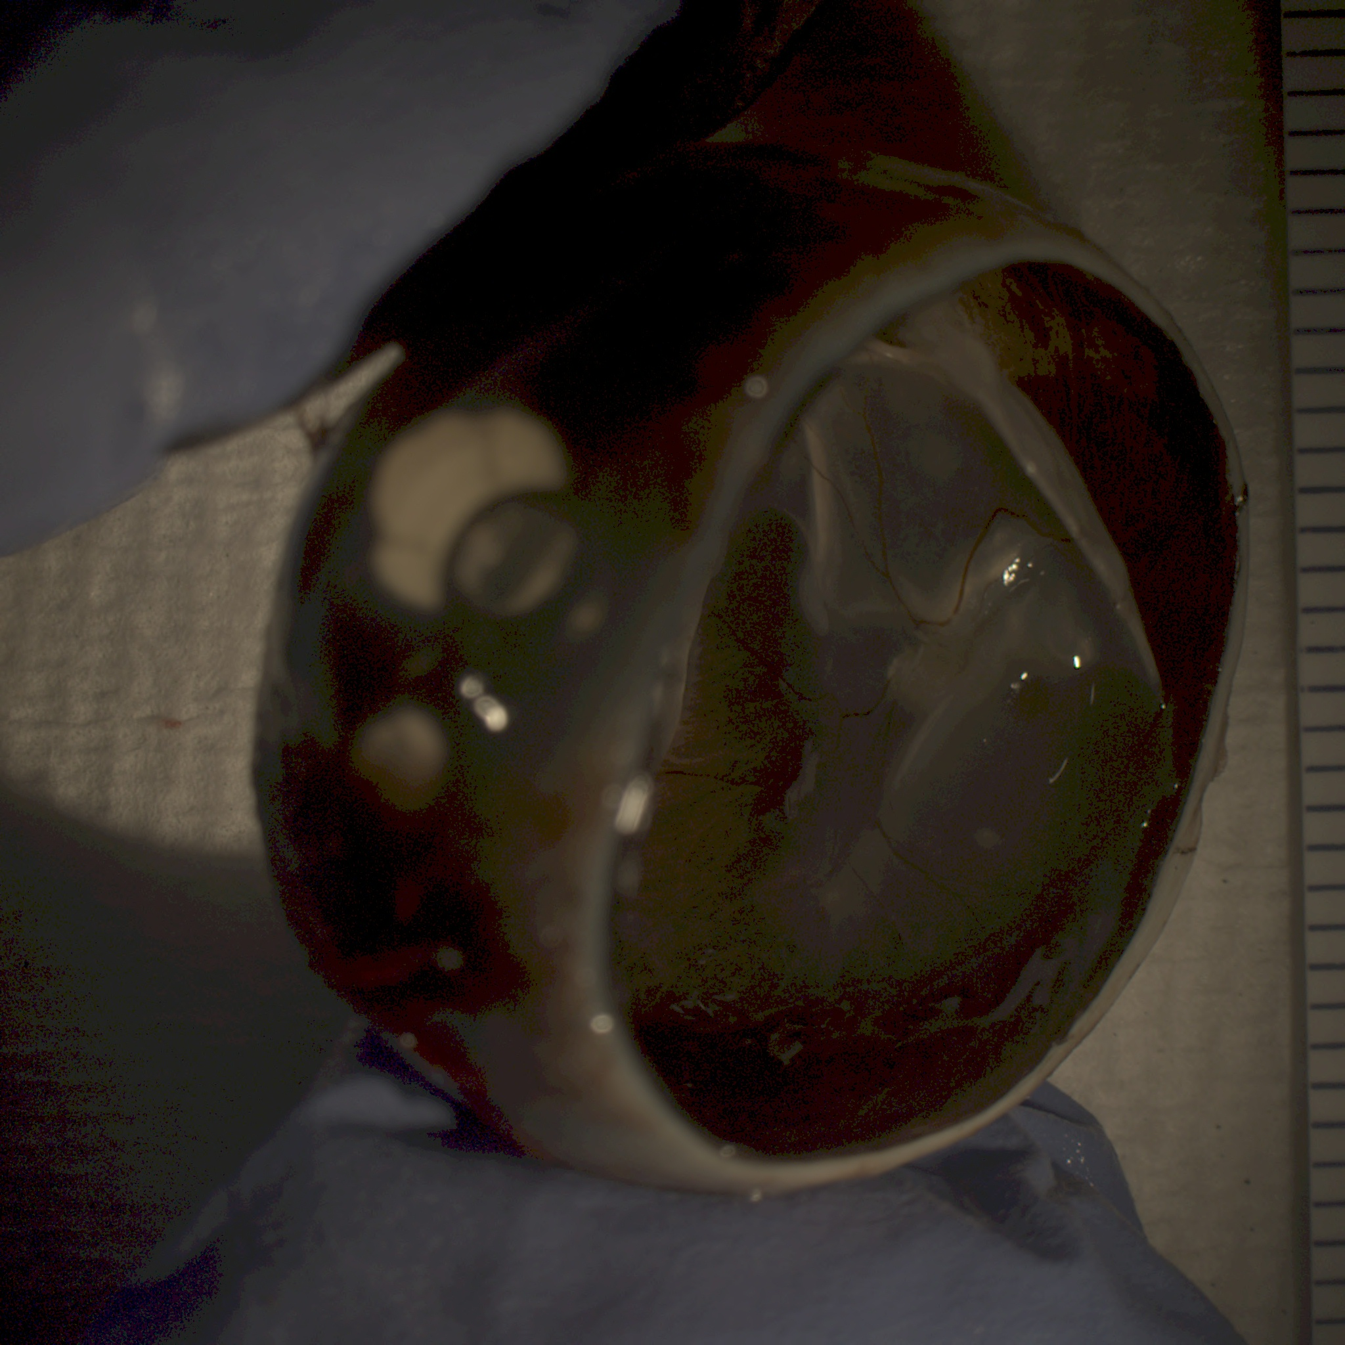
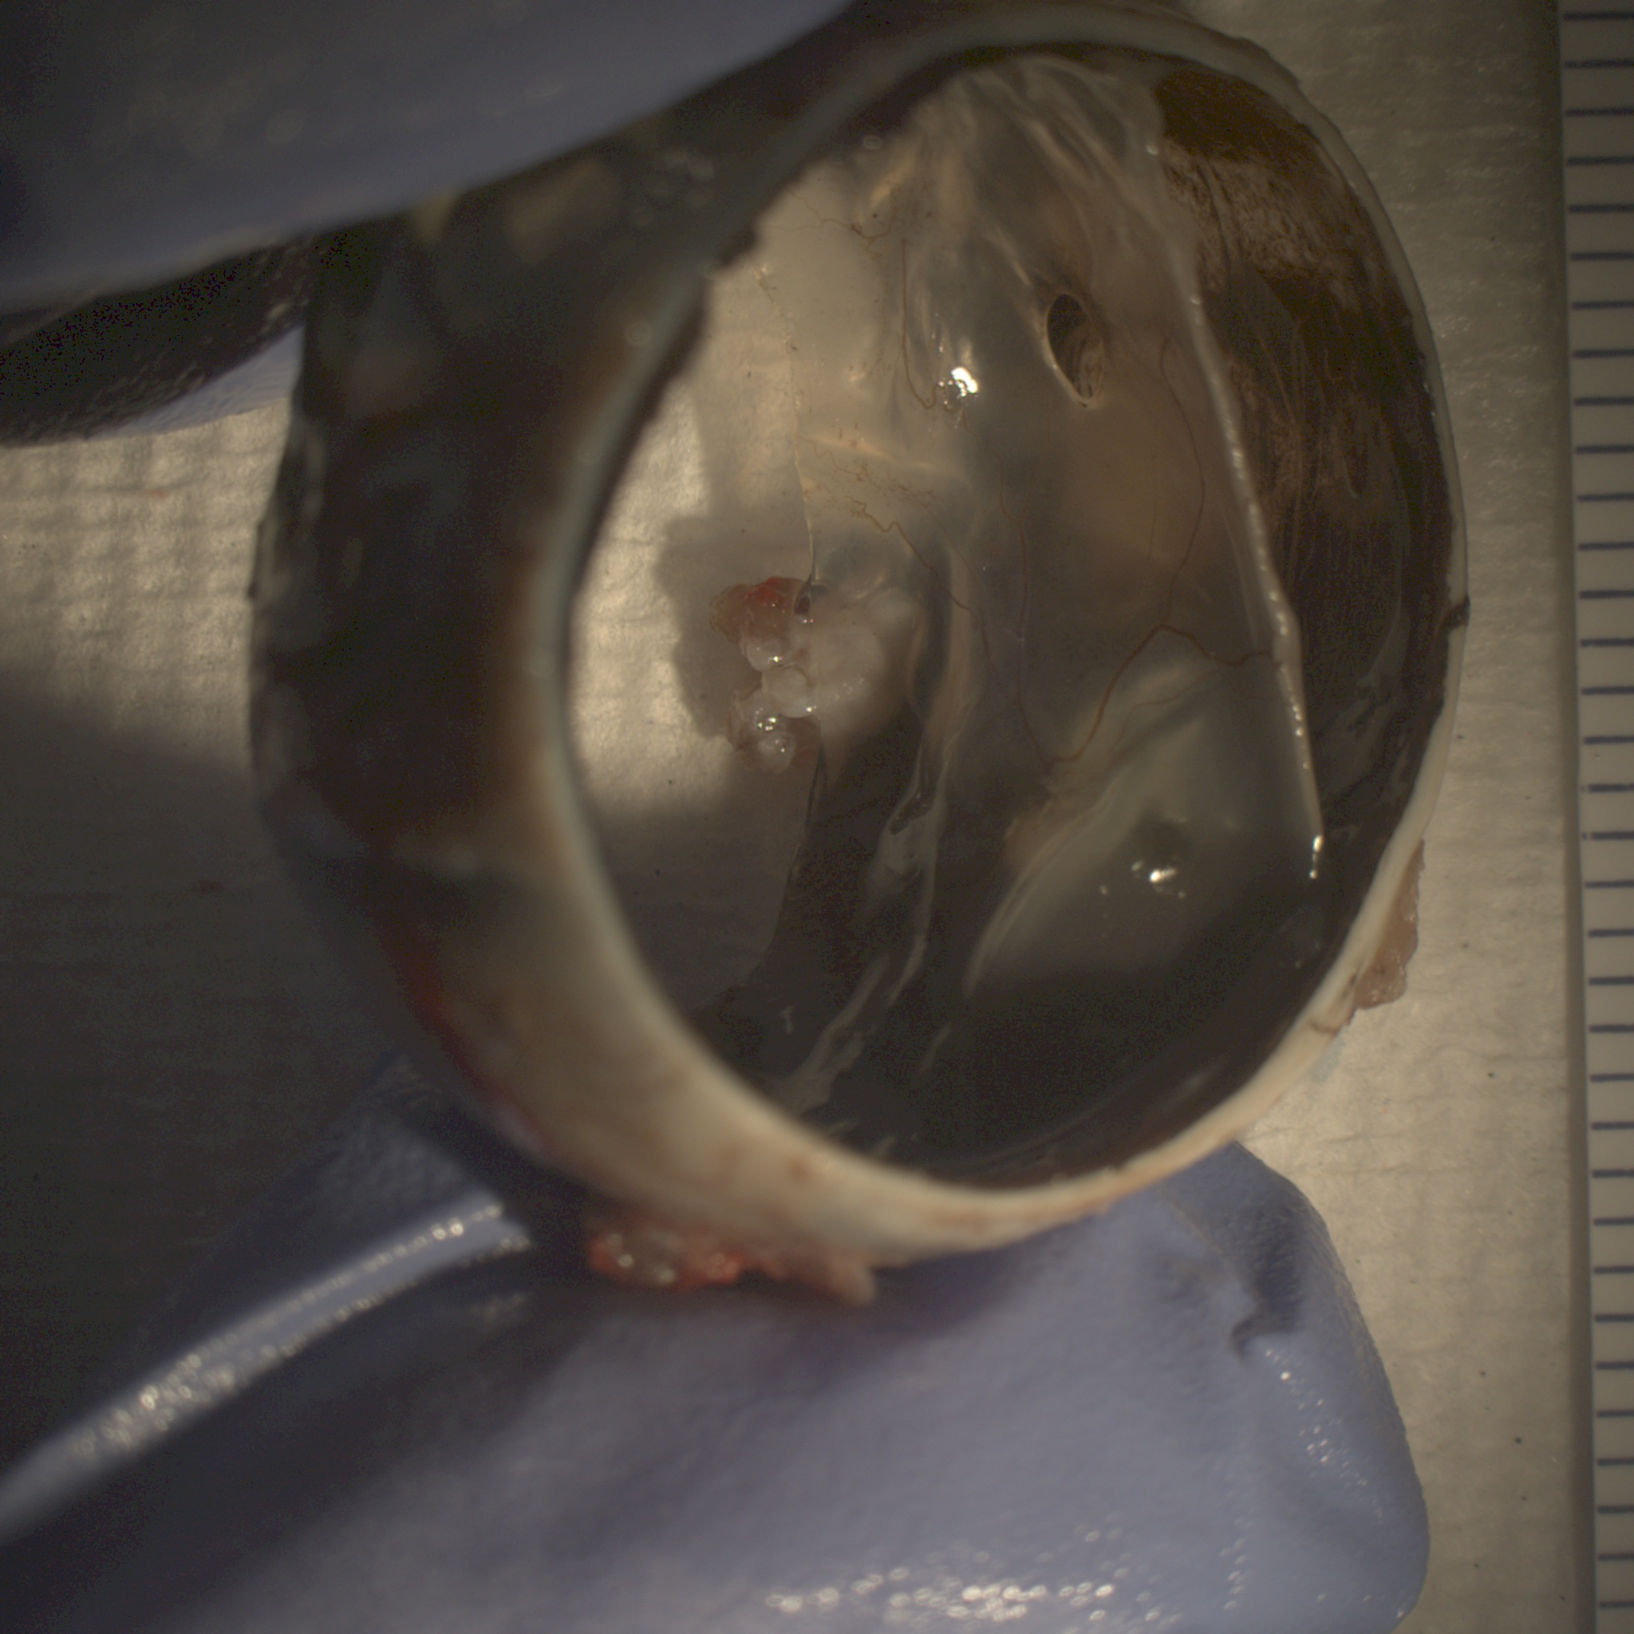
EP7.85

