Slide 1
Neuropathology Conference Case Presentation
Vasculitis
Kiruba Dharaneeswaran, PGY3
2016

Slide 2
HPI – Patient “JW”
52 y/o woman with a Hx of asthma, recurrent sinusitis and nasal polyps p/w numbness/tingling and weakness
1 week PTA developed pain on soles of feet
Over next 2 days developed L → R foot tingling
Went to ED, thought 2/2 steroid effect (sinusitis)
Next day tripped over toes, went to PCP
Possible Tendonitis from Avelox. Ordered EMG to be safe
PCP “surprised by findings,” sent to PUH over concern for GBS
Notes:
Decrease words so not reading slide

Slide 3
HPI – Patient “JW”
Over the past few days she also had the gradual progression of:
numbness on lateral aspect of legs
weakness in L shoulder
difficulty with R hand grip
No recent illness
Last vaccine in august (flu shot)
Treated previous month with Avelox and Medrol for sinusitis; presently on low dose Medrol taper
Home meds: Pulmicort (budesonide); Dulera (formoterol-mometasone); Singulair; Vitamin D

Slide 4
Histories
Past Medical History
Asthma
Nasal polyps/chronic sinusitis
GERD
Past Surgical History
Sinus surgery to clear polyps (last fall); have recurred
Patellar frx repair L leg
Family History
Father with DM (type 2)
Mother with COPD (65 yr smoker)
Paternal aunt with stroke
Social History
Lives with husband in Irwin
Morks for mutual fund company
No alcohol/tobacco/illicit drugs
Notes:
Delete nonpertinent info or highlight the important positives and negatives

Slide 5
Physical Exam
MSK: Redness /swelling L wrist, and ankle; painful to palpation
Skin: Few scattered 1 mm petichiae fingers/palms
MS: (normal)
CN: (normal)
MOTOR: Normal bulk and tone. No adventitious movements or bradykinesia. Slight right pronator drift
Deltoid Biceps Triceps Wr ext Wr flex Handgrip
Left 5/5 5/5 5/5 5/5 5/5 4/5
Right 5/5 5/5 5/5 5/5 4/5 3/5 (R median distribution)
Iliopsoas Knee flex Knee ext Tib Ant Gastroc
Left 5/5 4/5 4/5 2/5 3/5
Right 5/5 5/5 4/5 4/5 4/5
REFLEXES: 2+ and symmetric in biceps, triceps, brachioradialis, patellar; and 1+ achilles tendons. Plantar responses flexor. No pathological reflexes. Flexor plantar responses.
SENSORY: Normal vibration throughout. Somewhat decreased LT/PP in right distal ulnar distribution, bilateral lateral distal LE and dorsum of feet but normal on plantar surface.
COORDINATION: No dysmetria or ataxia
Notes:
Arggg, too much information, ?decrease words?

Slide 6
Basic Labs
CBC: wbc 17.4, Hgb 12, plts 328
37% eosinophils
Chem: BUN/Cr = 25/2.8 (normal 4 days prior)
LFTs, NH3, CPK all normal
Normal TSH, A1c, UA
B12 - 299
Notes:
This is a good break point to request a differential

Slide 7
MRI Brain w/o

Slide 8
MRI Brain w/o
Notes:
Changes in differential?

Slide 9
More Labs
+pANCA, ESR/CRP = 60/7.040
elevated fibrinogen
Normal ANA, SSA/SSB, RPR, dsDNA/RNP, ENA, APL/ACL, Lyme, C3/C4
CSF: Normal
EMG (here): evidence of a left common fibular mononeuropathy
Notes:
FINAL differential?

Slide 10
Vasculitis: Definitions
Focal or systemic inflammation of blood vessels
causing ischemia or infarction
PNS is involved in 60-70% of systemic vasculitis
Primary versus secondary
connective tissue, rheumatologic, chronic inflammatory or infectious causes
Etiology is variable among the different subgroups
Notes:
I have chopped out the words as an example

Slide 11
Histopathology of vasculitis
Peripheral Nerve
H&E
CD3
Toludine Blue Thick section
Eosinophilic granulomatous polyangiits
Muscle Churg-Strauss H&E
CNS
Involvement in systemic vasculitis
H&E
H&E Infarcts secondary to lupus
Wegner’s
Dura matter H&E

Slide 12
Histopathology of vasculitis
CNS
Necrotizing Granulomatous
H&E
CD3
CD68
Amyloid angitis
H&E
CD3
Abeta
PMN Small vessel vasculitis
H&E
Basement membrane collagen 4
CD8
Myeloperoxidase

Slide 13
Vasculitis: Classification Schemes
By vessel size (large, medium, small, micro)
Peripheral Nerve Society Task Force
International Chapel Hill Consensus Conference
Updated 2012 (CHCC2012)
Most widely accepted
Integrates etiology, pathogenesis, pathology, demographics and clinical manifestations

Slide 14
CHCC2012
Notes:
Complex slide that you will need to walk folks through

Slide 15
Large Vessel Vasculitis
Large arteries (aorta and branches)
Granulomatous rather than necrotizing
Giant Cell Arteritis
Age usually >50. Often a/w PMR (50%)
Predilection for carotid/vertebrals and temporal aa.
Otologic (75%), Optic nerve (15%), CNS/PNS (5%)
Takayatsu
Age usually <50
Are these the same disease?

Slide 16
Medium Vessel Vasculitis
Onset is often more acute/necrotizing vs LVV
Polyarteritis Nodosa
Necrotizing, sparse immune deposits, mixed infiltrate
Medium/small arteries; spares arterioles/capillaries
Spares lungs. Skin, joints, kidneys ~50%
Associated w/ Hep B>C
PNS 65%, CNS or CN ~5%
Kawasaki
Associated with mucocutaneous LN syndrome
Infants and children
Often involves coronary arteries.
Can also involve large vessels

Slide 17
Small Vessel Vasculitis
Affects small intraparenchymal arteries, arterioles, capillaries and venules
ANCA-Associated Vasculitis
Granulomatous Polyangiitis (GPA) [ Wegeners]
Microscopic Polyangiitis
Churg-Strauss (EGPA)
Immune Complex Small Vessel Vasculitis
Henoch-Schönlein purpura (IgA vasculitis)
Essential Mixed cryoglobulinaemic (non-HCV)
Anti-Glomerular Basement Memberane (GBM)

Slide 18
ANCA-Associated Vasculitis
Granulomatous Polyangiitis (GPA) [ Wegeners]
Necrotizing, collagen necrosis, pauci-immune, LCV
Upper/lower resp tract, often glomerulonephritis
ANCA+ 85%, Usually PR-3 (c-ANCA)
CNS 5-10%, PNS 20-25%, CN 15%
Microscopic Polyangiitis (mPAN)
Necrotizing, pauci-immune, LCV in skin as well
Necrotizing glomerulonephritis
ANCA+ 80%, usually MPO (p-ANCA)
PNS 45%, CNS 10-15%

Slide 19
ANCA-Associated Vasculitis - cont
Churg-Strauss (EGPA)
Similar histopath but with eosinophilic infiltrate
Associated w/Asthma, nasal polyps, pulm infiltrates
Glomerulonephritis common
+ANCA in 35% (usually MPO); eosinophilia in 100%
PNS 65%, CNS 10-15%, CN <5%

Slide 20
Immune Complex Small Vessel Vasculitis
Henoch-Schönlein purpura (IgA vasculitis)
IgA vascular deposits; LCV in skin
Also joints, GI; very rarely lungs or CNS/PNS
“Essential” Mixed cryoglobulinaemic (non-HCV)
purpura,, glomerulonephritis, leg ulcers, arthritis, and sicca syndrome . Peripheral neuropathy in 65%
Anti-Glomerular Basement Memberane (GBM)
Pulmonary and renal capillaries

Slide 21
Secondary Systemic vasculitis
Connective Tissue Disease
RA, Sjögren’s, SLE, SS, DM, MCTD
Sarcoidosis
BehÇet’s disease
Infection
HBV, HCV, HIV, CMV, leprosy, Lyme, HTLV-1
Drugs
Atbx, thiazide diuretics, levamisole, NSAIDs, pheyntoin
Malignancy
Inflammatory bowel disease
Hypocomplementemic urticarial vasculitis syndrome

Slide 22
Primary CNS vasculitis
Extremely rare, ~2.4 per 1 million person-years
Diagnostic Criteria (Calabrese et al)
The presence of an acquired otherwise unexplained neurological or psychiatric deficit.
The presence of either classic angiographic or histopathological features of angiitis within the CNS.
No evidence of systemic vasculitis or any disorder that could cause or mimic the angiographic or pathological features of the disease.

Slide 23
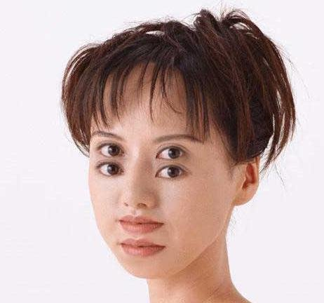
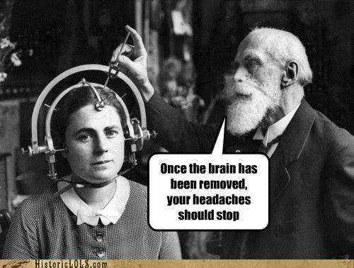
Primary CNS vasculitis
Headache: most common presenting symptom
Subacute onset; later can develop behavioral or personality changes, dementia or encephalopathy
Recurrent strokes in 30-50%
Rarely seizures, ataxia, coma, cranial neurpopathies
Fever, night sweats, malaise, weight loss also rare

Slide 24
Primary CNS vasculitis
CSF: Lymphocytic pleocytosis, elevated protein
MRI (sensitivity is 100%!)
Multiple strokes in different vascular territories
Can involve cortex, subcortex and leptomeninges
May see ass lesions, meningeal enhancement, ICH
Angiography: “Beading,” tapering, fusiform dilations etc can be found but are not specific
Pathology: Biopsy is the gold standard
Lymphocytic reaction; variable plasma cells, histiocytes, neurotrophils and eosinophils
Granulomatous <50%, Necrotizing <25%

Slide 25
Back to “JW”
Seen by renal medicine and rheumatology
Renal biopsy:
Segmental necrotizing glomerulitis with eosinophilia
No evidence of immune complex deposition
Compatible with Churg Strauss Syndrome
Received 5 days of 1g IV Methylprednisolone
Cr peaked at 3.4; as of 5/8 was 2.0
Improvement in sensorimotor deficits
Home on oral prednisone + cyclophosphamide

