Slide 1
Neurodegenerative Neuropath

Slide 2
The Neurodegenerates
Alzheimer Disease
Parkinson Disease
Lewy Body Dementia
Multiple Systems Atrophy
FTD / FTLDs
Motor Neuron Diseases
Huntington’s Disease

Slide 3
Previously established “normal” brain
Implies inexplicable decline
Insidiously progressive
**Proteinopathies**
tau
amyloid
Alpha synuclein
ubiquitin
huntingtin
TDP

Slide 4
PROTEIN | DISEASE | LOCATION
Amyloid (β) | Alzheimer | Extracellular, Plaques
Tau | Alzheimer FTLD PSP CBD | Neurofibrillary tangles Neuron AND glial inclusions
TDP-43 | FTLD ALS | Neuron AND glial inclusions
Synuclein (α) | Parkinson DLB MSA | Lewy Bodies Neuron inclusions
Polyglutamine | Huntington | Intranuclear cytoplasmic
Ubiquitin | DLB ALS | Bunina bodies Hyaline inclusions
Prion (:<) | CJD

Slide 5
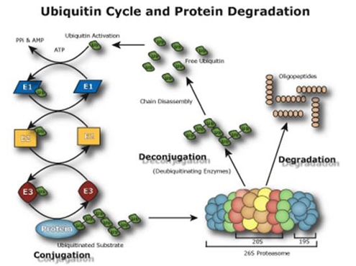
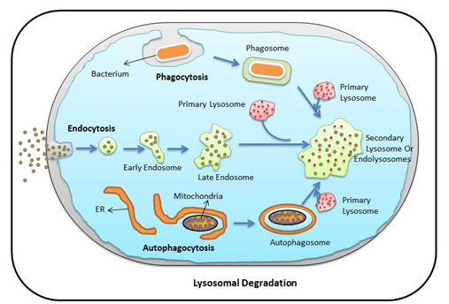
Protein Recycling

Slide 6
AMYLOID
&
TAU
Notes:
Which disease?

Slide 7
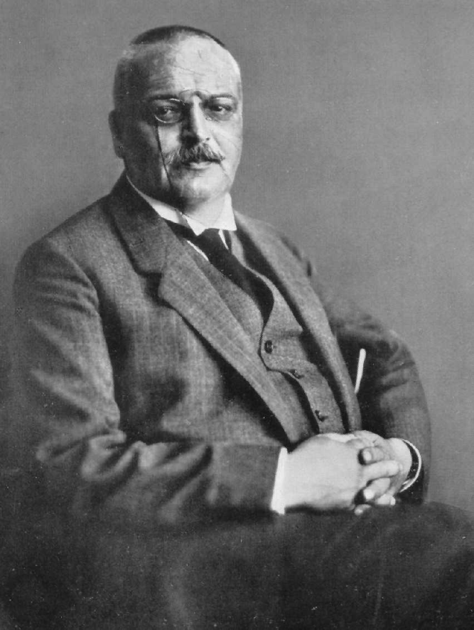
ALZHEIMER DISEASE
Alois Alzheimer

Slide 8
Alzheimer’s Disease
MOST COMMON CAUSE OF DEMENTIA!
Onset = 70s +
Manifestations
Short term memory… then
Judgement and Visuospatial tasks… then
Word finding / Behavior / Apraxias

Slide 9
Alzheimer’s Disease
Inheritance
75% sporadic / 24% w fhx / 1-2% dominant
PS1 / PS2 / APP = earlier onset disease
Apoe E4 = later onset disease
Prognosis = 8-10yrs

Slide 10
Alzheimer’s Disease
Gross:
Diffuse gyral atrophy and ventricular dilatation, with most severe involvement of the temporal cortex, amygdala, hippocampus, and entorhinal cortex with relative sparing of the occipital lobe
Microscopic:
Extracellular beta amyloid plaques found throughout the neocortex
Intracellular tau NFTs most numerous in the hippocampus, amygdala, and entorhinal cortex, but usually also in the neocortex

Slide 11
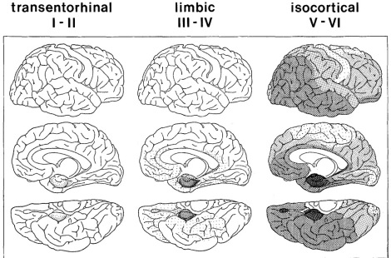

Slide 13
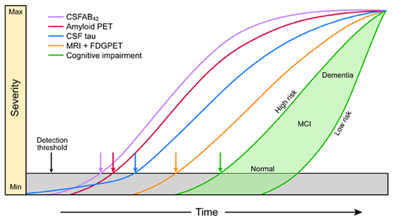
Notes:
See a decrease of amyloid in csf, increase in tau in csf with disease progression.

Slide 14
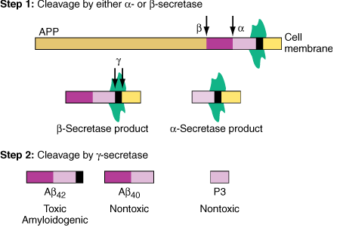

Slide 15
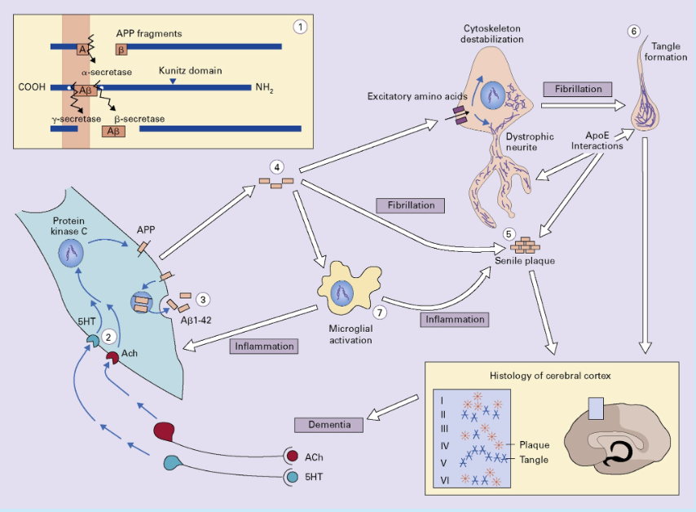

Slide 16
Alzheimer’s Disease
Frontal Lobe
H&E, Bielschowsky,βAmyloid, ptau
Hippocampus
H&E, Bielschowsky, βAmyloid, ptau
Mesial Temporal Sclerosis
H&E, Bielschowsky,
Cerebral Amyloid angiopathy
βAmyloid

Slide 17
alpha Synuclein
Notes:
What diseases?

Slide 18
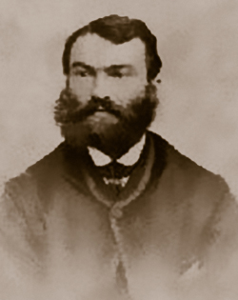
Parkinson Disease
James Parkinson

Slide 19
Parkinson Disease
MOST COMMON NEURODEGENERATIVE MOVEMENT DISORDER!
Onset: 55 – 65 yo
Manifestations (T R A P):
Resting / Pill rolling Tremor
Cogwheel Rigidity
Akinesia / Bradykinesia
Postural Instability
And… Hypomimia (masked face), RBD, Orthostasis, Dementia, Punding

Slide 20
Parkinson Disease
Inheritance: MCC (<50yo) = PARK2.. Parkin gene
Prognosis: 12+ yrs

Slide 21
Parkinson Disease
Gross:
Pallor of the substantia nigra and usually the locus ceruleus
Slight cortical atrophy and ventricular dilatation
Microscopic:
Loss of neurons/depigmentation in the substantia nigra
Presence of Lewy bodies in the substantia nigra and frequently other nuclei (locus ceruleus, dorsal motor nucleus of the vagus, nucleus basalis of Meynert)
Cortical Lewy bodies are found in essentially all patients with Parkinson's disease
Notes:
Neuromelanin produced in association with Dopamine
Loss of Dopamine production = Loss of neuromelanin
Neuromelanin distributes into nearby tissues where it is phagocytosed
Depigmentation of the SN
Cortical Lewy bodies, in contrast to brain stem Lewy bodies, do not have a distinct halo. They are eosinophilic, usually round, most frequently found in the lower cortical layers (V and VI), and most numerous in the temporal, insular, and cingulate cortices. Cortical Lewy bodies are also ubiquitin and α-synuclein immunoreactive

Slide 22
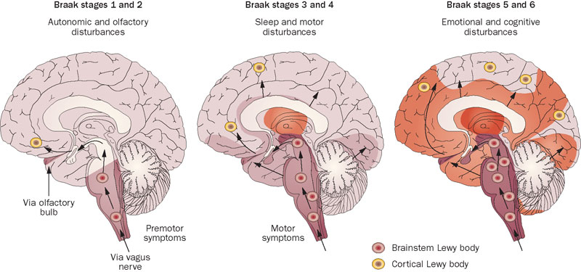

Slide 23
α-synucleinopathies
PD, DLB, MSA
Pathology Lewy Bodies
H&E
α-synuclein + cytoplasmic inclusions
Neurons – PD and DLB
Oligodendroglia - MSA

Slide 24
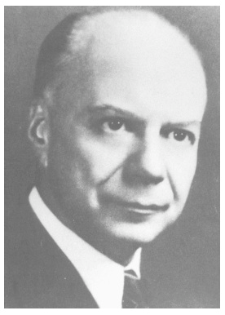
Lewy Body Dementia
Frederic Heinrich Lewy

Slide 25
Lewy Body Dementia
2nd MCC of Dementia! (well this and Vasc)
Onset: 70yo +
Manifestations:
Fluctuating impairment / attention **
Visual Hallucinations
Parkinsonism
Prognosis: 5-10yr

Slide 26
Lewy Body Dementia
Gross:
Diffuse cortical atrophy and ventricular dilatation with concomitant Alzheimer's disease
Pallor of the substantia nigra and locus ceruleus
Microscopic:
Cortical and brain stem Lewy bodies
Three levels of involvement
Brain stem
Limbic
Neocortical
Microvacuolation in the temporal cortex
Alzheimer's disease changes may be present

Slide 27
α-synucleinopathies
PD, DLB, MSA
Pathology Lewy Bodies
H&E
α-synuclein + cytoplasmic inclusions
Neurons – PD and DLB
Oligodendroglia - MSA

Slide 28
Multiple Systems Atrophy

Slide 29
Multiple Systems Atrophy
MSA(p) – striatonigral degeneration
MSA(c) – olivopontocerebellar degeneration
MSA(a) – Shy Drager Syndrome

Slide 30
Multiple Systems Atrophy
Onset: 50s to 60s
Manifestations:
MSA-P: akinesia, rigidity, dystonia, dysesthesia
MSA-C: gait and limb ataxia, dysarthria, oculomotor disturbances
Both: dysautonomia
Prognosis: 5-10yr
Notes:
In MSA-P, comprising 80% of all MSA, parkinsonian signs and symptoms are typically bradykinesia, rigidity, postural instability, and a postural/action tremor rather than the classic pill-rolling tremor seen in Parkinson's disease. These symptoms are usually poorly responsive to long-term levodopa therapy. In MSA-C, typical findings are gait and limb ataxia, cerebellar dysarthria, and oculomotor dysfunction. Babinski signs and hyperreflexia may be present in either type of MSA.

Slide 31
Multiple Systems Atrophy
Gross:
MSA-P: atrophy of the putamen and caudate nucleus
MSA-C: atrophy of the cerebellum, middle cerebellar peduncle, and pons
In both types, pallor of the substantia nigra
Microscopic:
MSA-P: neuronal loss and astrocytosis in the striatonigral system
MSA-C: cerebellar degeneration with Purkinje cell loss

Slide 32
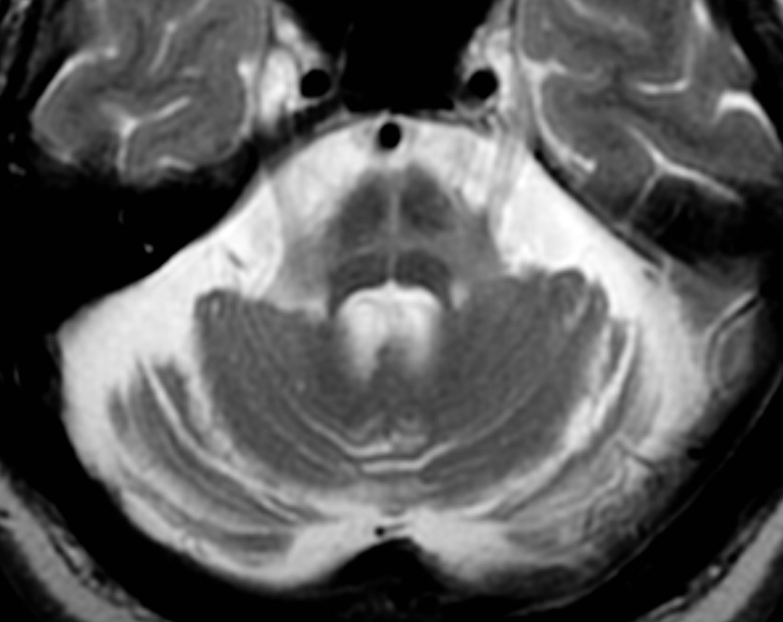

Slide 33
α-synucleinopathies
PD, DLB, MSA
Pathology Lewy Bodies
H&E
α-synuclein + cytoplasmic inclusions
Neurons – PD and DLB
Oligodendroglia - MSA

Slide 34
STOP FOR TODAY

Slide 35
tau
Notes:
What diseases?

Slide 36
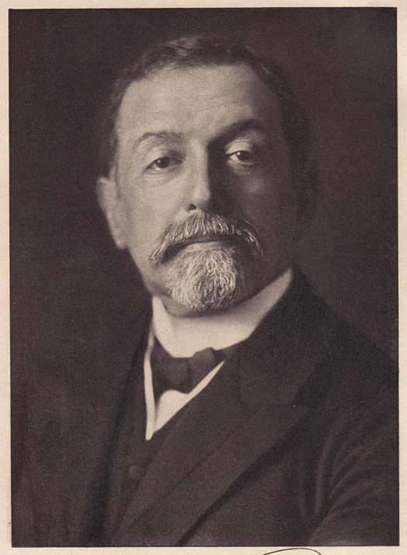
FTLDs/Taupathies
Arnold Pick

Slide 37
Behavioral variant FTD
Onset 45-60
Loss of social awareness, impulse control, inappropriate conduct
Progressive Non-fluent aphasia
Onset 45-60
Non-fluent aphasia, agrammatism, anomia
Semantic Dementia
Onset 45-60
Fluent aphasia, anomia, loss of word meanings
Progressive Supranuclear Palsy
Onset 60-65
Postural instability, falls, vertical gaze palsy
Corticobasilar degeneration
Onset 60-65
Asymmetric rigidity, apraxia (alien limb), parkinsonism
Notes:
Prognosis: 5-10yr

Slide 38
Behavioral variant FTD
Gross: fronto-temporal > orbital, cingulate atrophy; “knife edge”
Progressive Non-fluent aphasia
Gross: asymmetric LEFT perisylvian atrophy
Semantic Dementia
Gross: bitemporal atrophy
Progressive Supranuclear Palsy
Gross: midbrain > pons atrophy; pallor of substantia nigra
Corticobasilar degeneration
Gross: peri-rolandic / para-sagittal atrophy

Slide 39
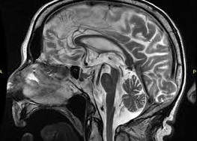

Slide 40
Insert video of back petting or killing ants

Slide 41
All that is FTLD is not tau…
TDP 43
Ub

Slide 42
FTD-MND
Associated with TAR DNA Binding Protein (TDP-43)
Spans FTLD spectrum of disease including:
Odd behaviors, social inappropriateness
Semantic and Non-fluent aphasias (less so)
Parkinsonism… then to boot
MND (implies poor prognosis at this step)
Notes:
Approximately 15% of patients with FTD also develop motor neuron disease (FTD-MND).

Slide 43
Tauopathies
PSP, CBD
FTLD
FTLD-tau (sporadic) 50%
FTLD-TDP (sporadic or inherited) 45%
H&E, tau, ubiquitin, TDP
FTLD-FUS 5%
FTLD-UPS <1%
FTLD-ni <1%
Pick’s
MAPT mutations
H&E, tau, Bielschowsky
FTDP-17TAU

Slide 44
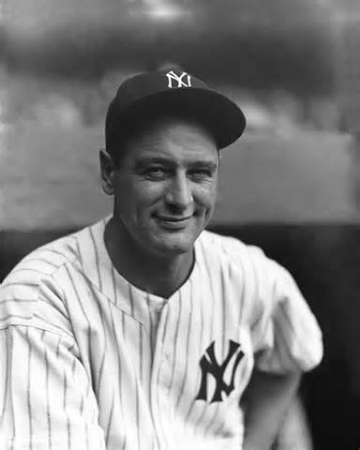
Motor Neuron Disease

Slide 45
Amyotrophic Lateral Sclerosis
Combined UMN-LMN signs
Hyperreflexia, spasticity, pathologic reflexes
Hyporeflexia, weakness, atrophy, fasciculations
Primary Lateral Sclerosis
Predominantly UMN signs
Progressive Muscular Atrophy
Predominantly LMN signs
Spinal & Bulbar Muscular Atrophy (Kennedy)
Combined spinal and bulbar MND

Slide 46
Motor Neuron Disease
Gross:
Progressive atrophy of caudate, putamen
Atrophy of cerebral cortex
Microscopic:
Loss of anterior horn cells
Loss of Betz cells in Primary Motor Cortex
Loss of myelinated axons of Lateral CST
Bunina Bodies in Anterior Horn Cells

Slide 47
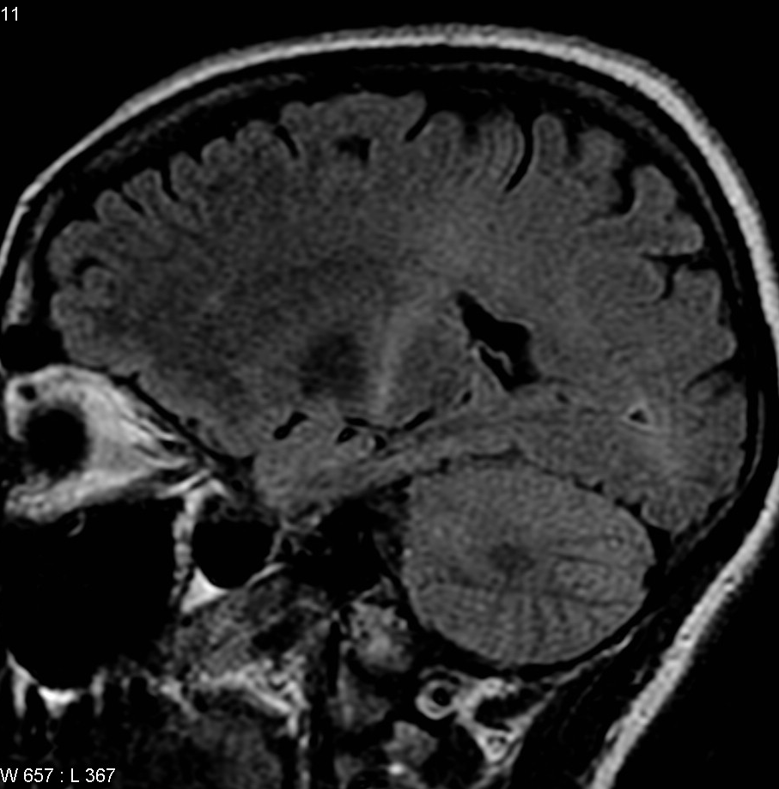

Slide 48
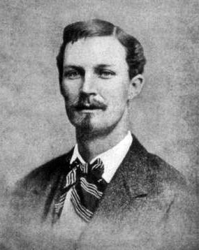
Huntington Disease
George Huntington

Slide 49
Huntington Disease
Autosomal Dominant mutation in huntingtin gene on Chromosome 4 → CAG expansion
Onset:
Juvenile – can be < 20 yo (> 50 rpts)
Adult – 40s (sxs if > 40 rpts)
Manifestations:
Movements – chorea, dystonia
Mood – psychiatric disease, increased suicidality
Memory – cognitive impairment

Slide 50
Huntington Disease
Gross:
Atrophy of caudate and putamen
Atrophy of cortex
Microscopic:
Neuronal loss and astrocytosis of caudate and putamen, cerebral cortex, mesial temporal lobes
Neuronal loss in substantia nigra, thalamus, hypothalamus, pons, cerebellum…

Slide 51
Extra / Resource slides

Slide 54
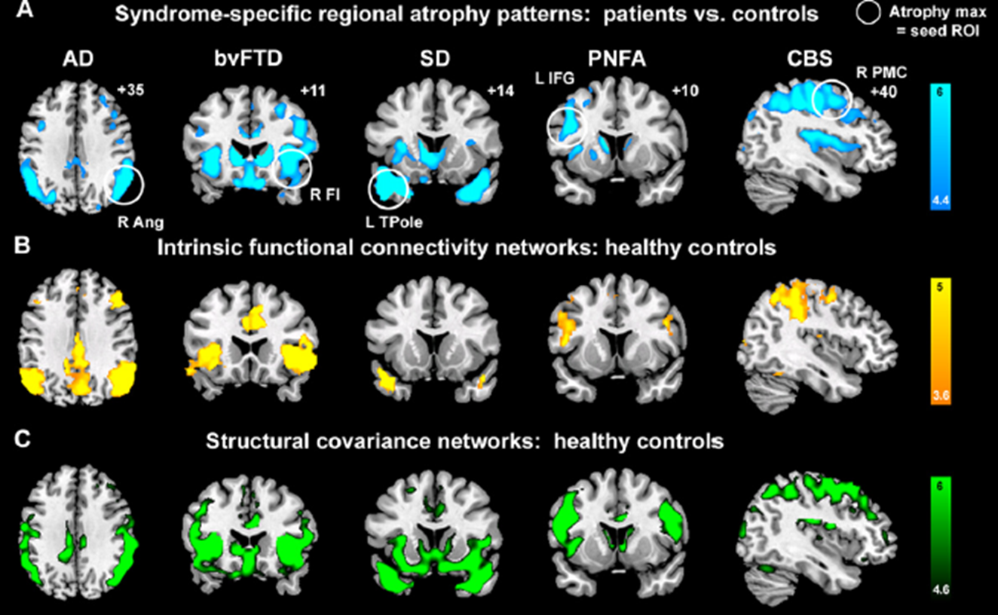

Slide 55
AD
Definition
▪Most common cause of dementia, characterized pathologically by the presence of senile plaques and neurofibrillary tangles (NFT)
Incidence and Prevalence
▪Incidence increases with age: between 70 and 80 years—1 to 2 cases per 100 individuals per year; >80 years—2 to 8 cases per 100 individuals per year▪Prevalence: approximately 4.5 to 5 million individuals currently affected with Alzheimer's disease in the United States –Between 60 and 64 years—1%–85 years—50%
Gender and Age Distribution
▪Higher prevalence in women possibly because of a higher percentage of women in older age groups (ratio of 1.2 to 1.5)▪Mean age at onset is 80 years▪Early-onset disease occurs at ages younger than 60 to 65 years (approximately 7% of all Alzheimer's disease)
Clinical Features
▪Most common symptoms are memory loss and cognitive dysfunction▪Usually present with short-term memory impairment▪May present with judgment and visuospatial impairment▪Slowly progressive▪Eventual complete deterioration of cognition, loss of mobility, rigidity; incontinence, and mutism
Radiologic Features
▪MRI and noncontrast-enhanced CT show diffuse cortical atrophy, with more severe involvement of the mesial temporal lobe structures and ventricular dilatation
Prognosis and Treatment
▪Average duration is 7 years (range, 2 to 18 years)▪Cholinesterase inhibitors may slow down the rate of cognitive decline▪Many other approaches are under study, but not yet ready for nonresearch use (Aβ vaccine, infused intravenous immunoglobulin, tau vaccines, inhibitors of tau kinases, antioxidant agents, and antiinflammatory agents)

Slide 56
AD
Gross Findings
▪Decreased brain weight▪Diffuse gyral atrophy and ventricular dilatation, with most severe involvement of the temporal cortex, amygdala, hippocampus, and entorhinal cortex with relative sparing of the occipital lobe
Microscopic Findings
▪Diffuse plaques and neuritic plaques found throughout the neocortex▪NFT most numerous in the hippocampus, amygdala, and entorhinal cortex, but usually also in the neocortex▪Determination and quantitation of neuritic plaque density and NFT location and density is necessary for pathologic diagnosis
Ultrastructural Features
▪Neuritic plaque contains Aβ protein, often forming a dense central core of amyloid, surrounded by distorted neurites usually containing paired helical filament–tau (PHF-tau) protein▪NFTs are intraneuronal accumulations of PHF-tau
Genetics
▪Most disease is sporadic▪Autosomal dominant early-onset Alzheimer's disease is found in 1% to 2% of all Alzheimer's disease▪Three genes have been identified that contain mutations in familial Alzheimer's disease: presenilin-1, presenilin-2, and amyloid precursor protein▪The ϵ4 allele of apolipoprotein E gene confers an increased risk of Alzheimer's disease by decreasing the age at disease onset
Immunohistochemical Features
▪Neuritic plaque, diffuse plaque, and amyloid angiopathy immunoreact with antibodies to Aβ protein▪NFTs and dystrophic neurites of plaques immunoreact with tau antibodies

Slide 57
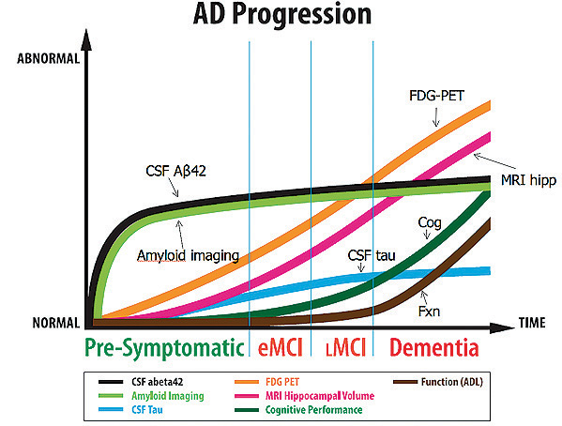

Slide 58
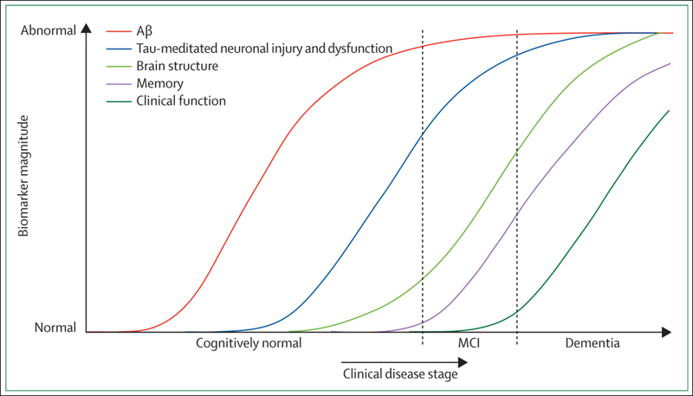

Slide 59
Parkinson’s Disease
Definition
▪Parkinson's disease is the most common neurodegenerative movement disorder and is a predominantly sporadic progressive disease defined by the presence of bradykinesia, rigidity, and tremor clinically and by substantia nigra degeneration and Lewy bodies pathologically
Incidence and Prevalence
▪Incidence is 16 to 19 per 100,000 per year▪Prevalence increases with age –Ranges from 100 to 200 per 100,000
Gender and Age Distribution
▪Peak age at onset is between 55 and 65 years▪Slight increased predilection in men
Clinical Features
▪Classic features: bradykinesia or akinesia, cogwheel rigidity, resting tremor▪Other symptoms/signs: slow shuffling gait with a stooped posture and loss of arm swing, postural instability, masked facies
Radiologic Features
▪MRI and CT are usually normal
Prognosis and Treatment
▪Standard therapy is levodopa▪Because of limitations with long-term use of levodopa, dopamine agonist therapy is also used▪Average duration is 13 years

Slide 60
PD
The most common cause of Parkinson's disease of early onset (<50 years) is a mutation in the Parkin gene ( PARK2) on chromosome 6. The Parkin gene codes for ubiquitin protein ligase.
Lewy bodies are intraneuronal cytoplasmic spherical inclusions ranging from 8 to 30 nm in diameter. They have hyaline eosinophilic cores surrounded by pale haloes ( Figure 6-14A). A single neuron may contain one or more Lewy bodies. They are ubiquitin, α-synuclein, and usually neurofilament immunoreactive.
Lewy bodies are also found in the locus coeruleus, nucleus basalis of Meynert, dorsal vagal nucleus, hypothalamus, olfactory bulb, Edinger-Westphal nucleus, raphe nuclei, intermediolateral cell column of the spinal cord, and autonomic ganglia.

Slide 61
PD
Cortical Lewy bodies, in contrast to brain stem Lewy bodies, do not have a distinct halo. They are eosinophilic, usually round, most frequently found in the lower cortical layers (V and VI), and most numerous in the temporal, insular, and cingulate cortices. Cortical Lewy bodies are also ubiquitin and α-synuclein immunoreactive

Slide 62
PD
Gross Findings
▪Pallor of the substantia nigra and usually the locus coeruleus▪Slight cortical atrophy and ventricular dilatation
Microscopic Findings
▪Loss of neurons in the substantia nigra▪Presence of Lewy bodies in the substantia nigra and frequently other nuclei (locus coeruleus, dorsal motor nucleus of the vagus, nucleus basalis of Meynert)▪Cortical Lewy bodies are found in essentially all patients with Parkinson's disease
Ultrastructural Features
▪Lewy bodies have radially arranged intermediate filaments associated with granular and vesicular material
Genetics
▪Usually sporadic▪Very rarely familial▪Park1: autosomal dominant Parkinson's disease in Greek and Italian families caused by a mutation in the α-synuclein gene on chromosome 4▪Park2: autosomal recessive Parkinson's disease, juvenile onset, caused by a mutation in the parkin gene on chromosome 6 ▪Park5: Parkinson's disease caused by a missense mutation in the UCHL1 gene on chromosome 4
Immunohistochemical Features
▪Lewy bodies are α-synuclein, ubiquitin, and neurofilament immunoreactive▪Lewy neurites are identified with α-synuclein, ubiquitin, or neurofilament antibodies in the CA2-CA3 region of the hippocampus, amygdala, nucleus basalis of Meynert, brain stem, olfactory bulb, intermediolateral column of the spinal cord, and autonomic ganglia▪α-Synuclein and ubiquitin-immunoreactive glial inclusions are also identified in regions where cortical Lewy bodies are found

Slide 63
Dementia with Lewy Bodies
Definition
▪Dementia characterized pathologically by the presence of cortical and brain stem Lewy bodies▪Also known as dementia with Lewy bodies and the Lewy body variant of Alzheimer's disease▪May have concomitant Alzheimer's disease
Incidence and Prevalence
▪No incidence data available▪Reported to be the most common cause of dementia after Alzheimer's disease▪Prevalence in tertiary care centers is estimated at 26% of all dementia cases
Gender and Age Distribution
▪Age at onset ranges from 68 to 92 years▪Slight predilection in men
Clinical Features
▪Fluctuations in cognitive impairment and level of consciousness▪Visual hallucinations▪Parkinsonism: bradykinesia, limb rigidity, gait disorder
Radiologic Features
▪MRI may show generalized atrophy in 60%
Prognosis and Treatment
▪Duration of disease is 6 to 9 years▪Cholinesterase inhibitors decrease psychiatric and behavioral symptoms▪Supportive therapy

Slide 64
DLB
brain stem predominant, limbic (transitional), and cortical
Cortical regions to be evaluated are the middle frontal gyrus and the inferior parietal lobule

Slide 65
DLB
Gross Findings
▪Diffuse cortical atrophy and ventricular dilatation with concomitant Alzheimer's disease▪Pallor of the substantia nigra and locus coeruleus
Microscopic Findings
▪Cortical and brain stem Lewy bodies▪Three levels of involvement: brain stem, limbic, and neocortical▪Microvacuolation in the temporal cortex▪Alzheimer's disease changes may be present: diffuse and neuritic plaques, neurofibrillary tangles
Ultrastructural Features
▪Lewy bodies have radially arranged intermediate filaments associated with granular and vesicular material
Genetics
▪No genetic abnormalities known
Immunohistochemical Features
▪Lewy bodies are α-synuclein, ubiquitin, and neurofilament immunoreactive▪Lewy neurites are identified with α-synuclein, ubiquitin, or neurofilament antibodies in the CA2/CA3 region of the hippocampus, amygdala, nucleus basalis of Meynert, brain stem, olfactory bulb, intermediolateral column of the spinal cord, and autonomic ganglia▪α-Synuclein- and ubiquitin-immunoreactive glial inclusions are also identified in regions where cortical Lewy bodies are found
Pathologic Differential Diagnosis
▪Parkinson's disease▪Alzheimer's disease▪PSP▪CBD▪Creutzfeldt-Jakob disease▪MSA▪FTLD

Slide 66
Multiple Systems Atrophy
striatonigral and olivopontocerebellar structures and the presence of α-synuclein–immunoreactive glial cytoplasmic inclusions. The entities previously called olivopontocerebellar atrophy, Shy-Drager syndrome, and striatonigral degeneration are now encompassed by two groups within MSA: MSA-P (parkinsonian predominant) and MSA-C (cerebellar predominant).

Slide 67
MSA
Definition
▪Sporadic progressive adult-onset disease distinguished by the presence of α-synuclein–immunoreactive glial cytoplasmic inclusions▪Subdivided into two types: multiple system atrophy, parkinsonian predominant (MSA-P) and multiple system atrophy, cerebellar predominant (MSA-C)
Incidence and Prevalence
▪Incidence is 3 per 100,000 per year▪Prevalence varies from 4 to 16 per 100,000
Gender and Age Distribution
▪Male sex preponderance▪Age at onset ranges from 33 to 78 years▪Most often in the sixth decade
Clinical Features
▪MSA-P: akinesia, rigidity, dystonia, dysesthesia▪MSA-C: gait and limb ataxia, dysarthria, oculomotor disturbances▪Dysautonomia occurs in both
Radiologic Features
▪MRI shows atrophy of the caudate nucleus, putamen, cerebellum, and brain stem
Prognosis and Treatment
▪Duration ranges from 6 to 9 years▪MSA-P transiently responds to levodopa

Slide 68
MSA
In MSA-P, comprising 80% of all MSA, parkinsonian signs and symptoms are typically bradykinesia, rigidity, postural instability, and a postural/action tremor rather than the classic pill-rolling tremor seen in Parkinson's disease. These symptoms are usually poorly responsive to long-term levodopa therapy. In MSA-C, typical findings are gait and limb ataxia, cerebellar dysarthria, and oculomotor dysfunction. Babinski signs and hyperreflexia may be present in either type of MSA.

Slide 69
MSA
Gross Findings
▪MSA-P: atrophy and discoloration of the putamen, atrophy of the caudate nucleus▪MSA-C: atrophy of the cerebellum, middle cerebellar peduncle, and pons▪In both types, pallor of the substantia nigra
Microscopic Findings
▪MSA-P: neuronal loss and astrocytosis in the striatonigral system▪MSA-C: cerebellar degeneration with Purkinje cell loss
Ultrastructural Features
▪Glial cytoplasmic inclusions are composed of both twisted and straight filaments
Genetics
▪No familial clustering or genetic abnormalities known
Immunohistochemical Features
▪α-Synuclein-, ubiquitin-, and tau-immunoreactive glial cytoplasmic inclusions are present in the pyramidal, extrapyramidal, limbic, corticocerebellar, and supraspinal autonomic systems

Slide 70
FTLD
Definition
▪Degeneration of the frontal and temporal lobes often in association with abnormal tau deposits; usually clinically characterized by frontotemporal dementia, but, in specific subtypes, other neurologic signs (apraxia, gaze palsies, etc.) are seen and sometimes parkinsonism and motor neuron disease symptoms▪Includes the following entities: –MSTD: sporadic and frontotemporal dementia and parkinsonism linked to chromosome 17 (FTDP-17), Pick's disease, PSP, CBD, AGD
Incidence and Prevalence
▪MSTD (sporadic and FTDP-17): no data –Pick's disease: incidence—ranges from 2.2 to 8.9 per 100,000 per year–PSP: incidence: 0.3 to 14 per 100,000 per year and prevalence—1.4 to 6 per 100,000–CBD: incidence: <1 per 100,000 per year–AGD: incidence at autopsy—5% to 23%, up to 43% in very elderly
Gender and Age Distribution
▪No gender predilection known except for PSP which has a slight predilection for males▪Age distribution: –MSTD: sporadic—limited data; very few cases reported, onset in 70s–FTDP-17: autosomal dominant, onset at a mean of 49 years with a range of 25 to 76 years–Pick's disease: peak occurrence in the sixth decade with a range of 45 to 65 years–PSP (overall): onset between 60 to 65 years–PSP-R: male to female ratio—1.8 to 1–PSP-P: equal sex distribution–CBD: mean age of onset is 63 to 66 years (range 47 to 77)–AGD: mean age (found at autopsy) 75 to 80 years

Slide 71
FTLD
Clinical Features
▪MSTD: sporadic—variable signs and symptoms, including FTD, parkinsonism, and motor neuron degeneration▪FTDP-17 and Pick's disease: FTD, extrapyramidal symptoms (late in course), clinical heterogeneity with different mutations, and intrafamilial and interfamilial heterogeneity with the same mutation▪PSP-R: postural instability and falls, supranuclear vertical gaze palsy, and cognitive impairment▪PSP-P: asymmetric onset, rigidity, tremor, bradykinesia, nonaxial dystonia, and initial response to levodopa▪CBD: progressive asymmetric rigidity, apraxia (alien limb phenomenon); parkinsonism may also present with FTD▪AGD: commonly overlaps with other degenerative pathology and identified only at autopsy; unique signs and symptoms not identified
Radiologic Features
▪MRI findings: –Most FTLD-tau show atrophy of the frontal and temporal lobes on MRI▪Semantic dementia: may show bitemporal atrophy▪Nonfluent aphasia: may show atrophy of the left perisylvian region –CBD: asymmetric atrophy of superior parasagittal perirolandic cortices–PSP: atrophy of midbrain and superior cerebellar peduncle; increased signal in midbrain and globus pallidus–AGD: anterior temporal and frontal lobe atrophy
Prognosis and Treatment
▪MSTD –Sporadic: 6 to 10 years' duration▪FTDP-17: duration of disease averages from 8 to 10 years▪CBD: duration—mean is 8 years (range, 5 to 11 years); nonresponsive to levodopa▪PSP: overall duration—mean is 7 years with a range of 5 to 9 years; average age at death is 75 ± 8 years –PSP-R has shorter duration than PSP-P▪AGD: limited data▪No treatments currently available

Slide 72
FTLD
Gross Findings
▪Most subtypes of FTLD-tau: decreased brain weight with varying degrees of mesial temporal lobe and frontotemporal atrophy with corresponding lateral ventricular enlargement. Atrophy of putamen, caudate, globus pallidus, hypothalamus often present –May see atrophy of orbital and cingulate gyri–Substantia nigra and locus coeruleus each usually pale▪Patients with semantic dementia may have bitemporal atrophy; asymmetric atrophy may be present with left perisylvian atrophy found with nonfluent aphasia –Pick's disease: often very severe atrophy (“knife edge”) and may see sparing of posterior superior temporal gyrus–CBD: perirolandic cortical atrophy (most severe parasagittally)–PSP: atrophy of midbrain and sometimes pons with corresponding enlargement of the fourth ventricle and aqueduct of Sylvius; pallor of substantia nigra; may see atrophy of subthalamic nucleus and superior cerebellar peduncle–AGD: mean brain weight—1200 g with either no or mild diffuse gyral atrophy of frontotemporal lobes. No significant atrophy of mesial temporal lobe structures
Microscopic Findings
▪All subtypes: –Varying degrees of neuronal loss and astrocytosis in the frontotemporal lobes–Basal ganglia and substantia nigra may also show neuronal loss–Typically superficial spongy change in the cortex (second layer)▪In addition: –Pick's disease: Neuronal loss of involved areas is usually severe; Pick bodies (argyrophilic intracytoplasmic inclusions) are most frequently found in the mesial temporal lobe structures, especially dentate granular cell neurons–Pick cells (ballooned or chromatolytic-appearing neurons) found scattered throughout the cortex •CBD: Neuronal loss and astrocytosis affecting the cortex (preferentially the primary motor and sensory cortices), substantia nigra, and basal ganglia•Balloon (chromatolytic-like) neurons in affected cortex (layers III, V, and VI) and cingulate gyrus, amygdala, insula, and claustrum•Argyrophilic deposits (see Argyrophilic grains following)

Slide 73
FTLD
–PSP: Neuronal loss and astrocytosis in substantia nigra, reticular formation of midbrain and pons, subthalamus, and globus pallidus. Each of these areas contains argyrophilic neurofibrillary tangles, neuropil threads, and glial deposits–PSP-R: especially widespread dense argyrophilic deposits–PSP-P and PAGF: neuronal loss and argyrophilic deposits limited to the globus pallidus, substantia nigra, and subthalamic nucleus–AGD: No significant neuronal loss. Argyrophilic grains and oligodendroglial coiled bodies are identified with Gallyas, Bodian, and Sevier silver stains; Congo red and thioflavin S negative •Argyrophilic grains: Spindle-shaped, elongated with tapered ends, in neuropil of transentorhinal cortex, entorhinal cortex (layers II and III), CA1 sector of hippocampus, parasubiculum, temporal cortex, orbitofrontal and insular cortices, basolateral nucleus of amygdale, and hypothalamic lateral tuberal nucleus•Oligodendroglial coiled bodies: found in white matter, especially at gray/white matter junction–Ballooned neurons: amygdala and lower layers of inferior temporal cortex; silver stain negative
Ultrastructural Features
▪Neuronal and glial tau deposits have been found to be composed of straight and twisted filaments▪Pick bodies: filamentous accumulation (straight or paired/twisted), nonmembrane-bound, and granular and vesicular material▪Pick cells: accumulation of neurofilament in neuronal cytoplasm▪CBD: neuronal and glial inclusions—filaments with 20- to 24-nm diameter and paired twisted tubules –PSP: neurofibrillary tangles and the abnormal glial filaments are composed of 15- to 18-nm straight filaments–AGD: argyrophilic grains are 4- to 8-µm rod- or comma-shaped protrusions on dendrites with otherwise normal structure and contain straight filaments and smooth tubules ranging in size from 9 to 25 nm.
Genetics
▪FTDP-17: mutations in the tau gene ( MAPT); at present 42 confirmed pathogenic mutations ▪CBD: sporadic, over expression of H1 haplotype in tau gene ( MAPT) ▪PSP: usually sporadic, but familial clustering reported; associated with over expression of H1 haplotype in tau gene ( MAPT) ▪AGD: sporadic; higher incidence of ApoE ϵ2 allele relative to Alzheimer's disease; no association with ApoE ϵ4

Slide 74
FTLD - tdp
Definition
▪Degeneration of the frontal and temporal lobes in association with abnormal TDP-43 and ubiquitin immunoreactive, tau-negative deposits; clinically characterized by FTD and sometimes parkinsonism and motor neuron disease symptoms▪Includes the following entities: –FTLD-TDP with or without mutations in progranulin gene ( GRN), inclusion body disease associated with Paget's disease of the bone associated with mutation in the valosin-containing protein gene ( VCP), and FTLD-TDP linked to chromosome 9q
Incidence and Prevalence
▪No incidence or prevalence data available
Gender and Age Distribution
▪No gender predilection known▪Age distribution: fifth to sixth decades
Clinical Features
▪FTD with motor neuron disease symptoms▪Language abnormalities and parkinsonism: frequent in association with GRN mutations
Radiologic Features
▪MRI shows atrophy of the frontal and temporal lobes▪Semantic dementia: may show bitemporal atrophy▪Nonfluent aphasia: may show atrophy of the left perisylvian region
Prognosis and Treatment
▪Disease duration ranges from 2 to 17 years; when MND is present, mean is 2 years▪No treatments currently available

Slide 75
FTLD
Gross Findings
▪Decreased brain weight and frontotemporal atrophy, most severe in the mesial temporal area; atrophy of the basal ganglia may be present▪Patients with semantic dementia may have bitemporal atrophy, and those with nonfluent aphasia may have left perisylvian atrophy
Microscopic Findings
▪Neuronal loss and astrocytosis: frontotemporal lobes, basal ganglia, and substantia nigra –Laminar spongiosis in layers I to III–Ballooned neurons may be seen–Hippocampal sclerosis: frequent
Ultrastructural Features
▪Neuronal TDP-43 immunoreactive inclusions: most commonly 10- to 20-nm diameter straight filaments with granular material
Genetics
▪Currently known associated gene mutations in familial cases: –Progranulin gene ( GRN) mutations (occasionally found in patients without positive family history) –Valosin-containing protein gene ( VCP) mutations –Linkage to chromosome 9p
Immunohistochemical Features
▪TDP-43 immunoreactive inclusions are present in the hippocampus, neocortex, striatum, globus pallidus, thalamus, substantia nigra, white matter U-fibers, and spinal cord▪Types of inclusions present: neuronal intranuclear inclusions (NIIs), neuronal cytoplasmic inclusions (NCIs), dystrophic neurites, neuronal diffuse cytoplasmic granular staining, and glial cytoplasmic inclusions (GCIs)▪Subtypes: –Cortical variant, associated with pure FTD: numerous long dystrophic neurites in the superficial cortical layers, striatum, amygdala, and hippocampus. NCIs are also found in the superficial and deep cortical layers–Found in familial cases of FTLD-TDP linked to chromosome 9p: NCIs in the superficial and deep cortical layers–Occurs in association with progranulin gene mutations and other familial cases in which the genetic mutation is not known: short dystrophic neurites, NCIs in the superficial cortical layers, and NIIs–In association with VCP gene mutations: dystrophic neurites and rare NCIs

Slide 76
FTLD - ub
Definition
▪FTLD with ubiquitin immunoreactive profiles that are tau, TDP-43, neurofilament, α-synuclein, and prion negative▪Currently two defined types: –FTLD associated with charged multivesicular body protein 2B ( CHMP2B) gene mutation –Atypical FTLD-U
Incidence and Prevalence
▪No incidence or prevalence data are available
Gender and Age Distribution
▪FTLD-U with CHMP2B mutation: no gender predilection known –Mean age at presentation: 57 years (range 46 to 65)▪Atypical FTLD-U: female to male ratio: 5 : 1 –Mean age at presentation is 35 years (±4.1)
Clinical Features
▪FTLD-U with CHMP2B mutation: behavior and personality changes with progressive aphasia; eventual akinetic rigid syndrome and dystonia ▪Atypical FTLD-U: disinhibition, aggression, psychosis; early institutionalization
Radiologic Features
▪FTLD-U with CHMP2B mutation: generalized cerebral atrophy without white matter changes ▪Atypical FTLD-U: not reported
Prognosis and Treatment
▪FTLD-U with CHMP2B mutation: ranges from 61 to 76 years ▪Atypical FTLD-U: mean duration: 8.3 years (±2.2 years)▪No treatments currently available

Slide 77
FTLD
Gross Findings
▪FTLD-U with CHMP2B mutation: frontotemporal atrophy with ventricular dilatation and white matter pallor ▪Atypical FTLD-U: symmetric atrophy of frontotemporal lobes and striatum; pale substantia nigra
Microscopic Findings
▪FTLD-U with CHMP2B mutation: Neuronal loss and astrocytosis of frontal and inferior temporal cortices with loss of white matter myelin and astrocytosis; superficial spongiosis ▪Atypical FTLD-U: Severe neuronal loss in hippocampus, substantia, nigra, and striatum. Variable neuronal loss in globus pallidus, periaqueductal gray matter, and thalamus. Superficial spongiosis
Ultrastructural Features
▪FTLD-U with CHMP2B mutation: not reported ▪Atypical FTLD-U: not reported
Genetics
▪FTLD-U with CHMP2B mutation (chromosome 3): autosomal dominant ▪Atypical FTLD-U: no mutations identified at present
Immunohistochemical Features
▪FTLD-U with CHMP2B mutation: ubiquitin and p62 immunoreactive NCIs in hippocampal dentate granule cell layer. No NIIs or dystrophic neurites ▪Atypical FTLD-U: Ubiquitin immunoreactive NCIs in frontal/temporal lobes, dentate granule cell layer of hippocampus, striatum, periaqueductal gray, third nerve, hypothalamus, and nucleus basalis. Sparse neurites in the same regions▪NNIs in affected cortical regions and hippocampus

Slide 78
Motor Neuron Disease
Definition
▪Neuromuscular disorder, predominantly sporadic, classically with degeneration of upper and lower motor neurons
Incidence and Prevalence
▪Incidence is 1 to 3 per 100,000 per year▪Prevalence is 2.7 to 7.4 per 100,000
Gender and Age Distribution
▪Age of onset: –Sporadic ALS: 55-65 years; median of 64 years–Familial ALS: 1 decade earlier▪Male predominance in sporadic disease (1.5 : 1, M : F); occurs equally in males and females in familial ALS
Clinical Features
▪ALS typically shows a combination of upper and lower motor neuron signs▪Upper motor neuron signs: hyperreflexia, spasticity, pathologic reflexes▪Lower motor neuron signs: hyporeflexia, weakness, muscle atrophy, and fasciculations▪Primary lateral sclerosis: subtype of ALS with predominantly UMN signs▪Progressive muscular atrophy: subtype of ALS with predominantly LMN signs
Radiologic Features
▪MRI: hyperintensity of corticospinal tracts on T2-weighted, proton density-weighted, and FLAIR-weighted images
Prognosis and Treatment
▪Bulbar onset: 2-3 years▪Limb onset: 3-5 years▪Shorter duration in familial ALS

Slide 79
MND
Gross Findings
▪Wasting of limbs, diaphragm, and intercostal muscles▪The cervical and lumbosacral enlargements of the spinal cord and the anterior motor roots are atrophic and shrunken, respectively▪Atrophy of the precentral gyrus may be present in cases of long duration
Microscopic Findings
▪Loss of anterior horn cells and brain stem motor nuclei neurons▪Loss of Betz cells in the primary motor cortex▪Loss of myelinated axons of the anterior and lateral corticospinal tracts▪Bunina bodies—small, round, eosinophilic NCIs in the anterior horn cells
Ultrastructural Features
▪Bunina bodies are electron dense and composed of tubules, vesicular structures, and neurofilaments▪TDP-43 and ubiquitin-immunoreactive skein-like or spherical structures are bundles of filaments with granules
Genetics
▪10% of ALS patients have autosomal dominant familial disease▪20% of familial cases are due to a mutation in the Cu/Zn superoxide dismutase 1 gene on chromosome 21▪Thus far, 51 familial cases are described associated with mutation in the TARDBP gene on chromosome 1
Immunohistochemical Features
▪Skein-like or spherical inclusions in the anterior horn cells are TDP-43 and ubiquitin immunoreactive; TDP-43 glial cytoplasmic inclusions also found▪Bunina bodies are cystatin C immunoreactive and ubiquitin negative

Slide 80
Huntington’s Disease
Definition
▪Autosomal dominant disease caused by a mutation in the huntingtin gene ( HTT) on chromosome 4 and characterized by chorea and psychiatric abnormalities and degeneration of the basal ganglia
Incidence and Prevalence
▪No incidence data available▪Prevalence is 5 to 10 per 100,000 in Western countries
Gender and Age Distribution
▪No gender predilection▪Mean adult disease onset is 40 years▪Juvenile onset is classified as younger than 20 years
Clinical Features
▪Adult onset is characterized by chorea, cognitive impairment, and psychiatric manifestations. Terminally, all patients are akinetic and rigid▪Juvenile-onset disease is manifested as bradykinesia and hypokinesia with eventual rigidity. Seizures may also occur
Radiologic Features
▪CT and MRI show caudate and putamen atrophy correlating with the degree of clinical impairment; generalized brain atrophy also seen
Prognosis and Treatment
▪The mean duration of disease (adult and juvenile) ranges from 12 to 17 years▪Current treatment is of symptoms only, not prevention, and is primarily effective in managing psychiatric symptoms. Benefits of treatment of chorea are limited

Slide 81
Gross Findings
▪Decreased brain weight (mean 1063 grams)▪Progressive atrophy of the caudate and putamen (Vonsattel grades 0 to 4)▪Atrophy of cerebral cortex
Microscopic Findings
▪Neuronal loss and astrocytosis of the caudate and putamen developing in a dorsomedial-to-ventrolateral, caudal-to-rostral pattern▪Neuronal loss and minimal astrocytosis in the cerebral cortex (layers III, V, and VI) and mesial temporal lobe structures▪Variable degrees of neuronal loss in substantia nigra, thalamus, hypothalamus, subthalamus, claustrum, pons, olivary complex, and cerebellum
Ultrastructural Features
▪Nuclear inclusions are composed of a mixture of nonmembrane-bound granules and straight and tortuous filaments and fibrils▪Dystrophic neurites are composed of filaments and granules
Genetics
▪Autosomal dominant disease caused by a mutation in the huntingtin gene ( HTT) on chromosome 4 ▪Disease caused by expansion of CAG nucleotide repeats▪Number of CAG repeats correlates inversely with age at onset and directly with the severity of disease▪Normal repeat length is up to 35; Huntington's disease is associated with lengths of 36 or greater▪Adult-onset disease: usually repeats 40 to 50▪Juvenile-onset disease: repeats >50
Immunohistochemical Features
▪Intraneuronal nuclear inclusions and dystrophic neurites immunoreactive for ubiquitin and huntingtin proteins in the neostriatum, cortex, and hippocampus

Slide 82
Spinocerebellar Ataxias
SCA: Clinical syndromes
SCA1: Saccades hypermetric; Spasticity; Executive dysfunction; Evoked motor potentials with Long conduction times; OPCA
SCA2: Saccadic velocity slow; Parkinsonism; Myoclonus; Action tremor; Pons atrophy (OPCA); Cuba; No gaze evoked mystagmus
SCA3/Machado-Joseph: Saccadic dysmetria, intrusions & oscillations; Ophthalmoparesis; Gaze-evoked nystagmus; Spasticity; Polyneuropathy; Brazil & Portugal
SCA4: Sensory loss; Later onset > 40
SCA5: Pure cerebellar syndrome; Bulbar signs; Early onset; Slow progression
SCA6: Pure cerebellar syndrome; Saccadic dysmetria; No family history; Late onset > 50; Nystagmus - Gaze evoked, Downbeat & Perverted head-shaking
SCA7: Pigmentary retinopathy; Hearing loss; Onset in 1st decade
SCA8: Cerebellar; Cognitive & Psychiatric; Spasticity; Sensory neuropathy, Mild
SCA9: Ataxia + Ophthalmoplegia
SCA10: Pure cerebellar syndrome ± Seizures, complex partial; Mexico
SCA11: Pure cerebellar syndrome; Hyperreflexia; Benign course
SCA12: Tremor (Early arm); Hyperreflexia; Dementia; Cortical & Cerebellar atrophy
SCA13: Early childhood onset; Mental retardation
SCA14: Ataxia; Myoclonus (with early onset); Cognitive decline
SCA15: Pure cerebellar; Slow progression
SCA16: Head & Hand tremor
SCA17: Dysphagia; Intellectual deterioration; Absence seizures; Extrapyramidal signs
SCA18: Muscle atrophy; Sensory loss
SCA19: Cognitive impairment, mild; Myoclonus
SCA20: Palatal tremor; Dysphonia
SCA21: Cognitive disorders; Extrapyramidal features
SCA22: Pure cerebellar syndrome; Slow progression; Hyporeflexia
SCA23: Ataxia; Sensory loss; Pyramidal signs
SCA25: Sensory neuropathy; Severe cerebellar atrophy
SCA26: Pure cerebellar syndrome
SCA27: Tremor; Dyskinesia; Psychiatric episodes
SCA28: Ophthalmoplegia; Hyperreflexia
SCA30: Pure cerebellar syndrome; Late onset
SCA31: Pure cerebellar syndrome; Japanese
SCA32: Cognitive deficits; Azoospermia
SCA34: Erythrokeratoderma
SCA35: Upper motor neuron signs; torticollis
SCA36: Fasciculations & Muscle wasting (Motor neuron); Late onset
SCA37: Vertical eye movements abnormal; Late onset
DRPLA: Myoclonus & Epilepsy (Onset < 20 years); Choreoathetosis, Dementia, Psychosis (Onset > 20 years); OPCA

Slide 83
Spinocerebellar Ataxias
Definition
▪Dominantly inherited ataxias caused by expanded repeats of triplet nucleotides and characterized by variability in age of onset, clinical manifestations, and pathologic findings▪Currently, at least 28 different SCAs are described
Incidence and Prevalence
▪No incidence data available▪Prevalence is 0.8 to 5 per 100,000 overall; SCA3 is the most common SCA
Gender and Age Distribution
▪SCA2 (olivopontocerebellar atrophy of Menzel): onset between 15 and 40 years▪SCA3 (Machado-Joseph disease): –Type 1: onset in the first 2 decades–Type 2: onset between the second and fourth decades–Type 3: onset between the fourth and sixth decades▪SCA6: mean age of onset—50 years▪No gender predilection
Clinical Features
▪SCA2: limb and gait ataxia, dysarthria, intention tremor, sensorimotor neuropathy, and abnormal eye movements▪SCA3: –Type 1: dystonia, spasticity–Type 2: ataxia, nystagmus, dysarthria–Type 3: ataxia, peripheral sensory and motor neuropathy▪SCA6: cerebellar dysfunction (ataxia, dysarthria, and nystagmus)
Radiologic Features
▪MRI shows slight atrophy of the brain stem, middle cerebellar peduncle, cerebellum, and cervical spinal cord in SMA3 and more severe atrophy of the same structures in SMA2▪SMA6: cerebellar atrophy
Prognosis and Treatment
▪SCA2: mean duration of 10 years▪SCA3: range of 5 to 12 years▪SCA6: range of 20 to 30 yearsNo preventive therapies at present; symptomatic therapies are helpful for associated parkinsonism, sleep disturbances, and spasticity.

Slide 84
SCA
Gross Findings
▪SCA2: severe atrophy of the basis pontis, cerebellum, and cervical spinal cord. Brain weight is decreased▪SCA3: slight degree of atrophy of the posterior fossa structures and spinal cord, with normal brain weight▪SCA6: cerebellar atrophy
Microscopic Findings
▪SCA2: –Severe neuronal loss is seen in the inferior olivary nucleus, basis pontis gray matter, cerebellar cortex, and substantia nigra–The middle and inferior cerebellar peduncles and cerebellar white matter show axonal loss and astrocytosis–Spinocerebellar and posterior columns degenerate–Motor neurons and neurons of Clarke's column are lost▪SCA3: –Severe neuronal loss in the cerebellar dentate nucleus with grumose degeneration–The cerebellar cortex and inferior olivary nuclei are preserved–Degeneration of the basis pontis gray matter, neurons of Clarke's column, lower motor neurons, and substantia nigra–Degeneration of the superior cerebellar peduncle and spinocerebellar tracts–Cranial nerve nuclei often affected▪SCA6: –Severe loss of Purkinje cells; milder loss of internal granule cells, dentate nucleus neurons, and inferior olivary nucleus
Ultrastructural Features
▪Neuronal intranuclear inclusions: nonmembrane bound granular and filamentous structures; cytoplasmic inclusions—intralysosomal granules
Genetics
▪SCA2: CAG repeat expansion secondary to a mutation in the Ataxin-2 gene; disease has been reported with 32 to 77 repeats ▪SCA3: CAG repeat expansion secondary to mutation in the Ataxin-3 gene on chromosome 14; disease is found with 53 to 200 repeats ▪SCA6: CAG repeat expansion in CACNA1A gene on chromosome 19 (q13); disease occurs when the
expansion exceeds 21 CAGs

Slide 85
Friedrech’s Ataxia
Definition
▪Most common hereditary ataxia caused by GAA triplet nucleotide expansion
Incidence and Prevalence
▪No incidence data available▪Prevalence is 2 to 5 per 100,000
Gender and Age Distribution
▪Onset is usually during puberty▪Range is from 2 to 3 years to older than 25 years
Clinical Features
▪Limb and gait ataxia▪Sensory loss, weakness, sensorineural hearing loss▪Scoliosis, foot deformity, diabetes mellitus, hypertrophic cardiomyopathy
Radiologic Features
▪MRI shows spinal cord atrophy with a normal brain stem, cerebellum, and cerebrum
Prognosis and Treatment
▪Life expectancy is 35 to 40 years▪Clinical trials of treatment with coenzyme Q and related compounds are ongoing

Slide 86
FA
Gross Findings
▪The spinal cord is atrophic, and the lateral and posterior columns may appear gray▪The posterior roots are thin▪The dentate nucleus may be atrophic
Microscopic Findings
▪Severe neuronal loss and astrocytosis in the dentate nucleus▪Atrophy of the superior cerebellar peduncle▪Neuronal loss of the vestibular and cochlear nuclei▪Neuronal loss of the dorsal root ganglia and degeneration of the large myelinated sensory peripheral nerves▪Degeneration of the posterior columns, spinocerebellar tracts, and corticospinal tracts▪Degeneration of the nucleus dorsalis of Clarke
Ultrastructural Features
▪Axonal swellings filled with neurofilaments may be present in the dorsal root ganglia▪Occasional descriptions of onion bulbs in peripheral nerve biopsy specimens
Genetics
▪Autosomal recessive▪Mutation in the Frataxin gene on chromosome 9 ▪Mutation results in expansion of the GAA nucleotide triplet▪Normal number of repeats is 6 to 27; disease is associated with 70 to more than 100
Immunohistochemical Features
▪No specific immunohistochemical features at present

Slide 87
Dentatorubral-Pallidoluysian Atrophy (DRPLA)
Definition
▪Type of spinocerebellar ataxia found most commonly in Japan, but reported in North American and European individuals; caused by expansion of CAG trinucleotide repeats
Incidence and Prevalence
▪No incidence data available▪Prevalence is 0.2 to 0.7 per 100,000 in Japanese population
Gender and Age Distribution
▪Juvenile form of disease: age at onset, younger than 20 years▪Adult form of disease: age at onset, 20 to 30 years or older
Clinical Features
▪Common to both adult and juvenile forms: ataxia and dementia▪Juvenile form: progressive myoclonic epilepsy, ataxia, and progressive cognitive decline▪Adult form: choreoathetosis and psychiatric disturbances
Radiologic Features
▪MRI shows atrophy of the brain stem and cerebellum and cortex
Prognosis and Treatment
▪No therapy currently available▪Duration: adult-onset disease—progressive over a period of 10 to 20 years; juvenile-onset disease is more rapidly progressive

Slide 88
DRPLA
Gross Findings
▪Thickened skull bone▪Brain weight is decreased and diffuse proportional atrophy is present in both adult and juvenile forms▪In the adult form, the pons and cerebellum are most atrophic, and severe atrophy and discoloration may also be evident in the globus pallidus, subthalamus, dentate nucleus, and pontine tegmentum
Microscopic Findings
▪The cerebellar dentate nucleus shows severe neuronal loss and grumose degeneration▪The external segment of the globus pallidus also has severe neuronal loss and astrocytosis▪The red nucleus, caudate, putamen, substantia nigra, and subthalamus show variable degrees of neuronal loss▪White matter of the cerebellar/olivary complex, superior cerebellar peduncle is degenerated▪The posterior columns, spinocerebellar tracts, corticospinal tracts, and anterior horn cells of the spinal cord are also each degenerated▪Eosinophilic round intranuclear inclusions are present in the neurons and glia of affected areas▪Cytoplasmic filamentous inclusions are found in the neurons of the dentate nucleus
Ultrastructural Features
▪Intranuclear inclusions are composed of granular and filamentous non–membrane-bound material
Genetics
▪Autosomal dominant disease▪Mutation in the DRPLA gene (12p13.31) causes expansion of CAG repeats in the atrophin-1 protein ▪Normal number of repeats is 6 to 35; in disease, 54 to 79 repeats are found
Immunohistochemical Features
▪Intranuclear inclusions are ubiquitin and atrophin-1 immunoreactive▪Cytoplasmic filamentous inclusions of the dentate neurons are ubiquitin immunoreactive
Pathologic Differential Diagnosis
▪Other spinocerebellar ataxias▪Huntington's disease

