Slide 1
Neuropathology Conference
9/18/2017
Xiaowei (Bill) Su, aka Red Panda, PGY-2
Dr. Julia Kofler

Slide 2
Case 1
CC: OSH transfer for (?)acute/subacute stroke w/ hemorrhagic conversion
HPI:
80-yo F, mRS 0, at prior baseline until morning of admission
LSW 8am, observed going into bathroom by granddaughter
Found down @ 8:20am, stirring & moaning after LOC
Direct injury to occiput
Level 2 trauma to Washington Hospital, CTH c/f (?)CVA with ICH
Transferred to PUH ED, arrival 2:48pm

Slide 3
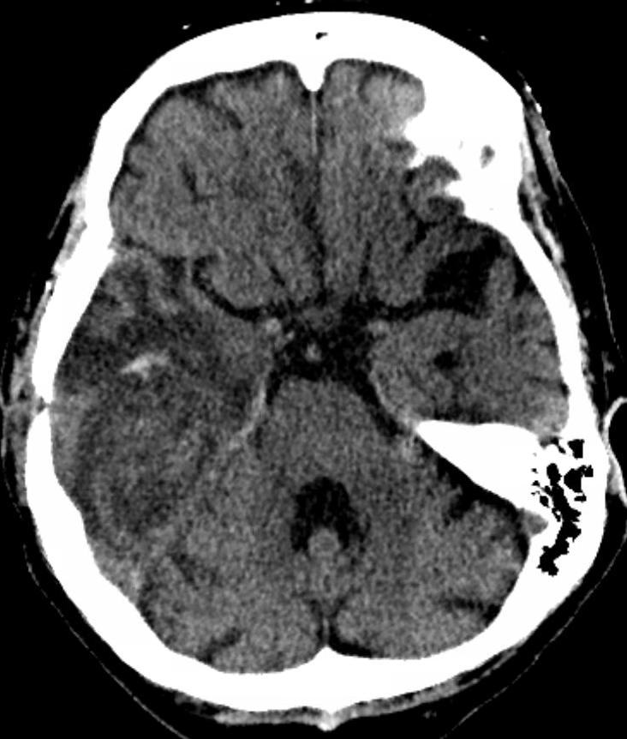
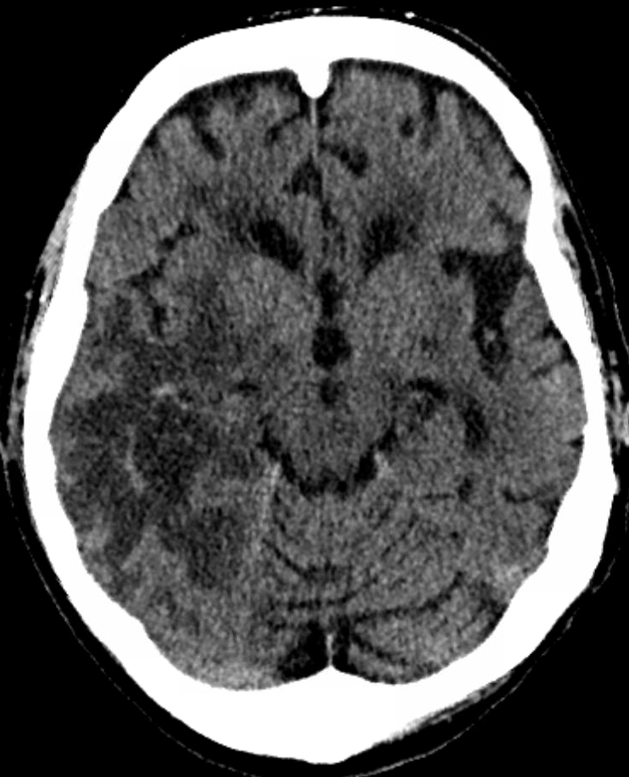
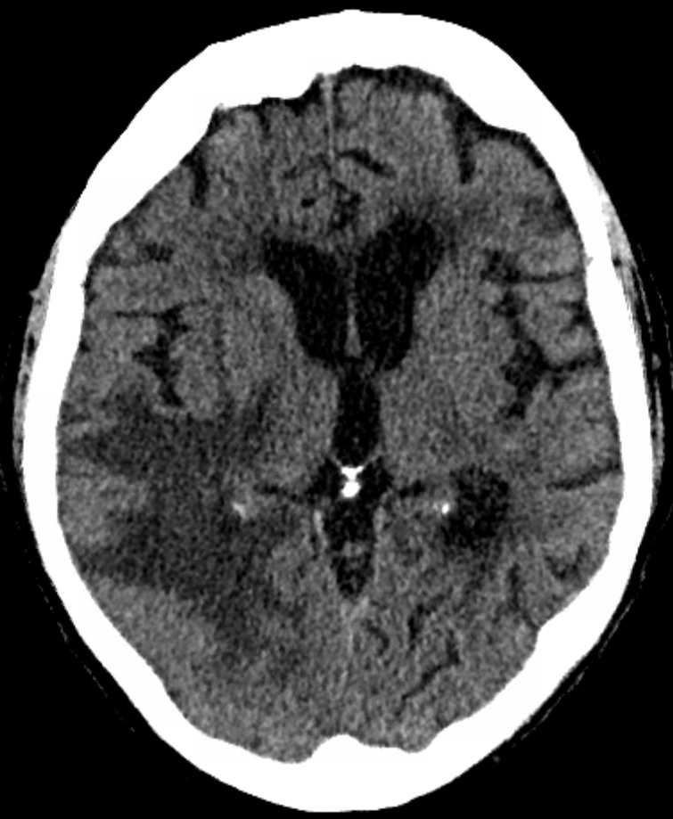
Case 1: OSH CT images

Slide 4
Case 1
DDx:

Slide 5
Case 1
PMHx: (not provided prior to transfer)
T2DM
HTN
HLD
R-temporal GBM (biopsy proven @ PUH May 2017) s/p chemo/XRT
Surgical Hx: brain biopsy as above
Family Hx: no known CVA, aneurysm, hemorrhage, tumors, or mass lesions

Slide 6
Case 1
Exam: NIHSS 0
VS: HR 102, BP 152/94, SpO2 94% 2L NC
Gen: Elderly woman lying in CT scanner, cervical collar in place, in NAD
MS: AAOx4, following commands, fluent speech w/o dysarthria
CN: VF full to fingers, PERRL, EOMI w/o nystagmus, facial muscles full & symmetric, uvula midline, soft palate elevation intact, tongue midline
Motor: Antigravity all extremities w/o drift
DTRs: 2+/4 biceps & patellar B/L
Sens: Intact to LT in all extremities w/o extinction to DSS
Cerebellar: FNF & heel-to-shin intact B/L

Slide 7
Case 1
Labs:
AST 24
\ 12.1 / 138 | 101 | 19 / Ca 9.2 ALT 14 INR 1.1
6.4 |----| 357 -----|------|----| 104 Mg Tbili 0.4 PTT 34.3
/ 36.3 \ 3.1 | 22 | 0.9 \ Phos AlkP 62
CTH: unchanged from Washington Hospital
CTA head & neck: no dissection, LVO, stenosis, aneurysm, or AVM

Slide 8
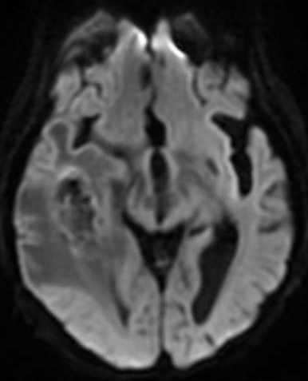
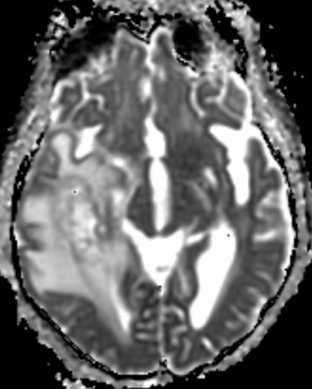
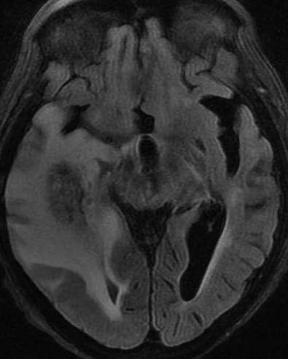
Case 1: MRI
    DWI ADC FLAIR

Slide 9
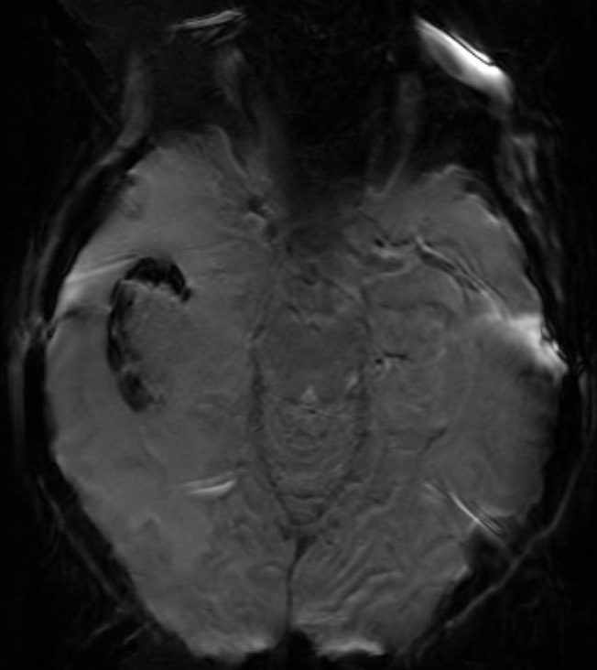
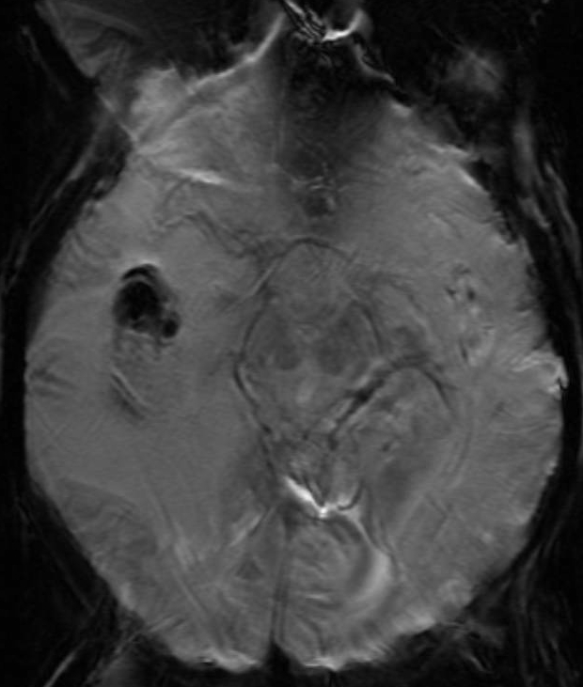
Case 1: MRI GRE

Slide 10
Case 1
DDx:

Slide 11
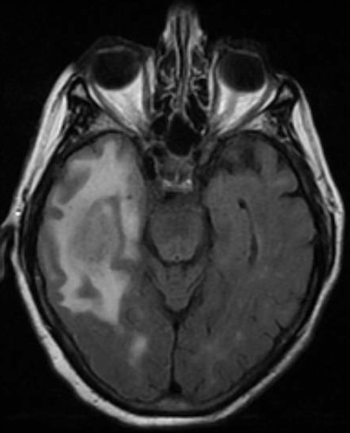
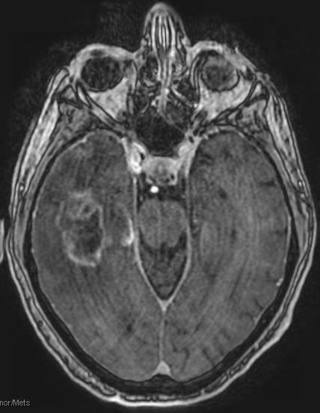
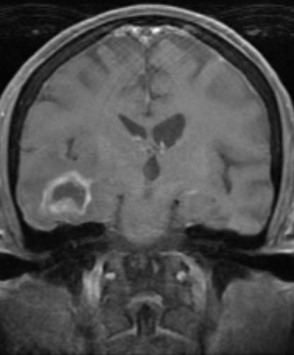
Case 1: Prior MRI - May 2017
    FLAIR SPGR Tumor SPGR Coronal

Slide 12
Case 1
Clinical course:
Admitted to NSGY Trauma service, home AED PPx resumed
Transferred to Medicine A-service
Mild waxing / waning confusion & sundowning
Discharged hospital day 5 with previously scheduled Hillman follow-up

Slide 13
Intraoperative smear 1
Intraoperative smear 2
H&E
GFAP
Ki-67
IDH1

Slide 14
Case 1
Neuropathology:
Strongly GFAP positive (astrocyte-derived), Ki-67 rate 15%
IDH wild-type, with TERT promotor & NF1 alterations
IDH: isocitrate dehydrogenase, mutated enzyme produces oncometabolite
TERT: reverse transcriptase component of telomerase
NF1: tumor suppressor gene regulating RAS/MAPK pathway
P53 / ATRX / EGFR / PTEN alteration negative
Molecular diagnosis: primary glioblastoma (WHO grade IV glioma)

Slide 15
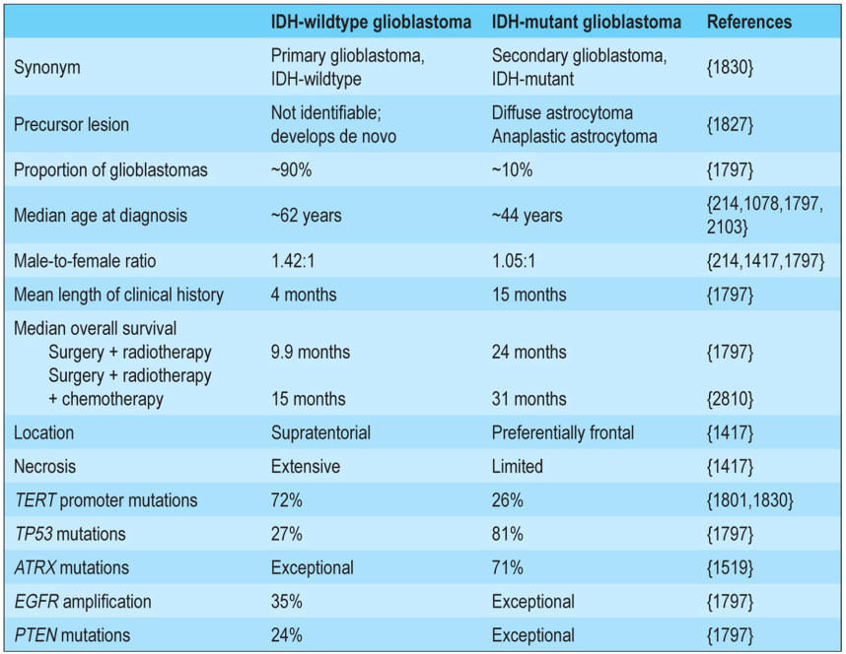

Slide 16
GBM, IDH-wildtype:
EGFR
Glioma, IDH-mutated:
p53
ATRX
IDH1

Slide 17
Case 1 – Glioblastoma multiforme
Aggressive, rapidly expanding, often with central necrosis
Irregularly rimmed ring enhancing lesion on MRI
GBM “butterfly lesions” cross corpus callosum involve B/L centrum semiovale
DDx: CNS lymphoma and multiple sclerosis (if small)
Survival inversely proportional to patient age, average 1-year
Tx: surgery & radiotherapy ± chemotherapy
Often associated with significant post-Tx vasogenic edema
New WHO 2016 classification:
  Primary / IDH-wildtype – de novo without precursor lesion
  Secondary / IDH-mutant – arising from diffuse or anaplastic astrocytomas

Slide 18
Case 2
CC: Referred to PUH EMU for spell classification
HPI:
66-yo M who started having “spells” in March 2017
Semiology: no prodrome, R-hand trembling ~30-60 sec, progressing to full body shaking up to ~20 min, worsened by sleep deprivation, max 1-2 weekly
VA Pittsburgh spot EEG with frequent midline spike and wave discharges
Meds:
Lamictal 150-300mg (AM-PM)
Pregabalin 150-300mg (AM-PM)

Slide 19
Case 2
PMHx:
TIA
CAD
T2DM
HTN
COPD
Chronic back pain
Surgical Hx: back & rotator cuff surgeries
Family Hx: no seizures or neurologic disorders

Slide 20
Case 2
Exam:
VS: T 36.4, HR 70, BP 112/79, RR 18, SpO2 96% RA
Gen: Lying in EMU bed on CCTV cEEG, in NAD
Neuro: MS / CN / motor / DTR’s / sensory / cerebellar intact, totally non-focal

Slide 21
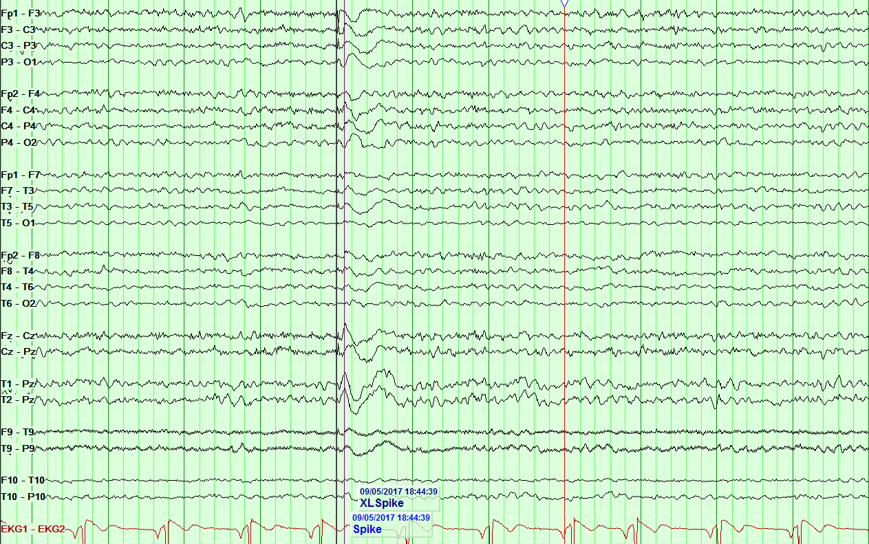
Case 2: cEEG

Slide 22
Case 2
DDx:

Slide 23
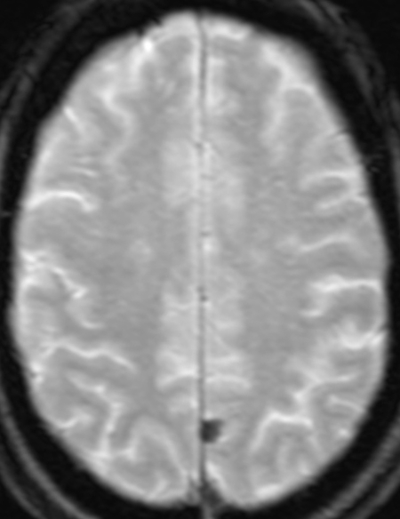
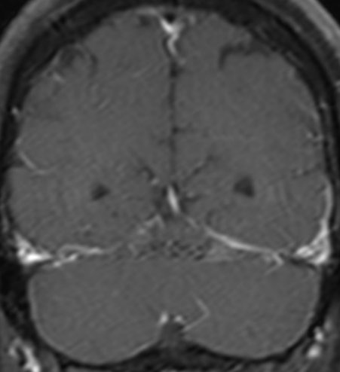
Case 2: MRI
    GRE Coronal T1 FS

Slide 24
Case 2
Clinical course:
8-day EMU course with baseline spikes / sharp waves midline (Fz>Cz>Pz) and L-parasagittal (F3,Fp1>>C3>P3) more than R-parasagittal (F4,Fp2>>C4>P4)
Single epileptiform discharges, sometimes within brief 3-5Hz gen. slowing
One captured event without abnormal cEEG correlate
Patient endorsed significant stress / anxiety related to events, esp. in public
Recommended outpatient counseling & CBT and VA Neurology follow-up

Slide 25
Case 2
Neuropathology:
Surgery not pursued due to stability on interval MRI scans
Representative pathological examples

Slide 26
Intraoperative smear
H&E
EMA
Ki-67

Slide 27
Case 2 – Meningioma
Slow-growing, dural-based tumors derived from arachnoid cap cells
Common sites: parasagittal region, cavernous sinus, tuberculum sellae, lamina cribrosa, foramen magnum, torcular zone
Symptoms arise from compression of adjacent structures
  Focal neural deficits
  Increased intracranial pressure
  Seizures
Most variants have excellent prognosis, curable by gross total resection
Papillary, chordoid, rhabdoid, clear cell, atypical, and anaplastic variants are rare and more aggressive, with increased rates of recurrence & metastasis

Slide 28
Meningioma, WHO grade 1-3
Meningioma, WHO grade 1:
  Meningothelial
  Transitional
  Fibrous
  Angiomatous
  Secretory
  Microcystic
  Metaplastic
  Psammomatous
  Lymphoplasmacyte-rich

Slide 29
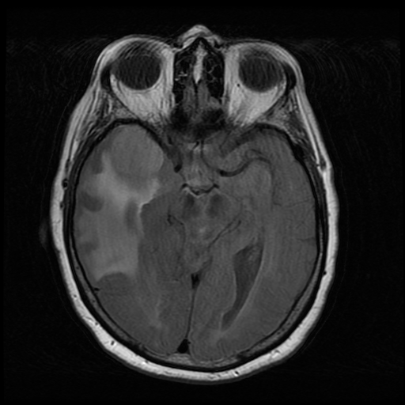
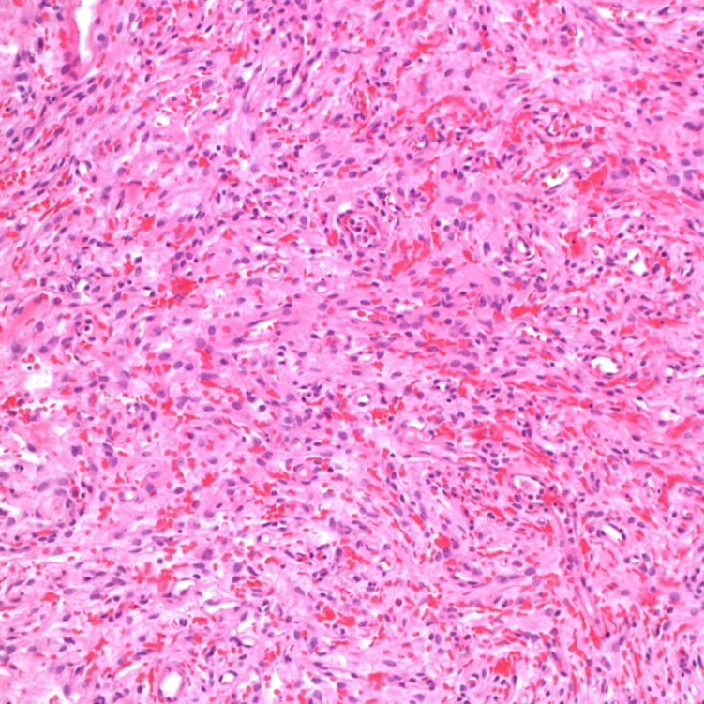
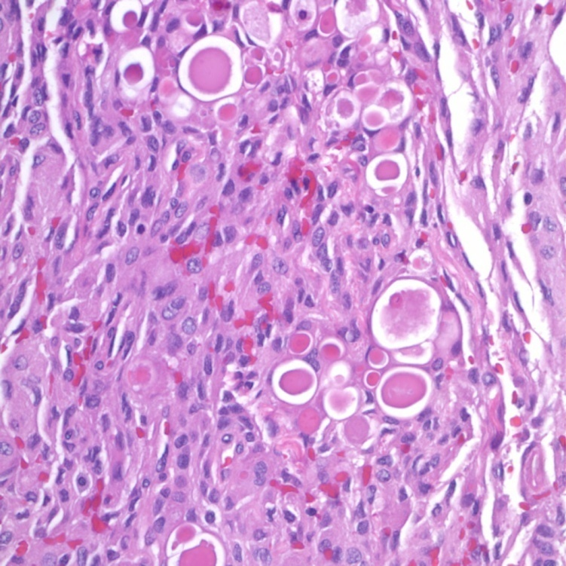
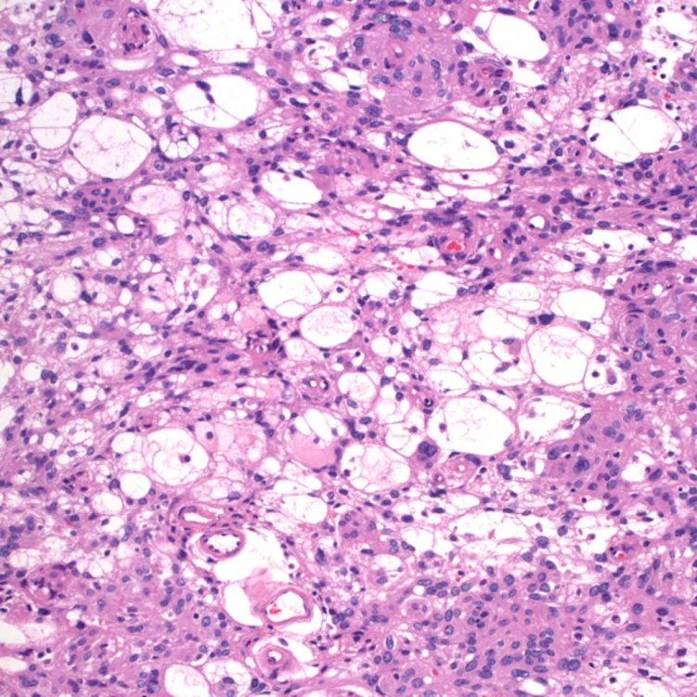
Angiomatous
Secretory
Microcystic

Slide 30
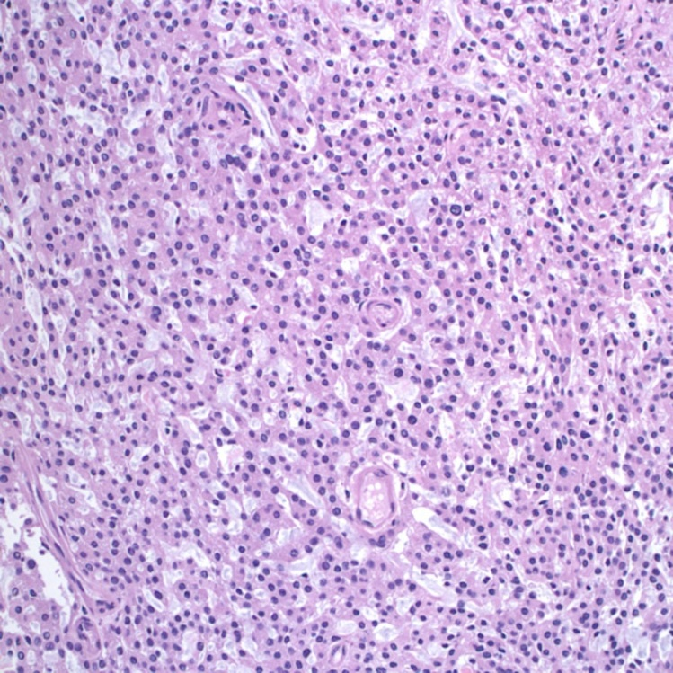
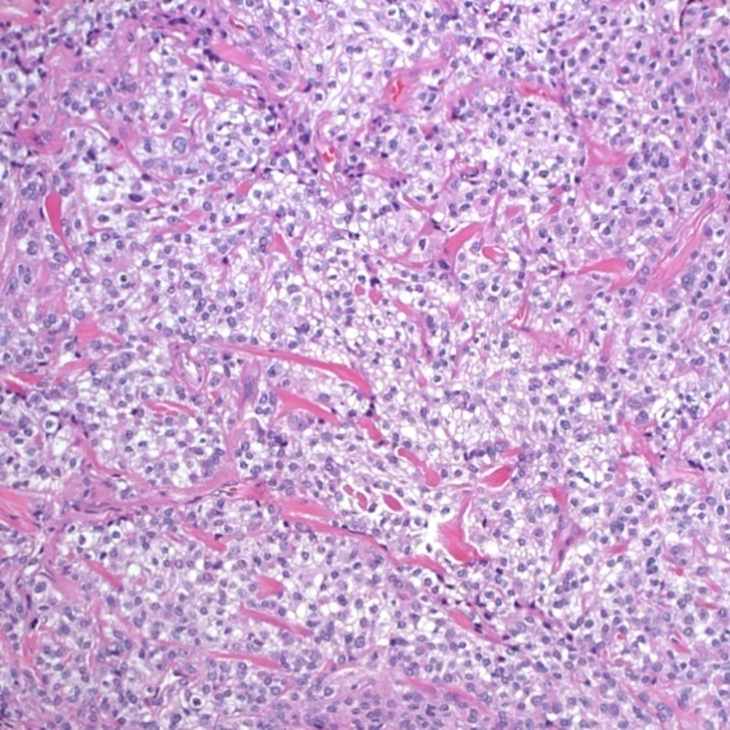
Meningioma, WHO grade 1-3
Meningioma, WHO grade 2:
  Atypical meningioma:
    Increased mitotic activity (>4 per 10 high-power fields)
    Three of the following features: Increased cellularity, small cell change (high N/C ratio), prominent nucleoli, sheeting, necrosis (example)
    Brain invasion (example H&E, example GFAP)
  Chordoid
  Clear cell
Chordoid
Clear cell

Slide 31
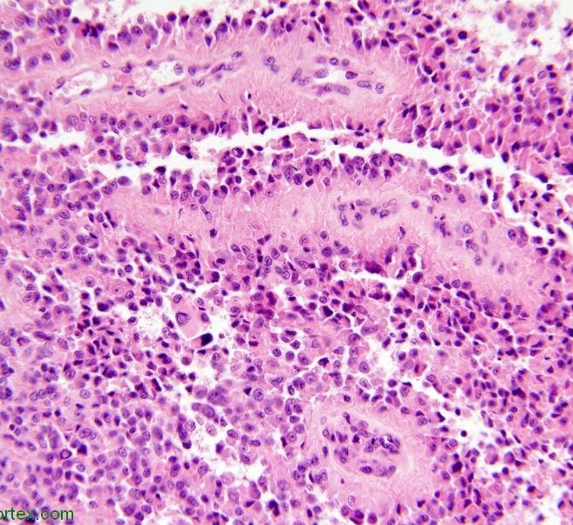
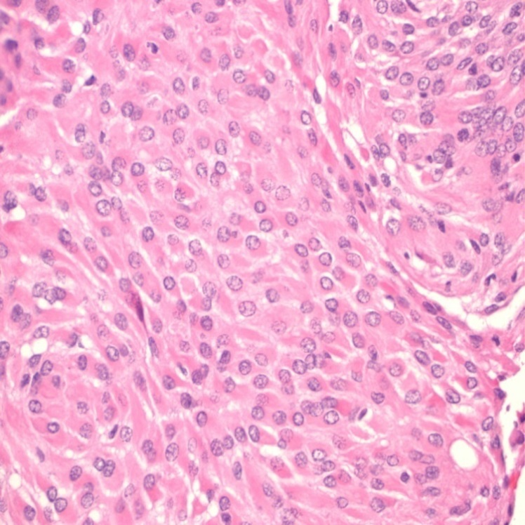
Meningioma, WHO grade 1-3
Meningioma, WHO grade 3:
  Anaplastic meningioma:
    Overtly malignant cytology (resembling carcinoma or sarcoma) and/or
    Markedly increased mitotic activity (>20 per 10 high-power fields)
  Papillary
  Rhabdoid
Papillary
Rhabdoid

Slide 32
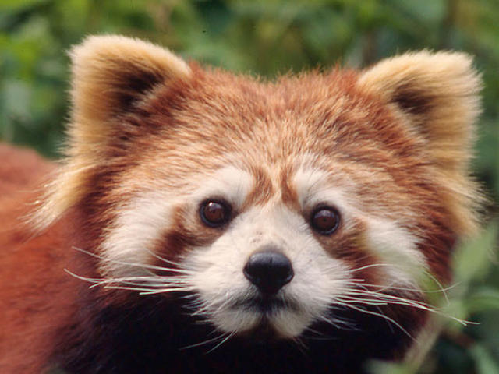
Questions and discussion
World Wildlife Fund
“To know the brain is the same thing as knowing the material course of thought and will, the same thing as discovering the intimate history of life in its perpetual duel with eternal forces, a history summarized and literally engraved in the defensive nervous coordination of the reflex, the instinct, and the association of ideas.”
Santiago Ramon y Cajal

