Slide 1
Neurodegenerative Pathology: Part I
10/6/17
Brian Hanrahan
Moderator: Dr. Wiley

Slide 2
Case #1
A 61 year old female presents to Neurology clinic for evaluation of memory loss. Her daughter reports short-term memory lapses and word-finding difficulty beginning 2 years ago. Now also with repeated episodes of getting lost.
Family history notable for strong paternal history of dementia with several affected relatives

Slide 3
Alzheimer’s disease (AD)
Clinical presentation: Impairment of memory and at least one other area of cognition. Early symptoms include forgetfulness for recent events or newly acquired information.
Often disorientation, especially to time, and difficulty with complex cognitive functions can be features of the disease.
Incidence:
Age 65-74 years, 3.0% with probable AD
75-84 years, 18.7%
>85 years, 47.2%

Slide 4
Alzheimer’s Disease
Genetics:
Late onset dementia (>60) is polygenic
+ Apolipoprotein E gene → ?aggregation/clearance of Aβ → earlier age of onset
Two copies of APOE E4 allele → 8-12 x increased odds, while one copy is 2-3x increased odds of developing AD
Familial AD = autosomal dominant, highly penetrant
Onset < 60 years old
3 genes: presenilin-1 (MC), presenilin-2, amyloid precursor protein
RITE Review:
APOE on Ch 19
Presenilin on Ch 14
Down syndrome patients develop AD before age 50.
Notes:
APOE is not causative; it is a susceptibility gene – thus more likely to develop AD but NOT definite. ~40% of patients with AD do NOT carry APOE E4
Presenilin gene is on chromosome 14 and autosomal dominant with 100% penetrance
APOE E2 decreases risk of AD

Slide 5
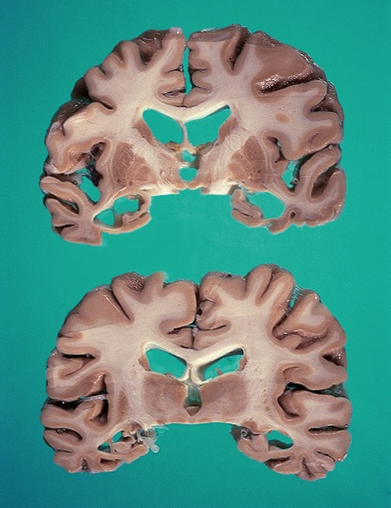
Gross Pathology
Notes:
Left – Gross, cortical atrophy in Alzheimers
Right – Gyral atrophy, enlarged ventricles esp. temporal horns
*Decreased weight
*Most affects mesial temporal lobe – temporal cortex, amygdala, entorhinal cortex, hippocampus

Slide 6
Alzheimer’s Disease
TAUOPATHY
Neuritic plaques (Aβ peptide) → EXTRA-cellular
Notes:
*Amyloid precursor protein (transmembrane neuron protein) → Aβ → aggregates → β-sheets (CONGO red)
*microtubule associated tau protein → phosphorylation → aggregates → helical filaments

Slide 7
Aβ-amyloid-immunostained plaque
Notes:
Aβ peptide, diffusely deposited, ill-defined, varied size EXTRACELLULAR

Slide 8
Silver stained neuritic plaque
Notes:
Again, Aβ peptide, diffusely deposited, ill-defined, varied size
*silver stain
*Diffuse plaque = ?Representative of pathological aging (as also seen in elderly without AD)
Silver-staining methods are helpful for histological identification of pathological deposits

Slide 9
Silver stained neuritic plaque (2)
Notes:
Thickened neuritis (primarily axons, dendrites), containing phos-tau
*Neuritic plaques correlate with degree of cognitive impairment

Slide 10
Alzheimer’s Disease
TAUOPATHY
Neuritic plaques (Aβ peptide) → EXTRA-cellular
Neurofibrillary tangles (phos-tau) → INTRA-cellular
Notes:
*Amyloid precursor protein (transmembrane neuron protein) → Aβ → aggregates → β-sheets (CONGO red)
*microtubule associated tau protein → phosphorylation → aggregates → helical filaments

Slide 11
Tau-immunostained neuritic plaque
Notes:
Again, thickened neuritis (primarily axons, dendrites), containing phos-tau
*Neocortex first
NFTs conform to shape of neuronal cytoloplasm:
cortex = flame, triangular, subcortical = globose or ‘ball of yarn’

Slide 12
NFT: Paired helical filament antibody immuno-stained

Slide 13
Paired helical filament antibody–immunostained neurofibrillary tangles in the entorhinal cortex. Note the dense clusters in layer II.

Slide 14
Alzheimer’s disease. Silver stained section of the CA1 sector of the hippocampus contains a moderate density of neuritic plaques and frequent neurofibrillary tangles.

Slide 15
Alzheimer’s disease. A moderate density of neuritic and diffuse plaques and neurofibrillary tangles is seen in the neocortex (modified Bielschowsky stain).

Slide 16
Alzheimer’s Disease
TAUOPATHY
Neuritic plaques (Aβ peptide) → EXTRA-cellular
Neurofibrillary tangles (phos-tau) → INTRA-cellular
Granulovaculoar degeneration
Notes:
*Amyloid precursor protein (transmembrane neuron protein) → Aβ → aggregates → β-sheets (CONGO red)
*microtubule associated tau protein → phosphorylation → aggregates → helical filaments

Slide 17
Granulovacuolar degeneration in multiple hippocampal neurons.
Notes:
Also seen in AD, granulovacular degeneration + hirano bodies
Granulovacular: mostly in pyramidal neurons of hippo = cytoplasmic vacuole containing a granule, which is immunoreactive with Ab to neurofilament, ubiquitin, tau, and tubulin
Granulovacuolar degeneration involves the accumulation of large, double membrane-bound bodies within certain neurons during the course of Alzheimer’s disease and other adultonset dementias. Because of the two-layer membrane morphology, it has been proposed that the bodies are related to autophagic organelles
Granulovacuolar degeneration (GVD) is characterized by the intraneuronal accumulation of large (up to 5 µm diameter) membrane-bound vacuoles harbouring a central granule
It represented late-stage autophagic markers, and accumulate at the nexus of autophagic and endocytic pathways

Slide 18
Alzheimer’s Disease
TAUOPATHY
Neuritic plaques (Aβ peptide) → EXTRA-cellular
Neurofibrillary tangles (phos-tau) → INTRA-cellular
Granulovaculoar degeneration
Hirano bodies.
Notes:
*Amyloid precursor protein (transmembrane neuron protein) → Aβ → aggregates → β-sheets (CONGO red)
*microtubule associated tau protein → phosphorylation → aggregates → helical filaments

Slide 19
Hirano body in the cytoplasm of a hippocampal neuron.
Notes:
Also seen in AD, granulovacular degeneration + hirano bodies
Hirano bodies: pyramidal neurons of hippo, cytoplasmic, eosinophilic, ‘rod-like’, composed of actin. Immunoreactive for tau, Aβ-amyloid protein, neurofilament
-Also found in other dementia types
Hirano bodies are intracellular aggregates of actin and actin-associated proteins

Slide 20
Alzheimer’s Disease
TAUOPATHY
Neuritic plaques (Aβ peptide) → EXTRA-cellular
Neurofibrillary tangles (phos-tau) → INTRA-cellular
Granulovaculolar degeneration
Hirano bodies.
Deposition of amyloid in the walls of blood vessels.
Notes:
*Amyloid precursor protein (transmembrane neuron protein) → Aβ → aggregates → β-sheets (CONGO red)
*microtubule associated tau protein → phosphorylation → aggregates → helical filaments

Slide 21
Cortical arteriole with amyloid deposition in the media and adventitia.

Slide 22
Cortical arteriole exhibiting amyloid deposition within its wall. Note the characteristic splitting of the arteriolar wall (thioflavin S stain under ultraviolet light).
Notes:
*Deposition of Aβ in vessel walls in > 80% of AD, and 25% of elderly without AD
*Most commmon in leptomeningeal and cortical arteries, arterioles; less in capillaries, veins or subcortical brain vessels
*Destruction of the vessel, +/- fibrinoid necrosis
*Amyloid angiopathy associated with lobar hemorrahage

Slide 23
Leptomeningeal and cortical arterioles with Aβ-amyloid deposition within their walls (Aβ-amyloid immunostain).

Slide 24
Alzheimer’s Disease
Frontal Lobe
H&E, Bielschowsky,βAmyloid, ptau
Hippocampus
H&E, Bielschowsky, βAmyloid, ptau
Mesial Temporal Sclerosis
H&E, Bielschowsky,
Cerebral Amyloid angiopathy
βAmyloid
Notes:
Bielschowsky (silver stain

Slide 25
Testing for AD
CSF levels of tau correlate with NFT stage, Aβ correlate with clinical diagnosis of AD
Tau: INCreased due to dying and damaged neurons
Aβ: DECreased due to accumulation of amyloid in plaques.
CSF testing is better than cognitive testing to predict conversion to AD from mild cognitive impairment.
PET imaging:
AD: hypometabolism of temporal and parietal lobes.
Notes:
Aβ -- Extracellular (being deposited outside cells so levels decrease)
Tau – Intracellular (increased within cells causing levels to increase)

Slide 26
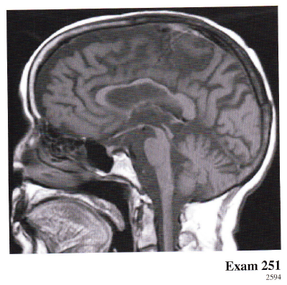
Tauopathies cont.
Corticobasal degeneration (CBD)
Presents with early limb apraxia due to focal frontal and parietal lobe dysfunction. Apraxia is usually asymmetric. Associated with rigidity, and/or aphasia
Progressive supraneuclear palsy (PSP)
Presents with marked postural instability, axial rigidity, parkinsonism without tremor, pseudobulbar palsy, and impairment of voluntary downward gaze. Most patients develop a subcortical dementia in the course of their illness.
Picks disease: subtype of frontotemporal dementia (FTD)
Presents with personality deterioration, frontal disinhibition
Notes:
This patient most likely has progressive supranuclear palsy (PSP). The typical features of this disorder include marked postural instability, axial rigidity, parkinsonism without tremor, pseudobulbar palsy, and impairment of voluntary gaze. Most patients develop a subcortical dementia in the course of their illness. MRI characteristically shows significant atrophy of the midbrain tegmentum (hummingbird sign), corpus callosum, and anterior cingulate gyrus. The patient's clinical presentation and radiographic features fit best with PSP as compared with the other disorders listed.

Slide 27
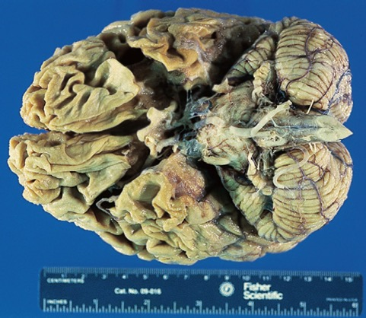
Pick’s disease: Diffuse atrophy affecting the frontal, temporal, and parietal lobes but most severely involving the frontal and temporal lobes and relative sparing of the superior posterior temporal gyrus.
Notes:
In Pick’s disease, the atrophy is typically extremely severe in the frontal and temporal lobes and is referred to as “knife-edge” or “walnut-like”; there may be sparing of the posterior superior temporal gyrus

Slide 28
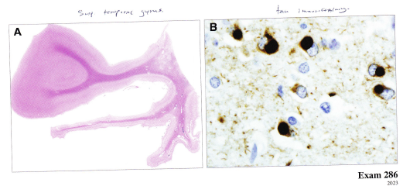
A. Atrophy of the temporal lobe with sparing of the superior temporal gyrus B. Rounded intracytoplasmic inclusions aka “Pick Bodies”
Notes:
aggregations of tau protein

Slide 29
Modified Bielschowsky–stained section of the dentate granular cell layer of the hippocampus showing numerous Pick bodies in the cytoplasm of the dentate neurons.
Notes:
Aka SILVER STAIN

Slide 30
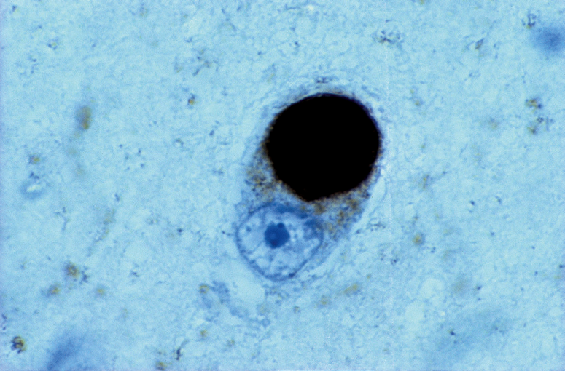
PHF-immunostained Pick body in the temporal cortex.

Slide 31
Picks disease
Genes:
Microtubule-associated protein tau gene (MAPT)
Mutations on chromosome 17 which, encodes for tau protein, can present in autosomal dominant pattern. Can also have parkinsonism symptoms.

Slide 32
Tauopathy Key points
AD
Macro: Diffuse atrophy
Micro: Neuritic plaques, Neurofibrillary tangles, Granulovaculoar degeneration, Hirano bodies, Deposition of amyloid in the walls of blood vessels. A(amyloid), B(plaques) and C(tangles) criteria
Picks disease (FTD)
Macro: Atrophy of frontal and temporal lobe with sparing of superior temporal gyrus “knife’s edge”
Micro: Pick bodies (ballooned or chromatolytic-appearing neurons)
CBD
Micro: Neuronal loss and astrocytosis affecting the cortex (preferentially the primary motor and sensory cortices), substantia nigra, and basal ganglia
PSP
Macro: Atrophy of the midbrain

Slide 33
Tauopathies
PSP, CBD
FTLD
FTLD-tau (sporadic) 50%
FTLD-TDP (sporadic or inherited) 45%
H&E, tau, ubiquitin, TDP
FTLD-FUS 5%
FTLD-UPS <1%
FTLD-ni <1%
Pick’s
MAPT mutations
H&E, tau, Bielschowsky
FTDP-17TAU

Slide 34
Case #2
A 70 year old female presents with several years of slow cognitive decline. Family noted difficulty with ADLs including dressing, eating without tremor. More recently, she complained of a young child who was visiting her in the afternoons, who wouldn’t speak to her and that no one else could see.

Slide 35
Lewy Body Dementia
It is the second most common dementia.
Presents with triad of symmetric parkinsonism, dementia, visual hallucinations.
Other potential clinical features include REM behavior disorder.
Memory issues are most often affecting attentional, executive and visuospatial domains.

Slide 36
Pathology:
SYNUCLEIOPATHY
Alpha syncluclein: Found predominantly in the presynaptic termini.
Function not clearly understood but felt to be associated with synaptic vesicles.
+cortical and brainstem lewy bodies with alpha-synuclein inclusions
Although synuclein deposition supersedes cell loss as evidence of degeneration, its actual role in the degenerative process remains unknown.
Notes:
https://www.ncbi.nlm.nih.gov/pmc/articles/PMC3866954/
Although synuclein deposition has thus superseded cell loss as evidence of degeneration, its actual role in the degenerative process remains unknown.
α-Synuclein has also been implicated in at least two other disorders, Multiple System Atrophy (MSA) and Dementia with Lewy Bodies (DLB). Interestingly, these conditions also produce clinical parkinsonism, but involve the deposition of α-synuclein in different cells from those affected by typical PD. MSA can begin with parkinsonism, autonomic failure or cerebellar ataxia, but usually progresses to involve one or both of the other components, resulting in the recognition that these initially disparate conditions reflect a common disorder. However, the parkinsonism observed in MSA does not generally respond well to dopamine replacement, presumably because the pathology affects many cell populations in addition to dopamine-producing cells of the substantia nigra, including postsynaptic medium spiny neurons in the striatum (Papp and Lantos, 1994; Sato et al., 2007). In contrast, PD affects preferentially the dopamine neurons, with spared postsynaptic cells still responsive to dopamine replacement.
In MSA, α-synuclein deposits in glial (generally oligodendroglial) cytoplasmic inclusions (GCIs) (Spillantini et al., 1998a; Tu et al., 1998), rather than in the neuronal Lewy bodies or dystrophic neurites more characteristic of PD. The expression of α-synuclein in oligodendrocytes reproduces the MSA phenotype, suggesting that the protein there is causative (Shults et al., 2005; Yazawa et al., 2005). Remarkably, α-synuclein is not normally expressed by oligodendrocytes (Miller et al., 2005), and a fundamental question remains about the origin of this protein: is it taken up from neurons, or does the pathological process activate expression by glia? In fact, the pathology shows relatively little deposition of synuclein in neurons, with only occasional nuclear and cytoplasmic inclusions (Farrer et al., 2004; Jellinger and Lantos, 2010; Nishie et al., 2004b). At the same time, oligodendrocytes do not seem to up-regulate expression of α-synuclein even in MSA (Miller et al., 2005). Regardless of its source, α-synuclein accumulates to particularly high levels in MSA, suggesting a process distinct from Lewy pathology. In addition, GCI lesions are widespread in MSA, but generally correlate with neuron loss in the substantia nigra, pons, cerebellum and intermediolateral cell columns of the spinal cord, suggesting that the glial process may be primary.
MSA is rarely familial (Soma et al., 2006) and mutations in α-synuclein have not been observed (Ozawa et al., 2006). However, polymorphisms in the synuclein gene may influence susceptibility to MSA (Al-Chalabi et al., 2009; Scholz et al., 2009). In addition, the analysis of familial MSA has recently identified mutations in COQ2, a protein required for the synthesis of coenzyme Q10 (Collaboration, 2013). The degenerative process in MSA may thus reflect a primary lesion in mitochondria.
DLB more closely resembles idiopathic PD in terms of Lewy body pathology. Although DLB appears to be a distinct syndrome, with early cognitive impairment, fluctuating alertness and visual hallucinations in addition to progressive parkinsonism, the distribution of Lewy pathology appears remarkably similar to that observed in PD, with a brainstem-predominant form and others involving the cortex as well (McKeith et al., 2005). Like PD and MSA, DLB also involves primarily the deposition of α-synuclein.
Lewy pathology was originally considered to involve only α-synuclein, but β- and γ- can deposit in both PD and DLB (Galvin et al., 1999). Similar to α-synuclein, β- accumulates presynaptically in PD, but γ- forms axonal spheroids. β-synuclein has been suggested to ameliorate the toxicity of α-synuclein, by reducing either its aggregation or its expression (Fan et al., 2006; Hashimoto et al., 2001). However, polymorphisms in β-synuclein predispose to DLB (Ohtake et al., 2004), and transgenic mice over-expressing the variant develop degeneration and behavioral abnormalities (Fujita et al., 2010). These animals do not develop typical Lewy pathology, but they do accumulate both α- and β-synuclein in axonal spheroids (Fujita et al., 2010). Indeed, β-synuclein appears as toxic as α-synuclein to cultured neurons (Taschenberger et al., 2013). Mutations in γ-synuclein have not been identified as a cause of familial PD or related disorders, and it has generally been considered nontoxic, but recent over-expression of even this isoform has produced degeneration in transgenic mice (Ninkina et al., 2009), and a polymorphism has also been linked to DLB (Nishioka et al., 2010). Rather than contribute to disease simply through a decline in their protective function (Li et al., 2004; Rockenstein et al., 2001), which nonetheless remains a possibility, β- and γ-synuclein may thus cause degeneration.
α-Synuclein also deposits in other neurodegenerative disorders. Alzheimer’s disease shows Lewy pathology in up to 60% of cases, but more often restricted to the amygdala than in PD or DLB (Hamilton, 2000; Leverenz et al., 2008; Uchikado et al., 2006). Neurodegeneration with brain iron accumulation due to mutations in pantothenate kinase type 2 also exhibit Lewy pathology labeling for α-synuclein and neuroaxonal spheroids labeling for β- and γ- (Galvin et al., 2000; Wakabayashi et al., 2000). Thus, synucleins accumulate in a variety of neurodegenerative processes, suggesting either that they are sensitive reporters for specific cellular defects, or that they participate in the response to injury.

Slide 37
Diffuse Lewy body disease with spongiform change in the parahippocampal gyrus
Notes:
*DLBD divided by location of involvement: 1) cortical, 2) limbic, 3) brainstem
*Microvacuolation of the cortex, similar to that found in prion diseases
*Lewy bodies found in amygdala in 60% of cases of familial AD
*Also present in DLBD are senile plaques (neuritic, diffuse); can also see NFTs in cortex

Slide 38
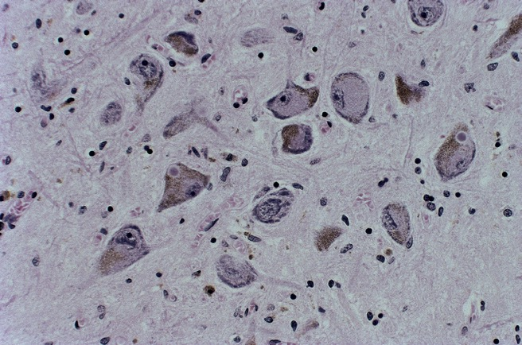
Lewy Bodies
Intraneuronal cytoplasmic spherical inclusions
Hyalin eosinophilic cores surrounded by pale haloes
Two neurons of the substantia nigra containing Lewy bodies
Notes:
*LB found in locus ceruleus, nucleus basalis of Meynert, dorsal vagal nucleus, hypothalamus, olfactory bulb, Edinger-Westphal nucleus, raphe nuclei, intermediolateral cell column of SC, autonomic ganglia

Slide 39
Cortical Lewy body in the superior temporal gyrus: B, α-Synuclein–immunostained cortical Lewy bodies.
Notes:
*Density of cortical LBs associated with PD + dementia

Slide 40
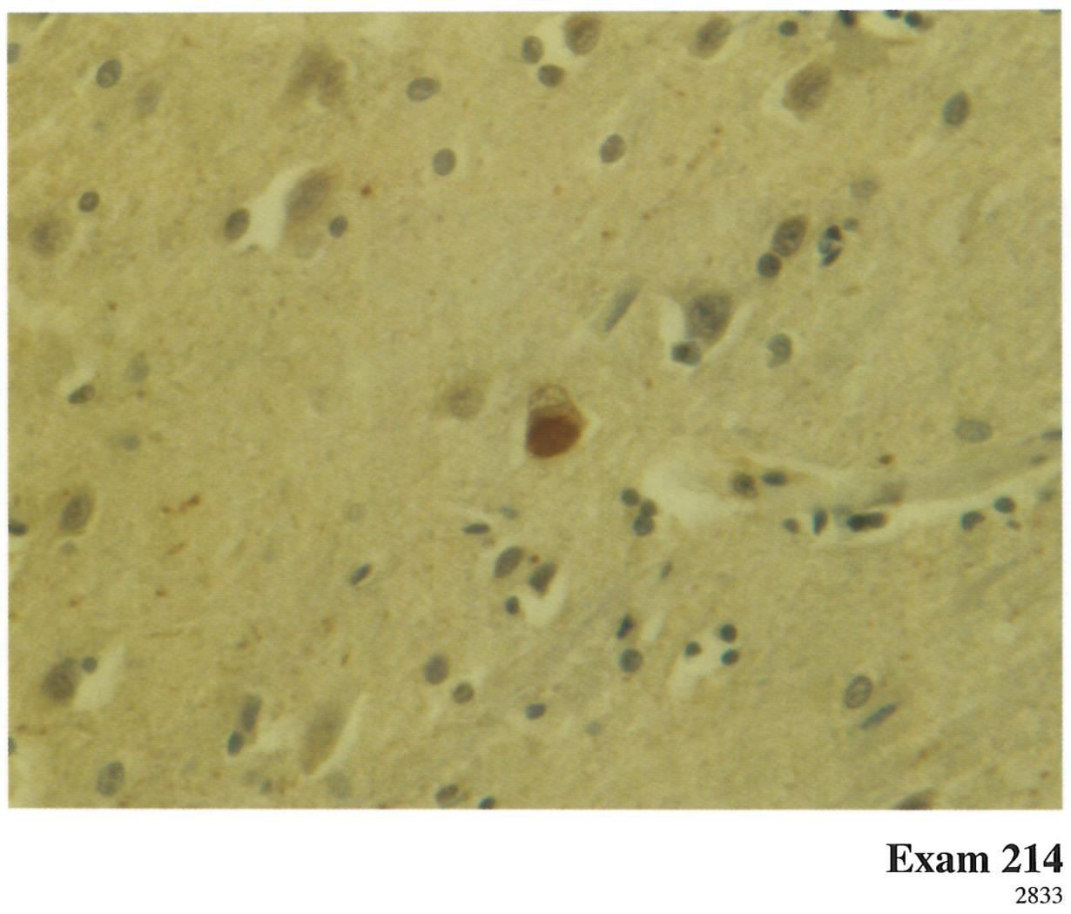
Lewy Bodies

Slide 41
Multiple System Atrophy
AKA: shy-drager, olivopontocerebellar atrophy, striatonigral degeneration
Exam: Parkinsonism, cerebellar dysfunction, pyramidal tract signs, autonomic dysfunction
Sporadic
Onset in 6th decade, M > F
Two groups
MSA-P (parkinsonian predominant) – 80%
MSA-C (cerebellar predominant)
Notes:
MSA-P: tremor is typically postural/action tremor, not resting as in PD
MSA-C: gait and limb ataxia, cerebellar dysarthria, oculomotor dysfunction

Slide 42
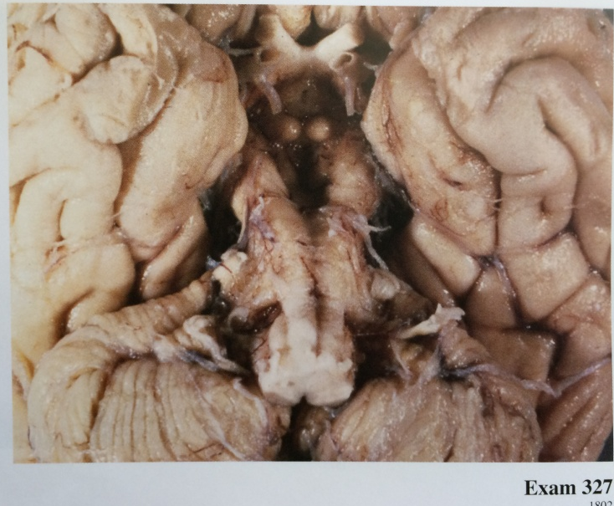
MSA-C Atrophy of middle cerebellar peduncle, cerebellum and pontine atrophy
Notes:
Atrophy and grayish discoloration of the putamen may be seen in MSA-P , whereas in MSA-C, cerebellar, middle cerebellar peduncular, and pontine atrophy are evident. In both types of MSA, the substantia nigra is pale. Slight cortical atrophy may be present.

Slide 43
MSA-P A horizontal slice of brain shows brown discoloration and atrophy of the putamen bilaterally.
Notes:
Atrophy and grayish discoloration of the putamen may be seen in MSA-P , whereas in MSA-C, cerebellar, middle cerebellar peduncular, and pontine atrophy are evident. In both types of MSA, the substantia nigra is pale. Slight cortical atrophy may be present.

Slide 44
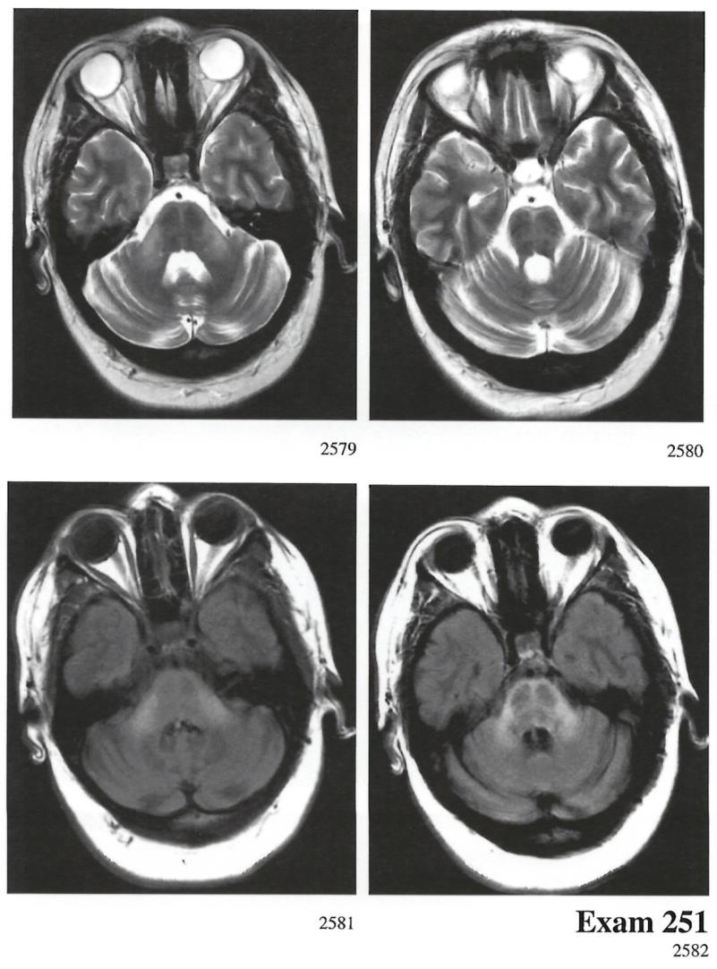
“Hot Cross Bun”
Notes:
The MRI findings show the "Hot Cross Bun" sign in the pons, as well as hyperintensity in the cerebellar peduncles. These
findings are most suggestive of multiple system atrophy, a neurodegenerative disorder. Parkinson disease, postencephalitic parkinsonism, and prolonged metoclopramide exposure typically would not have characteristic MRI findings. NPH would demonstrate enlargement of the ventricles along with transependymal flow.

Slide 45
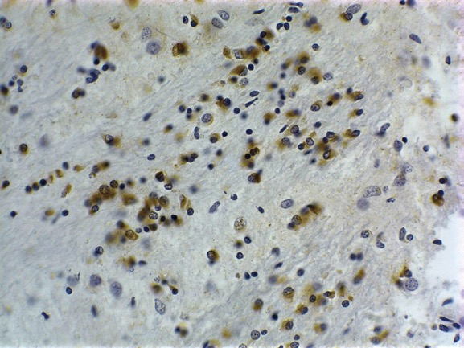
Multiple System Atrophy
Degeneration of striato-nigral, olivoponto-cerebellar structures
α-synuclein immunoreactive glial cytoplasmic inclusions →
Notes:
Necessary for the diagnosis of MSA is the glial cytoplasmic inclusion. These inclusions are found in oligodendrocytes of the subcortical nuclei exhibiting neuronal loss and astrocytosis; specifically putamen, substantia nigra, basis pontis, and inferior olivary nuclei. Glial cytoplasmic inclusions (GCIs) are also numerous in the white matter of the cerebellum. GCIs are argyrophilic (evident on Gallyas and Bielschowsky stains) structures that are α-synuclein immunoreactive

Slide 46
Multiple system atrophy: α-synuclein–immunoreactive glial cytoplasmic inclusions.
Notes:
*Inclusions may be triangular, half-moon, sickle, or flame shaped
Varied diameters, randomly arranged filaments mostly made of polymerized α-synuclein, +immunoreactive for ubiquitin but negative for glial fibrillary acidic protein

Slide 47
Multiple system atrophy: α-synuclein–immunoreactive glial cytoplasmic inclusions.

Slide 48
MSA—P. Neuronal loss and astrocytosis of the putamen

Slide 49
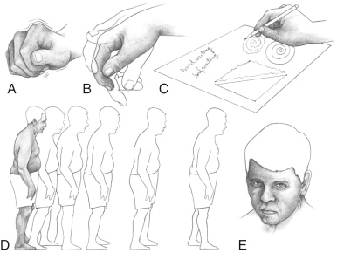
Parkinson’s Disease
Bradykinesia/akinesia + rigidity + resting tremor

Slide 50
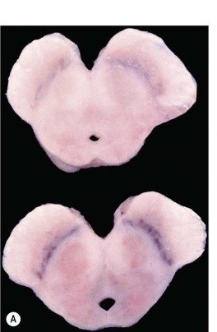
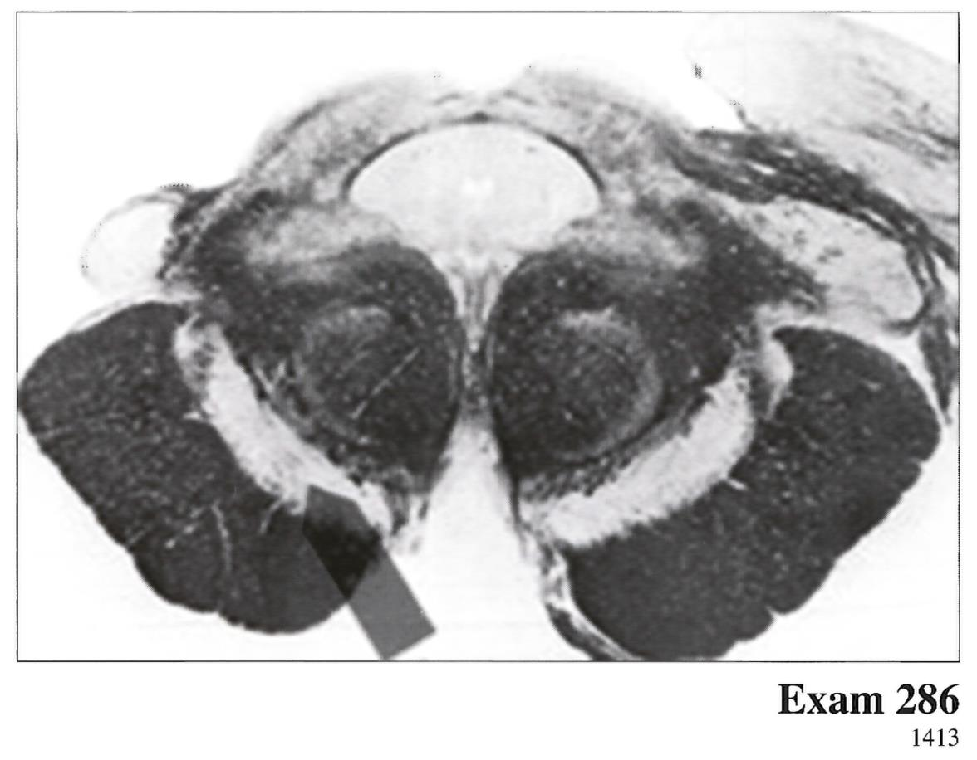
Parkinson’s Disease
Gross findings:
Pallor of substania nigra, locus ceruleus
+/- slight cortical atrophy, ventricular dilation
Notes:
The structure is the substantia nigra, which projects to and receives fibers predominantly from the caudate and putamen. Degeneration of this structure is seen in idiopathic Parkinson's disease.

Slide 51
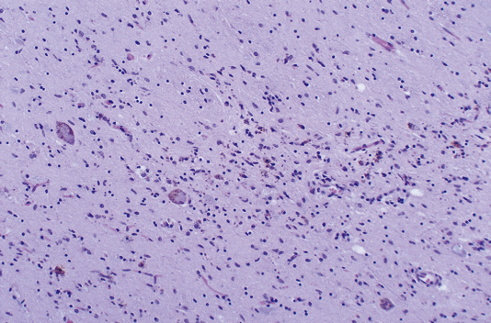
Parkinson’s Disease A) Normal density of pigmented neurons in SN B) Decreased density of pigmented neurons in PD; *pigment-laden macrophages
A
B
Notes:
Loss of melanin-containing, tyrosine hydroxylase-immunoreactive neurons in SNpc
*Loss of DA input to the striatum
*Stimulation of reactive astrocytosis, +melanin laden macrophages in areas of neuronal loss

Slide 52
Lewy bodies in the cytoplasm of a nigral neuron adjacent to a neuron containing a large pale body.
Notes:
Pale bodies – cytoplasmic areas of pallor found in pigmented neurons of SN, unclear relationship to LBs, ?precursors

Slide 53
α-synucleinopathies key points
Lewy bodies: Intraneuronal hyaline eosinophilic cores surrounded by pale haloes
MSA:
Macro: Atrophy of the pons and cerebellum. “Hot cross buns”
Parkinsons disease
Macro: Loss of pigment of the substania nigra
Micro: Decreased density of pigmented neurons in PD, pigment-laden macrophages, Lewy bodies of nigral neurons

Slide 54
α-synucleinopathies
PD, DLB, MSA
Pathology Lewy Bodies
H&E
α-synuclein + cytoplasmic inclusions
Neurons – PD and DLB
Oligodendroglia - MSA

