Slide 1
Acanthamoeba Keratitis
Jessica Kovarik, PGY-3
Clinical-pathologic Correlation

Slide 2
History
CC: Pain and decreased vision OS X 2 months
HPI: 53 yo female, thought to have a h/o herpetic infections OU*, referred by community-based ophthalmologist for evaluation of corneal ulcer OS
Previously treated with topical abx, steroids, cycloplegics, antivirals and oral acyclovir for presumed HSV stromal keratitis
*Later review indicates that in fact she did not have a history of herpes

Slide 3
History
POH: h/o contact lens wear, washes lenses with tap water
PMH: hyperlipidemia
Meds: Combigan BID, Cyclogyl BID, Vigamox QID, Viroptic 5x/day, acyclovir 400 mg PO BID
Allergies: PCN

Slide 4
Physical Exam
VA: 20/25 OD, 20/400 OS
T: 17 OD, 6 OS
P: 4 -> 3 OD, fixed and dilated OS; no RAPD
EOMs full
VFFTC OU

Slide 5
Say what? Confusing Ophtho Abbreviations 101
OD: right eye
OS: left eye
OU: both eyes
VA: visual acuity
T: intraocular pressure (tonometry)
P: pupils
VFFTC: visual fields full to confrontation
Epi: epithelial
KP: keratic precipitates
NS: nuclear sclerosis
c/d: cup-to-disc ratio
BCL: bandage contact lens
PKP: penetrating keratoplasty

Slide 6
Physical Exam
 | OD | OS
Lids/Lashes | Normal | Normal
Conjunctiva/Sclera | White and quiet | 2+ injection
Cornea | Clear | Large central epi defect w/ surrounding loose epithelium, faint stromal ring infiltrate, central stromal edema, central fine KP, no thinning
Anterior Chamber | Deep and quiet | Deep; 0.5 mm hypopyon
Iris | Round and Reactive | Fixed and dilated
Lens | NS | NS
Vitreous | Clear | Clear
Optic Nerve | Normal, c/d 0.3 | Normal, c/d 0.3
Macula | Normal | Normal
Periphery | Normal | Normal

Slide 7
Do you see the ring infiltrate? And the small hypopyon?

Slide 8
Impression/Plan
Acanthamoeba keratitis
Highly suspicious given lack of response to anti-viral therapy and clinical appearance
Obtained corneal cultures
DC’d Viroptic (possible long-term epithelial toxicity)
DC’d Acyclovir
Started Valtrex 1 g PO BID
Started PHMB (polyhexamethylene biguanide) Q3H
Increased Vigamox to Q2H
Started Homatropine daily
Artificial Tears QID

Slide 9
Clinical Course
6/13: culture + for acanthamoeba; negative PCR for HSV I and HSV II; VA HM; started Desomidine Q3H, DC’d Valtrex
6/16: pt c/o more pain and photophobia; now 1.2 mm hypopyon; increased PHMB and Desomidine Q1H; Alleve prn
6/24: larger epi defect, mild improvement in inflammation, trace hypopyon remaining
7/1: still larger epi defect, hypopyon resolved; replaced BCL

Slide 10
Clinical Course
7/15: pain improved, VA still HM; changed PHMB to chlorhexidine (cost); started topical voriconazole Q1H
7/29: pt unable to tolerate chlorhexidine 2ry to pain; epi defect larger, diffuse inflammation remains and confocal biomicroscopy suggestive of persistent cysts; started baquacil Q2H and replaced BCL

Slide 11
Confocal Biomicroscopy
Notes:
Suggestive of acanthamoeba

Slide 12
Find the edge of the epithelial defect…and note the circumferential corneal neovascularization
Notes:
stromal ring infiltrate with large overlying epithelial defect; diffuse peripheral circumferential superficial corneal neovascularization

Slide 13
Look closely… do you see the ground glass appearance of the stroma?
Notes:
diffuse, central ground glass appearance to stroma with 2+posterior stromal haze and multifocal punctate white stromal opacities

Slide 14
Clinical Course
8/11: pain and photophobia improved; CPM
8/26: c/o ‘throbbing pain’, tearing and photophobia OS; VA now LP; stromal infiltrate denser and fluffier (2ry to tight BCL vs. shift in acanthamoeba from cyst to trophozoite form vs. superinfection); BCL removed; cornea re-cultured: + yeast forms on corneal smear; started topical Amphotericin B Q1H and Fluconazole 200 mg PO BID

Slide 15
“Fluffy” usually means fungus to an ophthalmologist
Notes:
Dense, ‘fluffy,’ white stromal infiltrate

Slide 16
A giant close up… just in case that last photo wasn’t enough

Slide 17
And a couple more…

Slide 18
Clinical Course
9/2: OS ‘really sore’ – thought to be 2ry to enlarged epi defect after BCL was removed at last visit; plan for PKP
9/6: pt underwent PKP OS

Slide 19
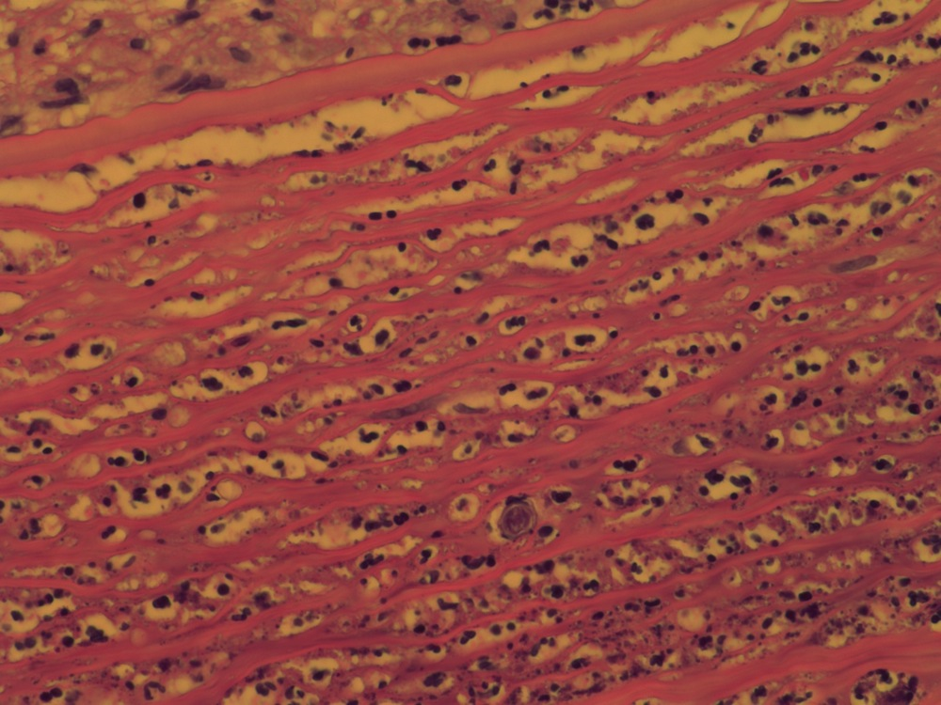
Where are those little cysts hiding?
Notes:
H&E stain of corneal button shows encapsulated cysts surrounded by PMNs in the posterior stroma

Slide 20
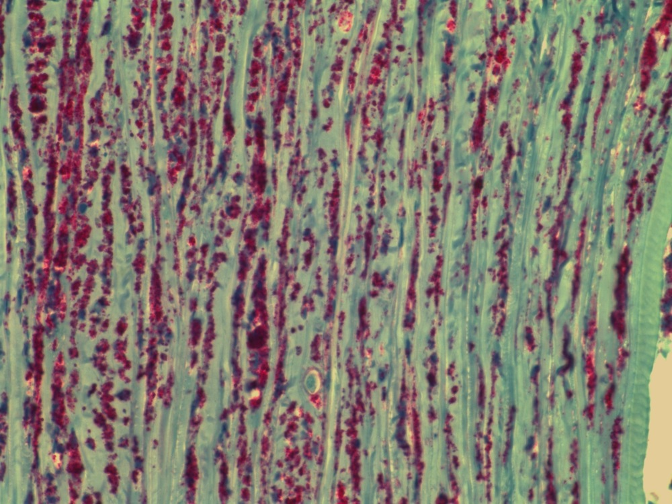
Lots of neutrophils…
Notes:
Myeloperoxidase stain showing heavy infiltration of neutrophils within cornea

Slide 21
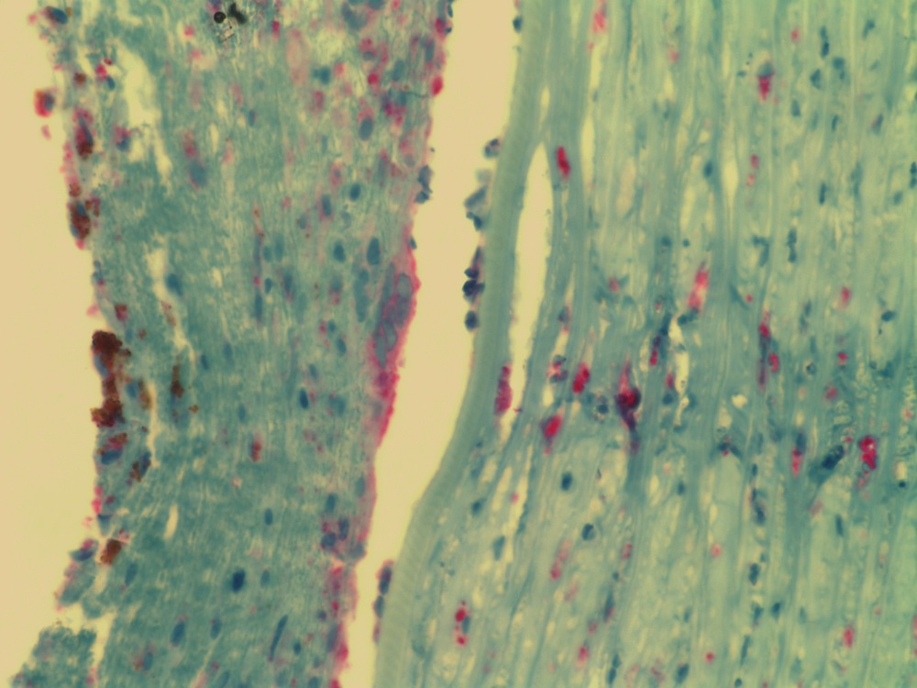
…and macrophages
Notes:
CD68 stain showing infiltration of macrophages

Slide 22
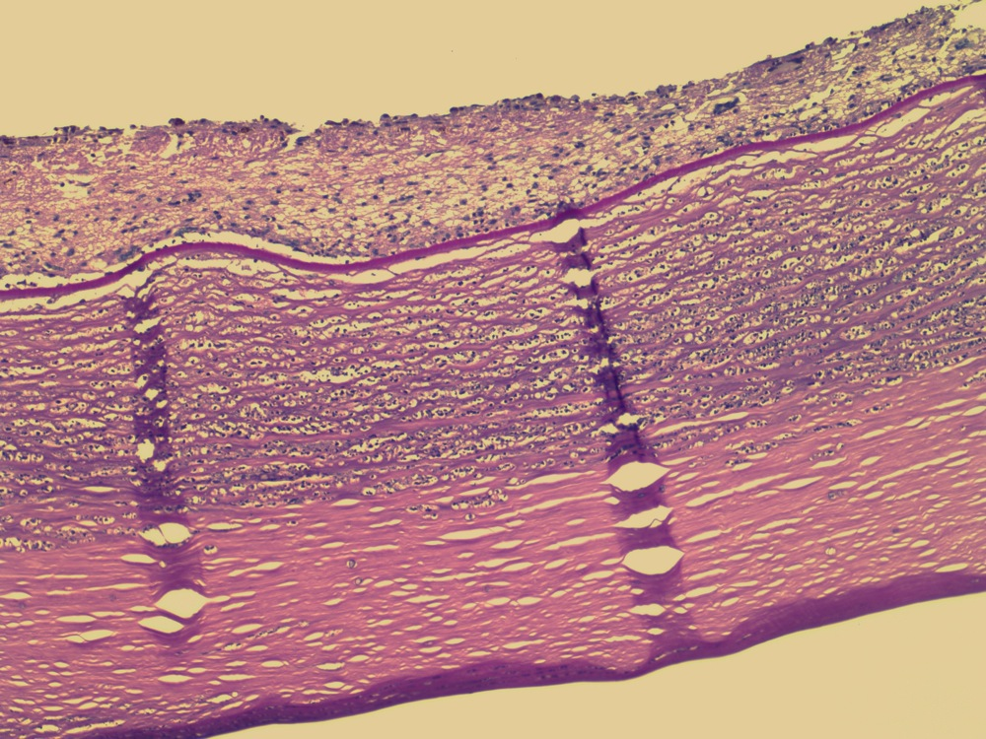
What is that sitting on the back of the cornea?
➔A retrocorneal membrane with granulomatous inflammation
Notes:
PAS stain

Slide 23
Clinical Course
POD#1 s/p PKP: epi defect ~40% of cornea; start post-op meds: Vigamox, PredForte, PHMB, polysporin ointment, atropine, NSAIDs prn; eye shield
POW#1: VA CF @ 3 ft; epi defect healed; significant posterior synechiae but fibrin in AC resolved
POW#3: VA 20/400; OS feels much better

Slide 24
Clinical Course
POM#3: VA 20/100, graft clear off all anti-parasite therapy

Slide 25
That’s all folks!

