Slide 1
An Eyelid mass
Marta Couce
UH Cleveland Medical Center

Slide 2
Clinical History & Presentation
87 yo male
Retired engineer, electrode welder
Hx of smoking.
Significant pmh:
prostate carcinoma Gl 4+4 (2012)
colon adenocarcinoma (1990)
More recently
Lung adenocarcinoma T1aN2M0 (tumor </= 1 cm with metastatic ipsilateral mediastinal LNs)

Slide 3
LUNG H&E

Slide 4
LUNG ICC
CK7
TTF1

Slide 5
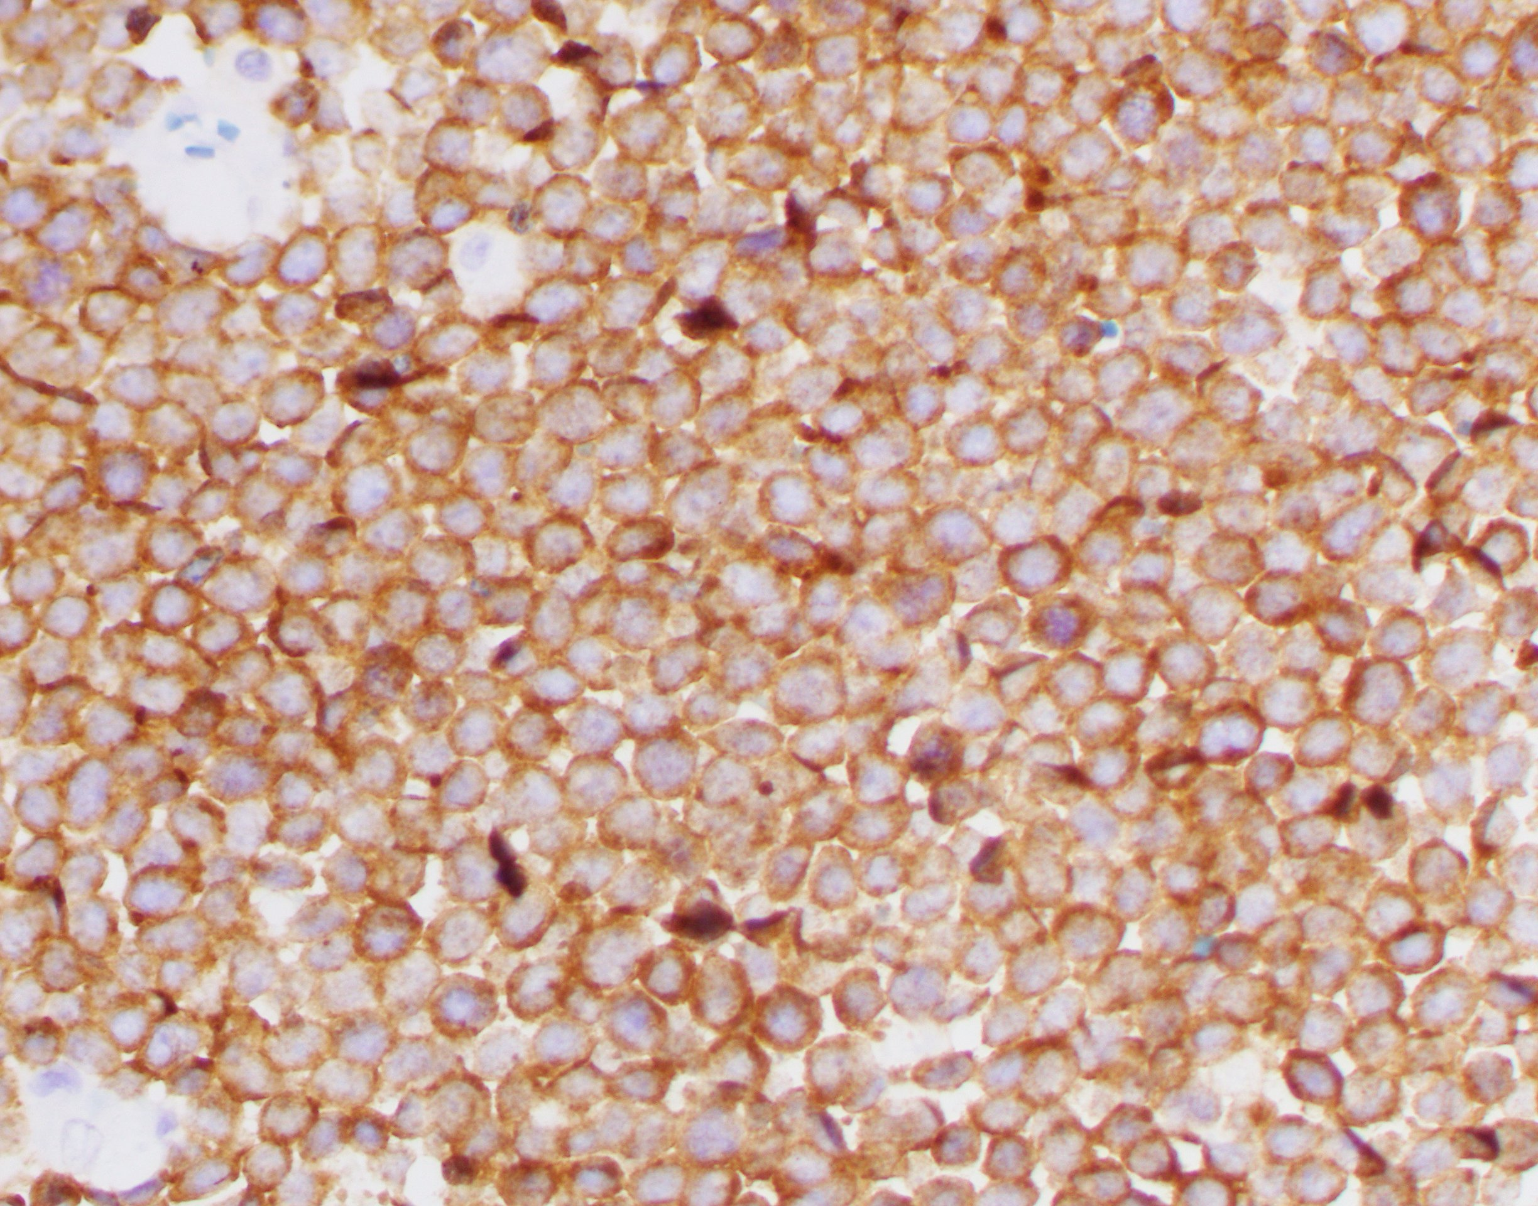
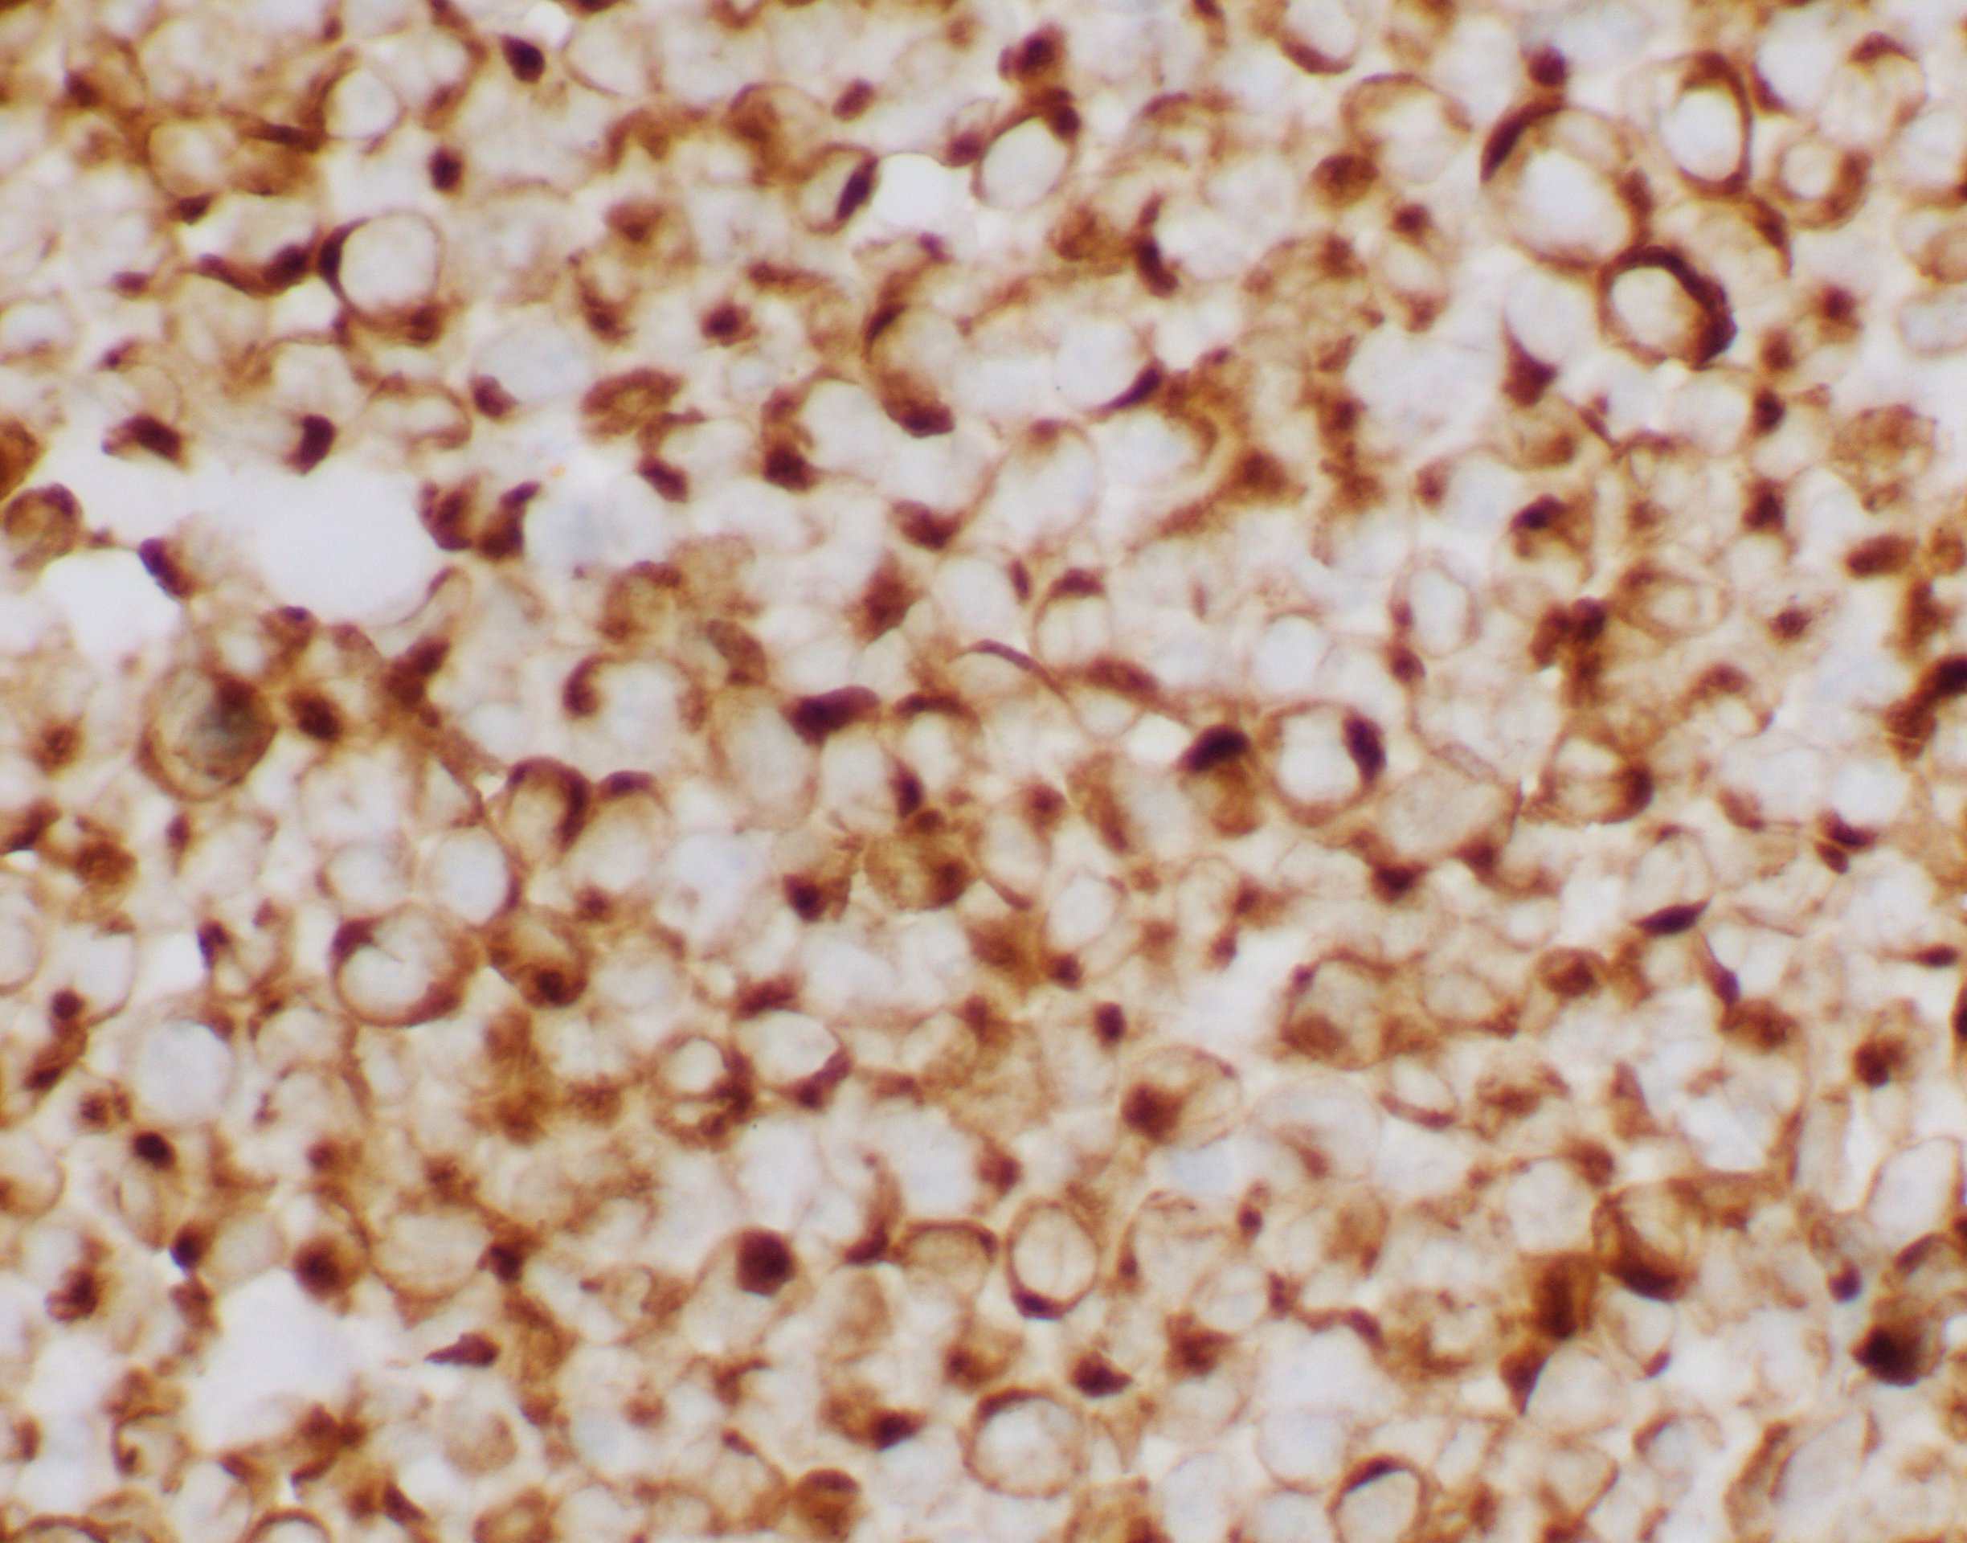
Follow up
Mass right cheek:
Ulcerated, multi-nodular. Largest nodule, 2cm
Dx:
Neuroendocrine carcinoma,
c/w Merkel cell carcinoma
Wide resection. reconstruction and adjuvant XRT 60 Gy proton .
SLNB, negative
Synaptophysin
CK 20

Slide 6
Follow up
One year later:
Mass in right upper eyelid (just outside radiation field) with right periorbital hypermetabolic mass

Slide 7
Current surgical procedure

Slide 8
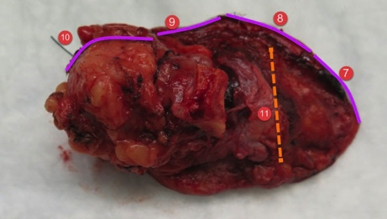
-Right radical resection of tumor with orbital exenteration
-Resection of lateral orbital wall
-Reconstruction with right temporalis flap
Split thickness skin graft.

Slide 9
H&E

Slide 10
H&E

Slide 11
ICC
CK20
CK20

Slide 12
ICC
SYNAPTOPHYSIN
SYNAPTOPHYSIN

Slide 13
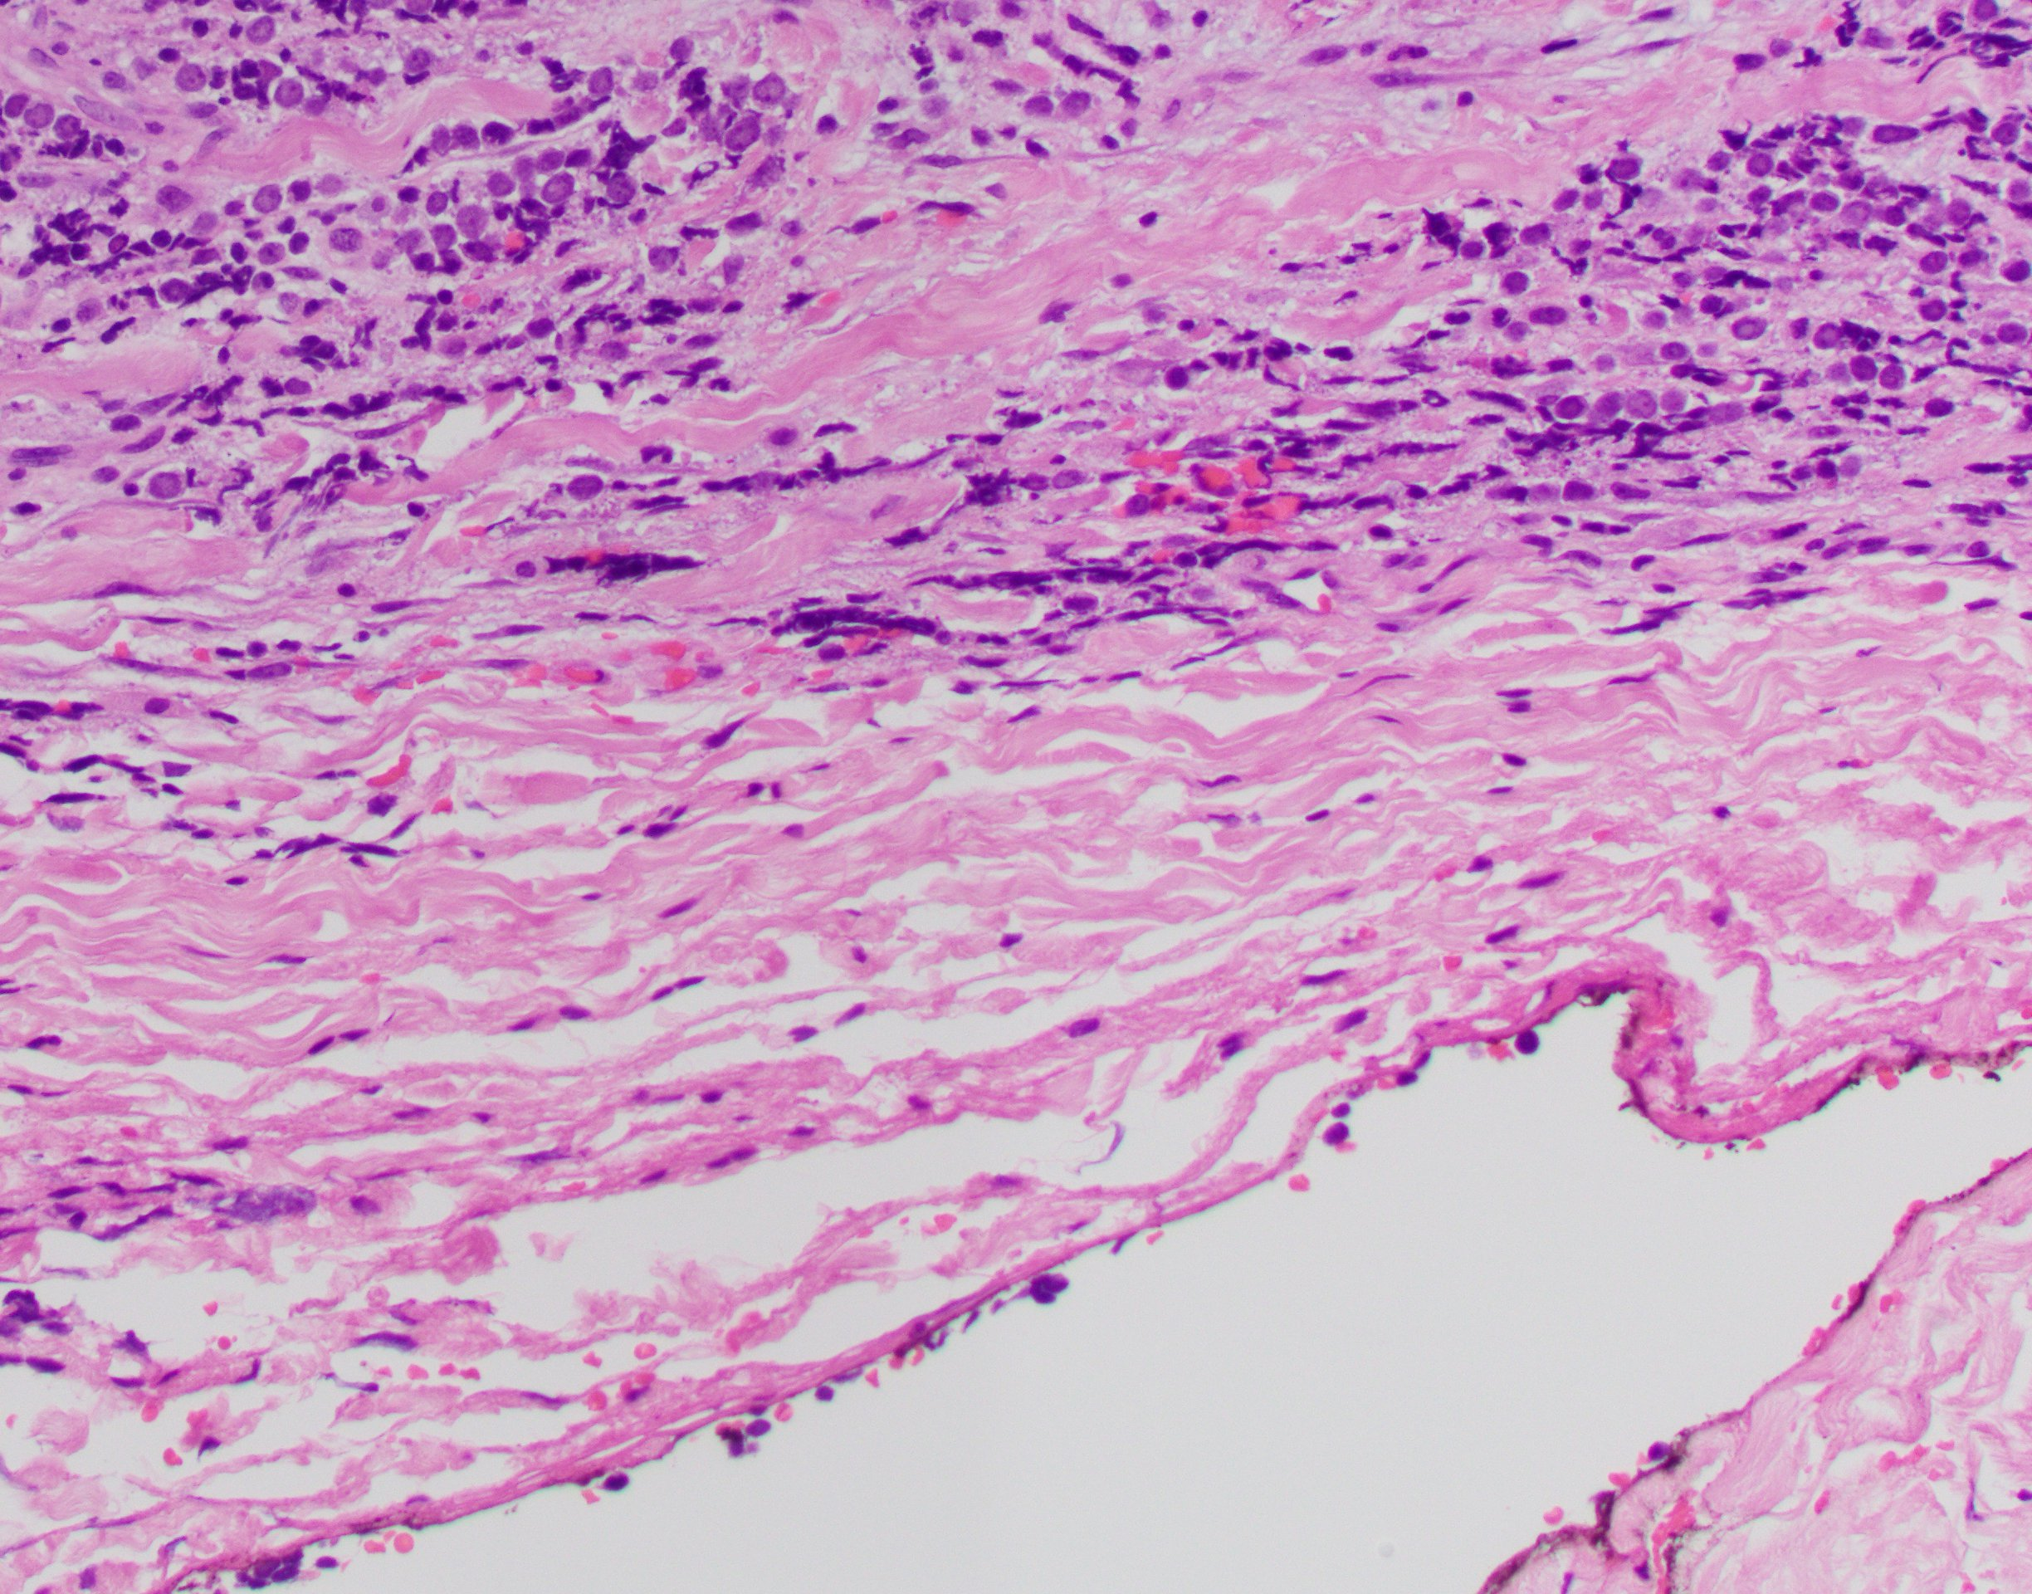
Diagnosis
Merkel cell carcinoma involving:
Eyelid, orbital soft tissue and lacrimal gland.
Largest tumor nodule: 1.5 cm.
Carcinoma is at <0.1cm from deep orbital margin
Rest of margins, bone, optic nerve and eye globe, negative

Slide 14
Last Follow up (1 month post-surgery)
ECOG performance status: 4 (totally disabled)
No additional treatment recommended

Slide 15
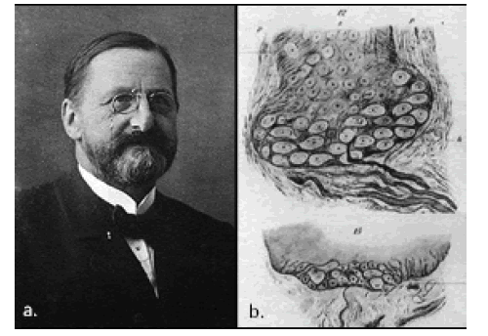
BRIEF HISTORY
Freidrich Sigmund Merkel, a German histopathologist, first described the Merkel cell (MC) in 1875.

Slide 16
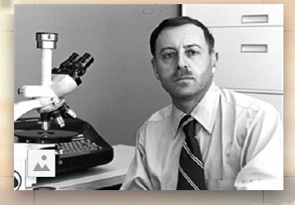
BRIEF HISTORY
Cyril Toker first described Merkel cell carcinoma in 1972. He analyzed 5 cases and described clinical and pathology findings.

Slide 17
Merkel Cell Carcinoma (MCC)
Aggressive neuroendocrine malignancy
More prevalent in men; >90% Caucasians
65% patients present with local disease,
26% with regional lymph node metastasis and
8% with distant metastasis.
Risk for MCC is increased in immunosuppressed patients
13-fold among HIV patients, 12 and 10-fold after solid organ transplantation, more common among patients with lymphoma and those receiving immunosuppressive therapy.
Incidence in USA has increased fivefold from 1986-2011

Slide 18
ETIOLOGY
UV radiation
Merkel cell polyomavirus (MCPyV )
MCPyV-specific antibodies have been detected in 80% of individuals 50 years or older .
MCPyV-related oncogenesis requires integration of the viral genome into the host-genome and mutation of the large T (LT) antigen.
MCPyV-negative MCC is among the most mutated of all solid tumors, including melanoma
MCPyV-negative MCC is also associated with high levels of T-cell infiltrates
Liu W. et al Cell Host Microbe 2016; 19(6): 775-787

Slide 19
DETECTION OF MCPYV IN TISSUE?

Slide 20
ICC
PML
PML SV40
Notes:
.

Slide 21
ICC
SV40 KIDNEY
SV40 MERKEL

Slide 22
Detection of Merkel cell carcinoma Polyomavirus in tissue
A monoclonal antibody against SV40 large T antigen (PAb416) does not label Merkel cell carcinoma
. Pelletier, DJ., Czeczok TW & Bellizzi AM. Histopathology 2018, 73, 162–166.
CM2B4 monoclonal antibody detects nuclear T-cell antigen (sensitivity 39-90%).

Slide 23
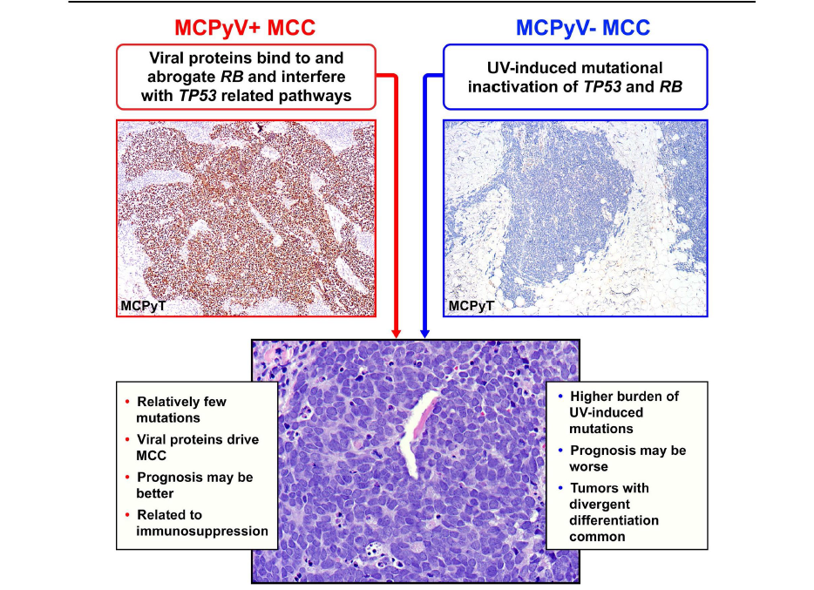
Tetzlaff MT, Nagarajan P. Head & Neck Pathology (2018) 12:31-43

Slide 24
MCC CLINICAL FEATURES
Firm, painless, rapidly enlarging, red-violet cutaneous nodule with a smooth surface
50% in head and neck
DD: Melanoma, BCC, Lymphoma, Metastatic SCC
AEIOU acronym (Heath et al.) :
asymptomatic/lack of tenderness,
expanding rapidly,
immune suppression,
older than age 50
UV-exposed site on a person with fair skin.

Slide 25
MCC Histological Features
Sheets/nests/trabeculae. Well circumscribed/infiltrative
May arise in association with SCC
Large “salt & pepper” nuclei and scant cytoplasm
High mitotic/apoptotic indexes.
Dermal involvement with variable extension into subcutis
May exhibit divergent differentiation
+ EMA, +CK20 (perinuclear dot staining pattern),
+ neuroendocrine markers

Slide 26
eyelid

Slide 27
Merkel cell carcinoma of the eyelid and periocular region
Eyelids are common primary sites with incidence ( 5% -20% of all cases of head and neck.
Upper eyelid, near the eyelid margin with eyelash loss.
Higher incidence in women
Commonly misdiagnosed as cysts, chalazia, or basal cell carcinomas
Merritt H. et al Cancers 2014, 6, 1128-1137

Slide 28
Merkel cell carcinoma of the eyelid and periocular region
81 yo male with previous hx of MCC of the cheek, negative margins, negative SLN.
Raven ML et al. Ophthalmology Volume 123, Number 10, October 2016

Slide 29
Merkel cell carcinoma of the eyelid and periocular region
East Tallinn Central Hospital Eye Clinic, Tallinn, Estonia
3 cases, females
fast growing tumor with no pain or itching
Mohs micrographic surgery
T2N0M0/T1N0M0 and T3N0M0 with 14 years, 3 years and 9 months fu without recurrence.

Slide 30
Prognostic Markers in MCC
Immune status
Higher density of tumor associated CD3 + T cells correlates with improved survival (Most pronounced in MCPyV+ tumors).
CD8+ T cell infiltrate, independently associated with better survival
Mutational signature
MCPyV- MCCs have significantly higher mutation burden
Most UV-signature mutations
CK20 negative MCCs harbor mutations in TET2, APC and BAP1 not identified in CK20 positive MCC.
Others…P63 expression (controversial)

Slide 31
Staging MCC
Tumor size (thickness) and extent of anatomic invasion
Growth pattern
Tumor associated lymphocytic infiltrate
Lympho vascular invasion
Patients with pathologically confirmed negative LNs have the best prognosis.
Patients with regional lymph node disease without a known primary (Stage IIIA) slightly better prognosis than those with known primary (Stage IIIB).

Slide 32
TREATMENT
Loco-regional MCC: wide excision and/or complete lymph node dissection and/or adjuvant radiation therapy.
Advanced MCC generally sensitive to chemotherapy, but responses are transient
median PFS +/-3 months
MCPyV- positive and -negative tumor cells express PD-L1,
Expression levels of PD-L1 in virus-positive tumors are higher than those in virus-negative tumors
Immune checkpoint inhibitors (anti-PD-1, PD-L1, and CTLA-4 Abs) as monotherapy or in combination with other agents or modalities
Responses were not associated with MCPyV status or PDL1 expression in tumor cells. Need to identify other predictive biomarkers
PDL1
PD1
MHCI
TCR
T-CELL
TUMOR CELL
PDL1
PD1
MHCI
TCR
T-CELL
TUMOR CELL
Anti-PD1
Anti-PDL-1

Slide 33
Summary & Conclusion
MCC is an aggressive neuroendocrine carcinoma that can occur in the eyelid
Rapidly growing red nodule/s
UV radiation and Polyomavirus infection are known causes, each with particular geographical preferences.
Hx of immunosuppression and advance age are risk factors
Treatment involves resection, SLN and potential radiation therapy and the use of immune checkpoint inhibitors

Slide 34
Thank you!

