Slide 1
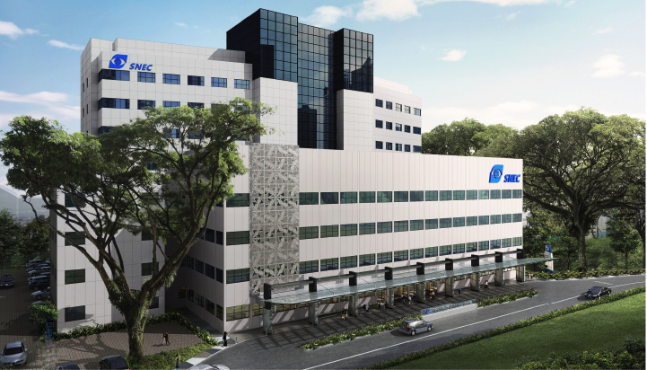
Iris Biopsy in Uveitis: Masquerade Syndrome
Dr Anita CHAN
Singapore National Eye Centre
Singapore Eye Research Institute
Singapore General Hosptial

Slide 2
Clinical history
A 83-year-old Chinese man, presented to the uveitis service at Singapore National Eye Centre (SNEC) with a 1-2 history of blurring of vision with floaters.
Past medical history: Diabetes mellitus
Past ocular history: Bilateral cataract surgery (Phacoemulsification), History of dry age related macular disease (ARMD)
Social history: Chronic smoker (>10 sticks/ day)
He was found to have anterior segment inflammation with vitritis.
A clinical diagnosis of intermediate uveitis was made
A vitreous aspiration was performed.

Slide 3
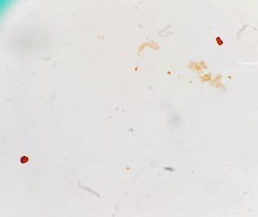
Intermediate uveitis Vitreous biopsy: Cytology
DQ
CD68
They show small groups of histiocytes . The background inflammatory infiltrate is composed of occasional small reactive lymphocytes and rare neutrophils. No atypical or malignant cells seen. Ziehl-neelson stain performed showed no acid fast bacilli. CD3, CD20, CD68 and Ki67 showed a predominance of CD68 positive macrophages with hardly any CD20 B cells or CD3 T cells. No increased proliferation index was seen on Ki67.
Notes:
They show small groups of histiocytes with slipper-shaped nuclei. Occasional
histiocytes show abundant foamy cytoplasm. The background inflammatory
infiltrate is composed of occasional small reactive lymphocytes and rare
neutrophils. No atypical or malignant cells seen. Ziehl-neelson stain performed
showed no acid fast bacilli.
CD3, CD20, CD68 and Ki67 showed a predominance of CD68 positive macrophages with
hardly any CD20 B cells or CD3 T cells. No increased proliferation index was
seen on Ki67.
All immunostains and special stains were performed in the presence of
satisfactory controls.

Slide 4
Follow up
Non responsive to treatment
Anterior uveitis: “Granulomatous” KPs
Noted to develop an iris mass without significant scleritis or any external conjunctival nodule
Notes:
Preop
28/june02016
V6/90 RE

Slide 5
Anterior segment Optical coherence tomography (AS-OCT, VISANTE©) demonstrating an iris mass with cystic spaces.
B
D

Slide 6
Iris Biopsy

Slide 7
Iris Biopsy: Higher magnification
*Hardly any normal iris tissue is present.
*
“Iris” tissue is composed completely of malignant cells with prominent squamous differentiation

Slide 8
Immunohistochemistry: Pancytokeratin
AE1/AE3

Slide 9
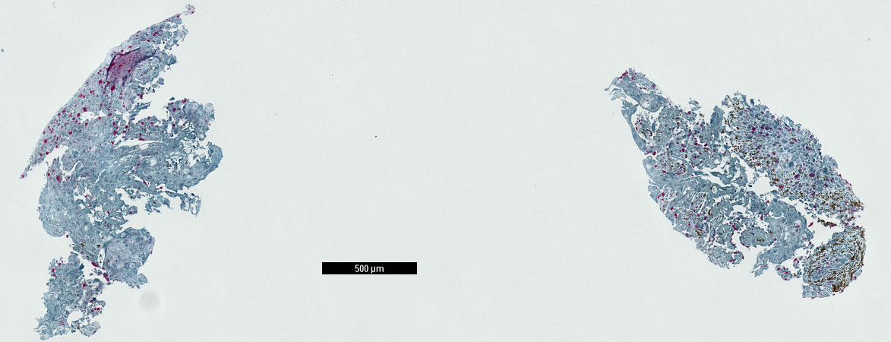
AE1/AE3
HMB45
Control
Ki-67

Slide 10
Diagnosis:
Iris biopsy: Squamous cell carcinoma
Based on the history: this is likely to be metastatic.
Most common metastatic site in a male : Lung
Further immunohistochemistry was not performed to subtype due to lack of tissue
CXR- previous finding of apical scarring which was initially attributed to Old ”TB” scars
CT Thorax- Nodules suggestive of a lung tumour
Although a smoker, patient had no prior history of a lung lesion and this was the first time the lesion was noted. In view of patient’s age, patient and family declined radical surgery and opted for palliative treatment.

Slide 11
Discussion
Iris metastases are rare and occur in 4-8% of systemic cancers.¹
Ferry and Font provided the first complete analysis of metastatic carcinomas to the anterior segment in 26 eyes.²
In their series, they noted a propensity for the tumour to involve the horizontal meridian of the iris or cilary body,² which is similar to our case
Most common primary sites of malignancy are the lung (in men) and breast (in women).¹⁻³
In some cases, the iris metastasis may be the first presentation of tumour.⁶
A high index of suspicion is necessary and direct iris biopsy or aqueous cytology are usually required for tissue diagnosis.

Slide 12
Discussion
Metastatic cancers to the iris can manifest as a uveitis masquerade.^{1,4,5}
They can present with a “granulomatous” type of anterior uveitis or inflammation.^{4,5}
These keratic precipitates may represent pseudoKPs⁶ or a granulomatous reaction to the tumour cells (Figure 2A,B).
In our case, there was no posterior uveal involvement although a reactive granulomatous response was seen in the anterior vitreous cytology (Figure 1).
They can cause secondary glaucoma or present as a hypertensive uveitis.^{1,4,5}
Squamous cell carcinoma metastasis to the iris have been reported to present as an solid iris mass with cystic spaces on imaging.⁶

Slide 13
Singapore National Eye Centre
Thank you
An SNEC Presentation

