Slide 1
EOPS
Washington D.C. 2018
J. Antonio Bermúdez Magner MD

Slide 2
Clinical presentation
9 yo male student resident of Mexico City
Presents with ”una telita blanca” (a white little cloth on the eye) refers mother for the past 2 years on the left eye
Asintomatic most of the time
Eye eventually red and with FBS.

Slide 3
PMH
PMH
PATHOLOGIC | Negative
PERINATAL | First Born, cesarean section Premature 7 ½ months Weight 2600 g, Lenght 42cm. Premature rupture of membranes Hospitalized for 15 days.
SURGICAL | Negative
ALLERGIC | Negative
FAMILY HISTORY | Negative

Slide 4
Past Ophthalmological History
POH
 | Corneal Lesion left eye 2 years ago Private ophthalmologist excised the lesion 2 times in the slit lamp. One time it was sent to pathology reporting hyperkeratosis and parakeratosis. No malignancy but no definite diagnosis. → Inicially negative No infections No trauma No visual disturbances No instilled eye drops → Re evaluation: Trauma from pencil left eye 6 months ago with only transient red eye OS.

Slide 5
SLIT LAMP EXAMINATION
OJO DERECHO |  | OJO IZQUIERDO
20/20 | Visual Acuity | 20/20
+0.25 -0.50 x 180º | Refraction | +0.25
10 mmHg | IOP | 10 mmHg
Dentro de Limites Normales | Biomicroscopy | Clinical Photographs
Applied retina, optic nerve 0.35. macula OK | Fundus Examination | Applied retina, optic nerve 0.35. macula OK

Slide 6
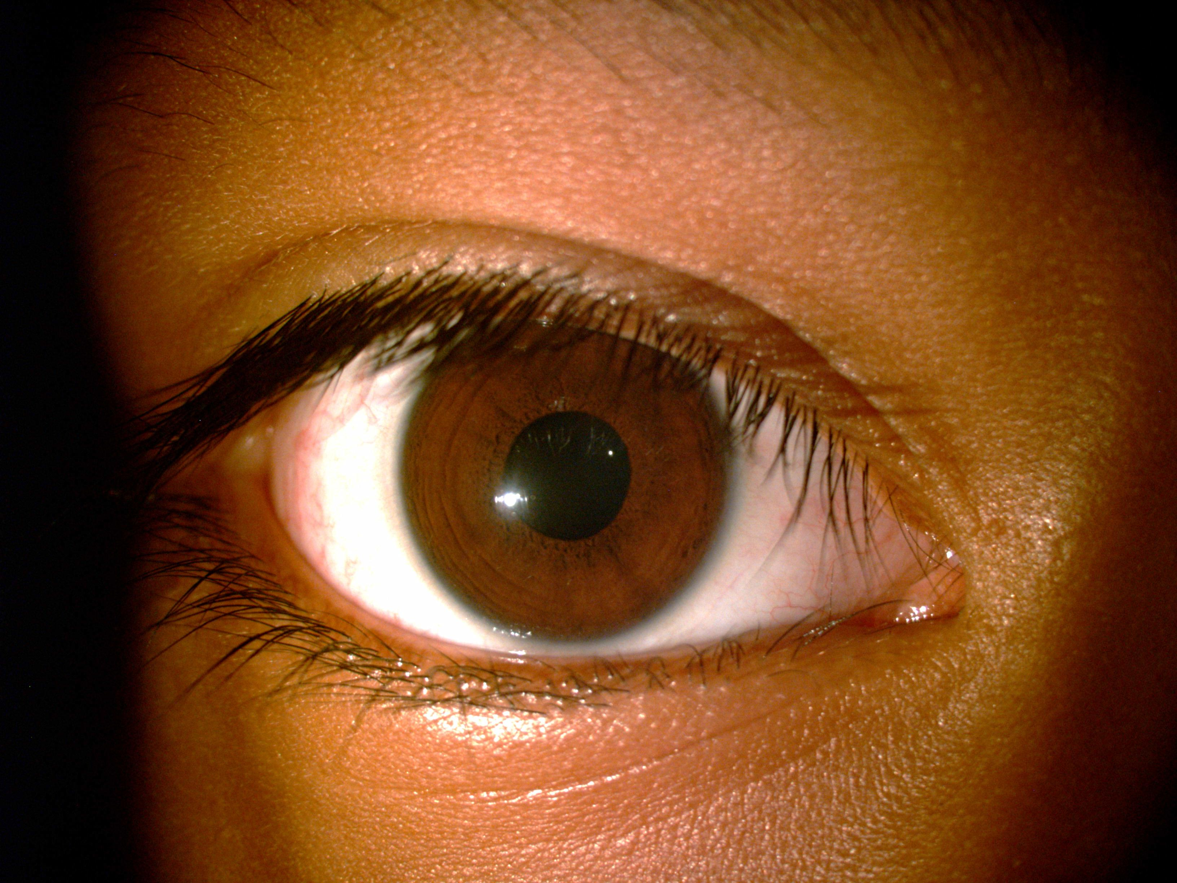
OD

Slide 7
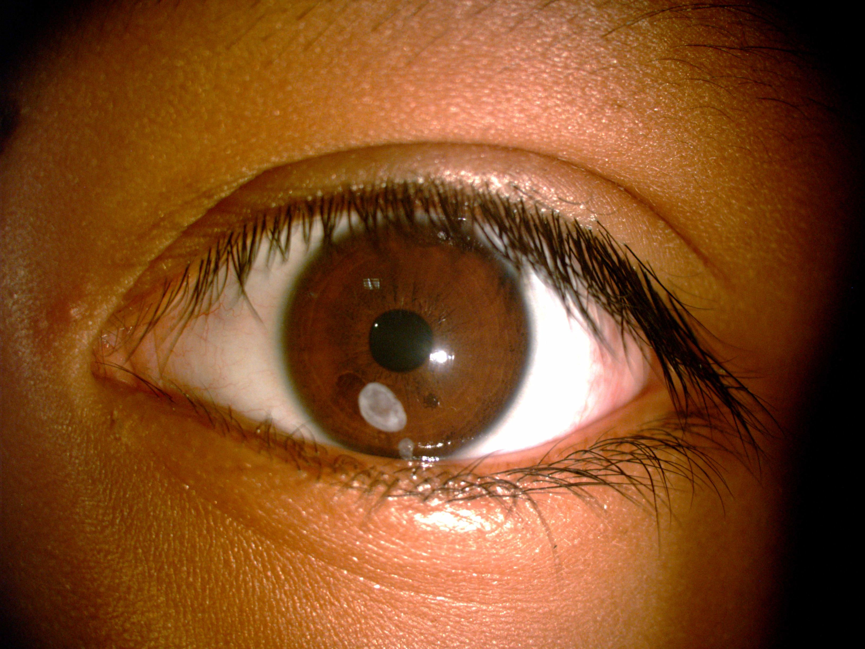
OS

Slide 8
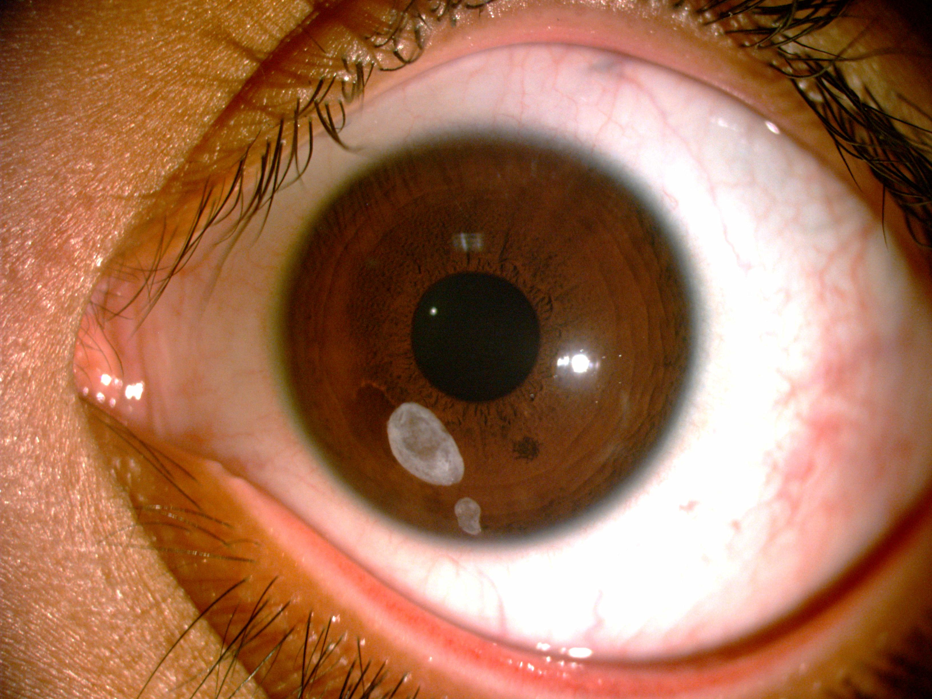
OS

Slide 9
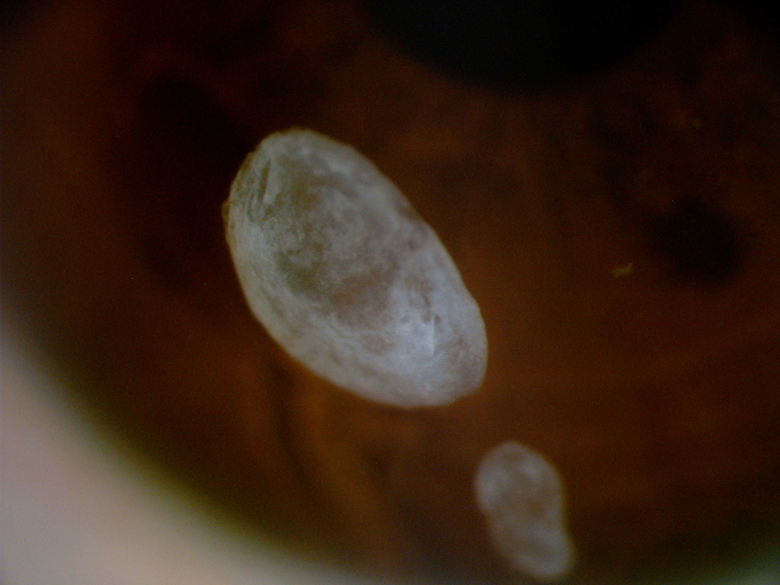
OS

Slide 10
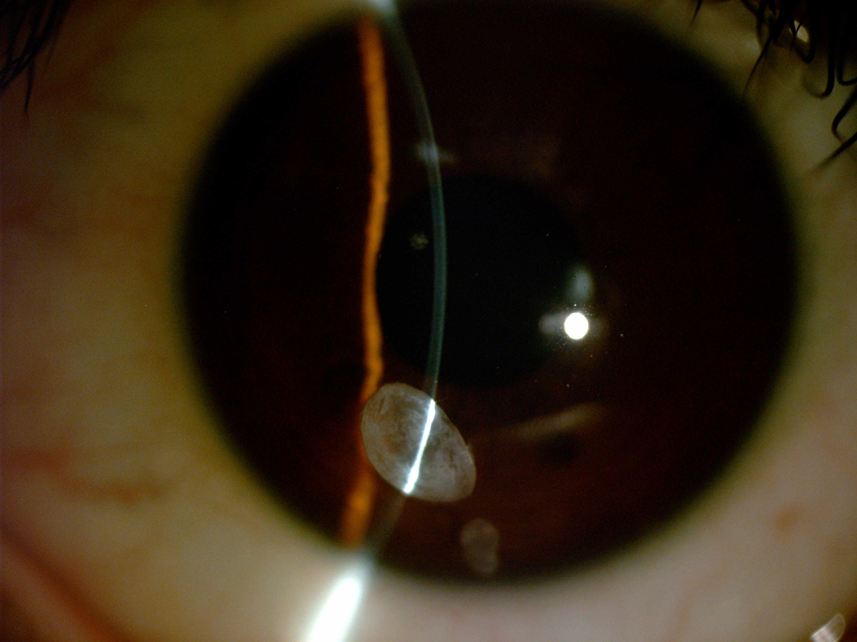
OS

Slide 11
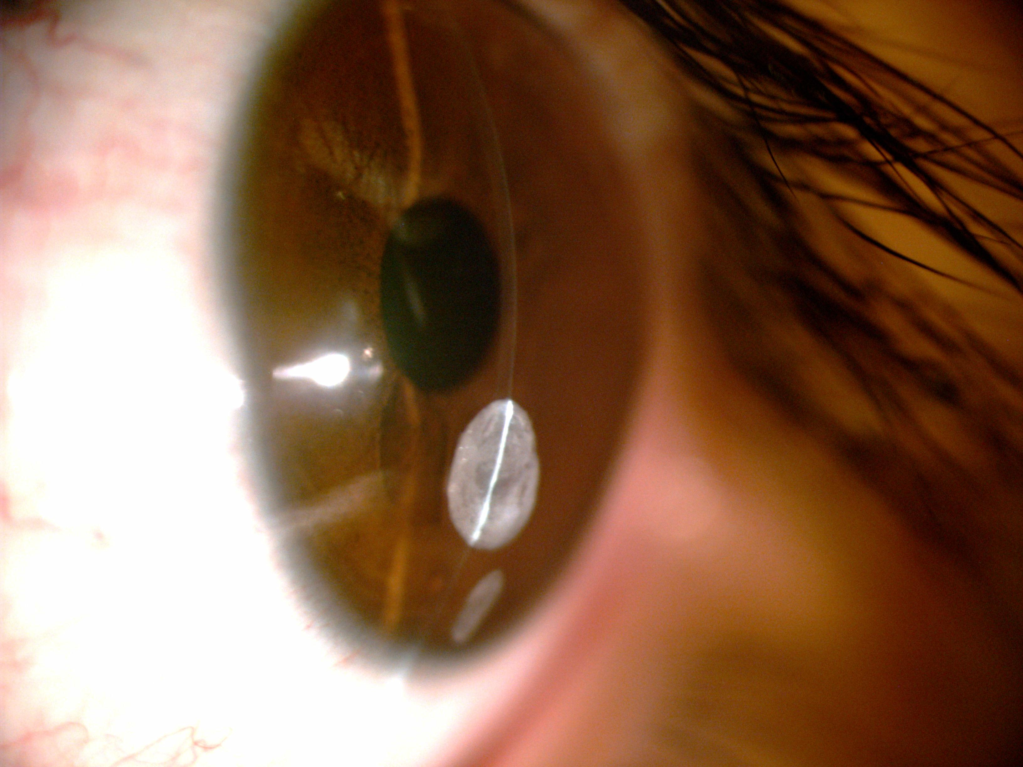
OS

Slide 12
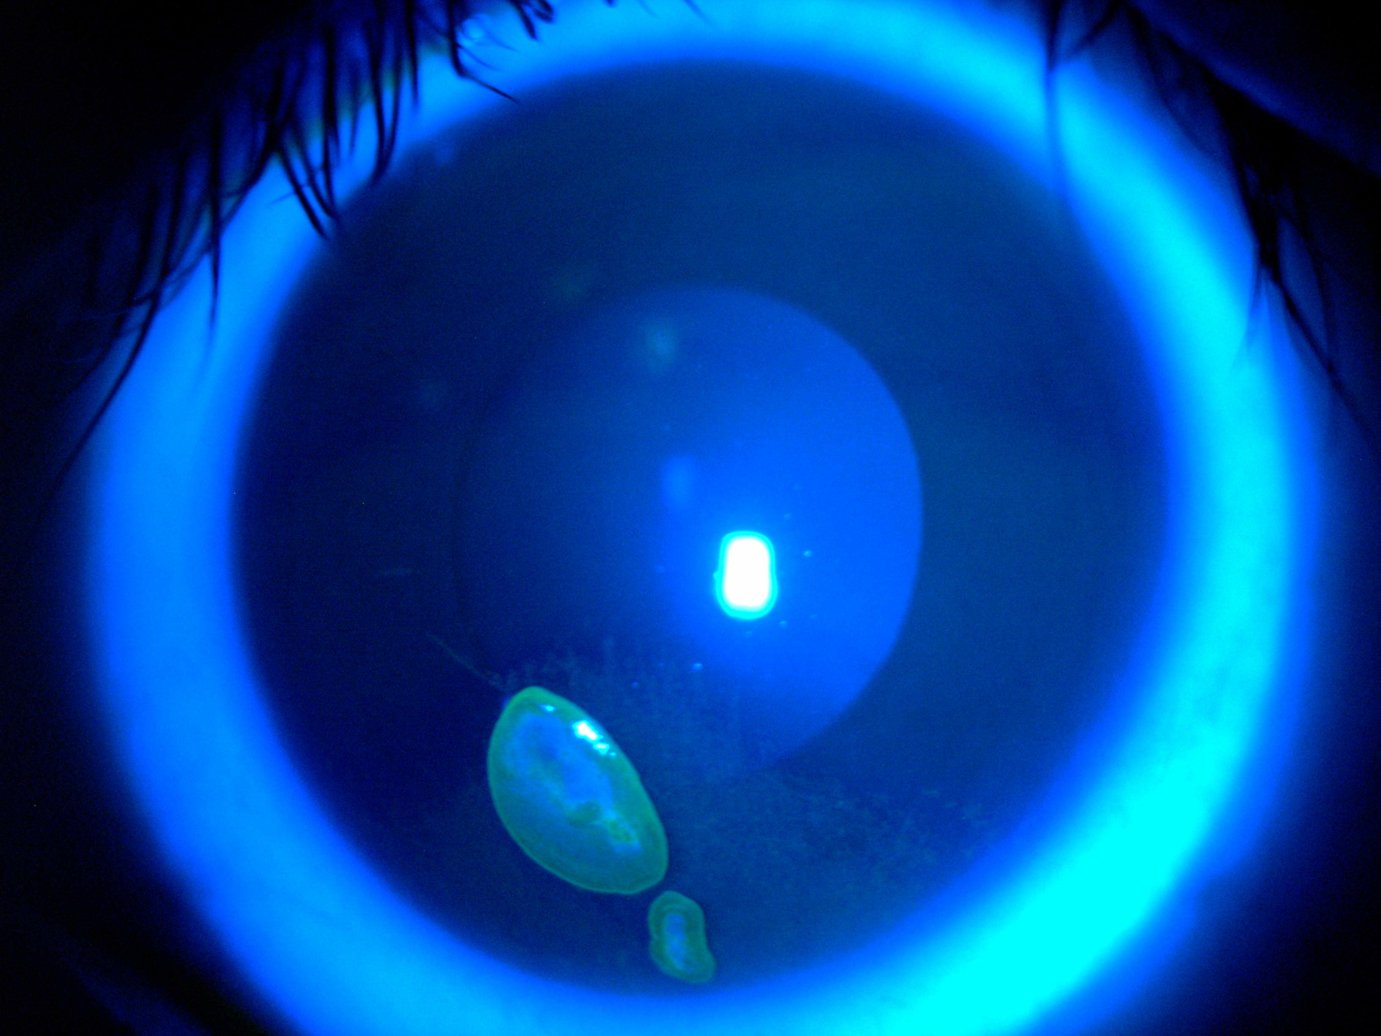
OS
Notes:
Fluorescein examination with blue cobalt light shows punctate superficial keratitis.

Slide 13
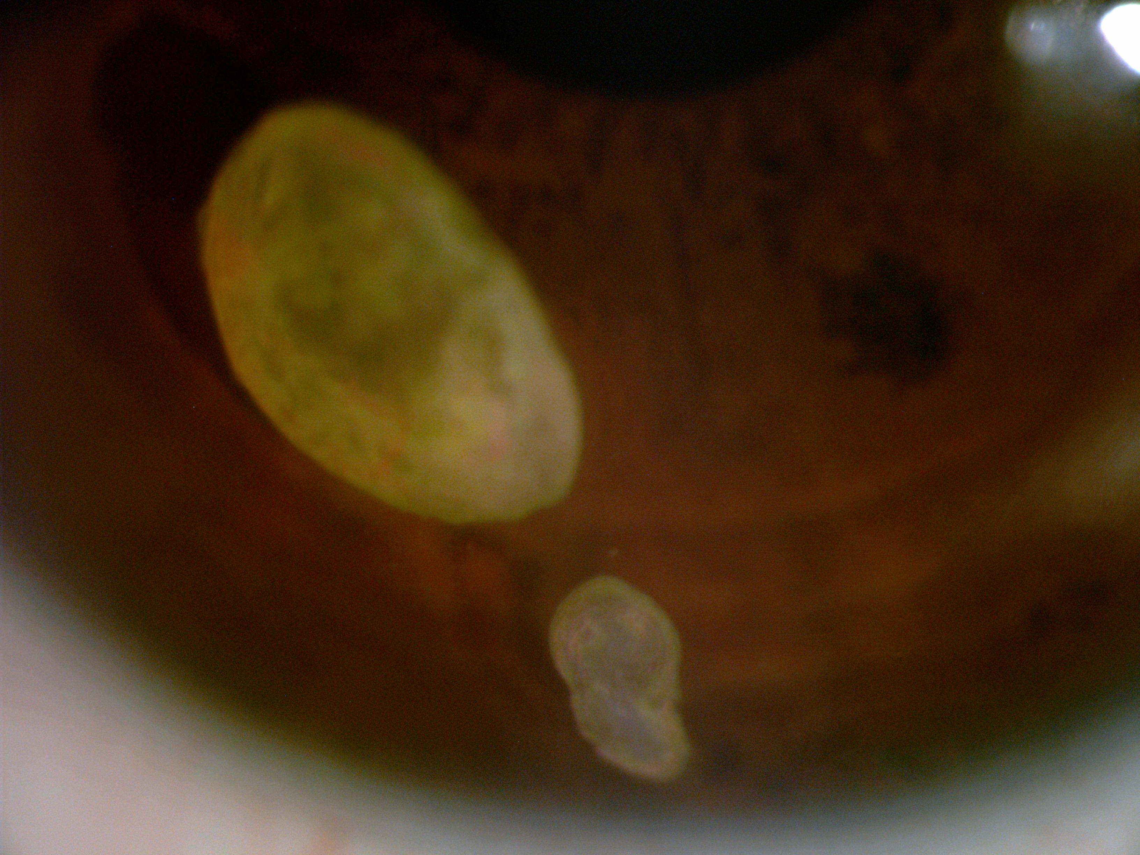
OS

Slide 14
OS

Slide 15
OS

Slide 16
DIFFERENTIAL DIAGNOSIS
KELOID-LIKE MYOBLASTIC/MYOFIFROBLASTIC PROLIFERATION
INFECTIOUS PSEUDOCRYSTALLINE KERATOPATHY
CALCIFIC BAND KERATOPATHY
CHRONIC ACTINIC KERATOPATHY

Slide 17
PATHOLOGY

Slide 18
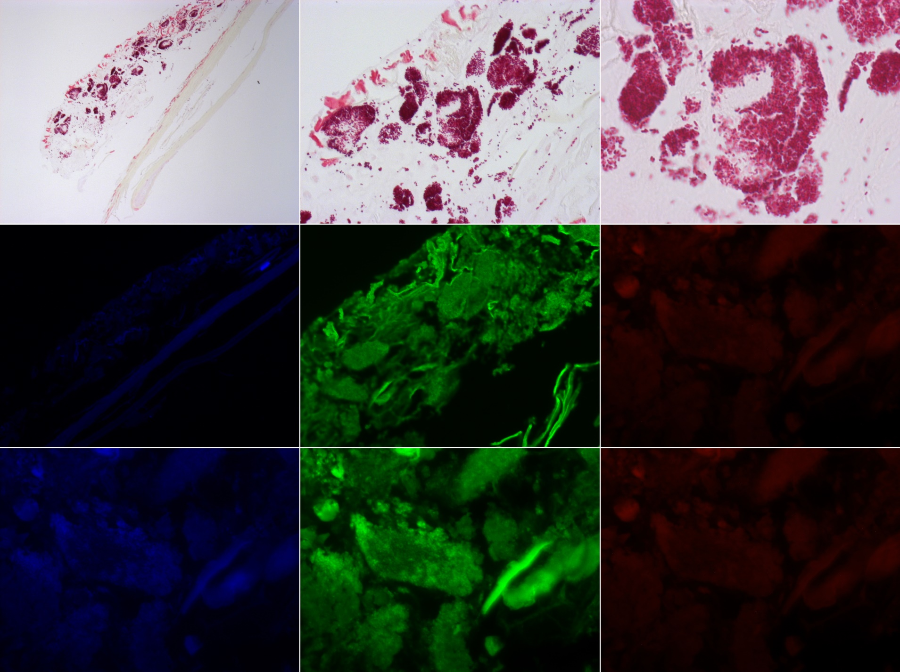

Slide 19
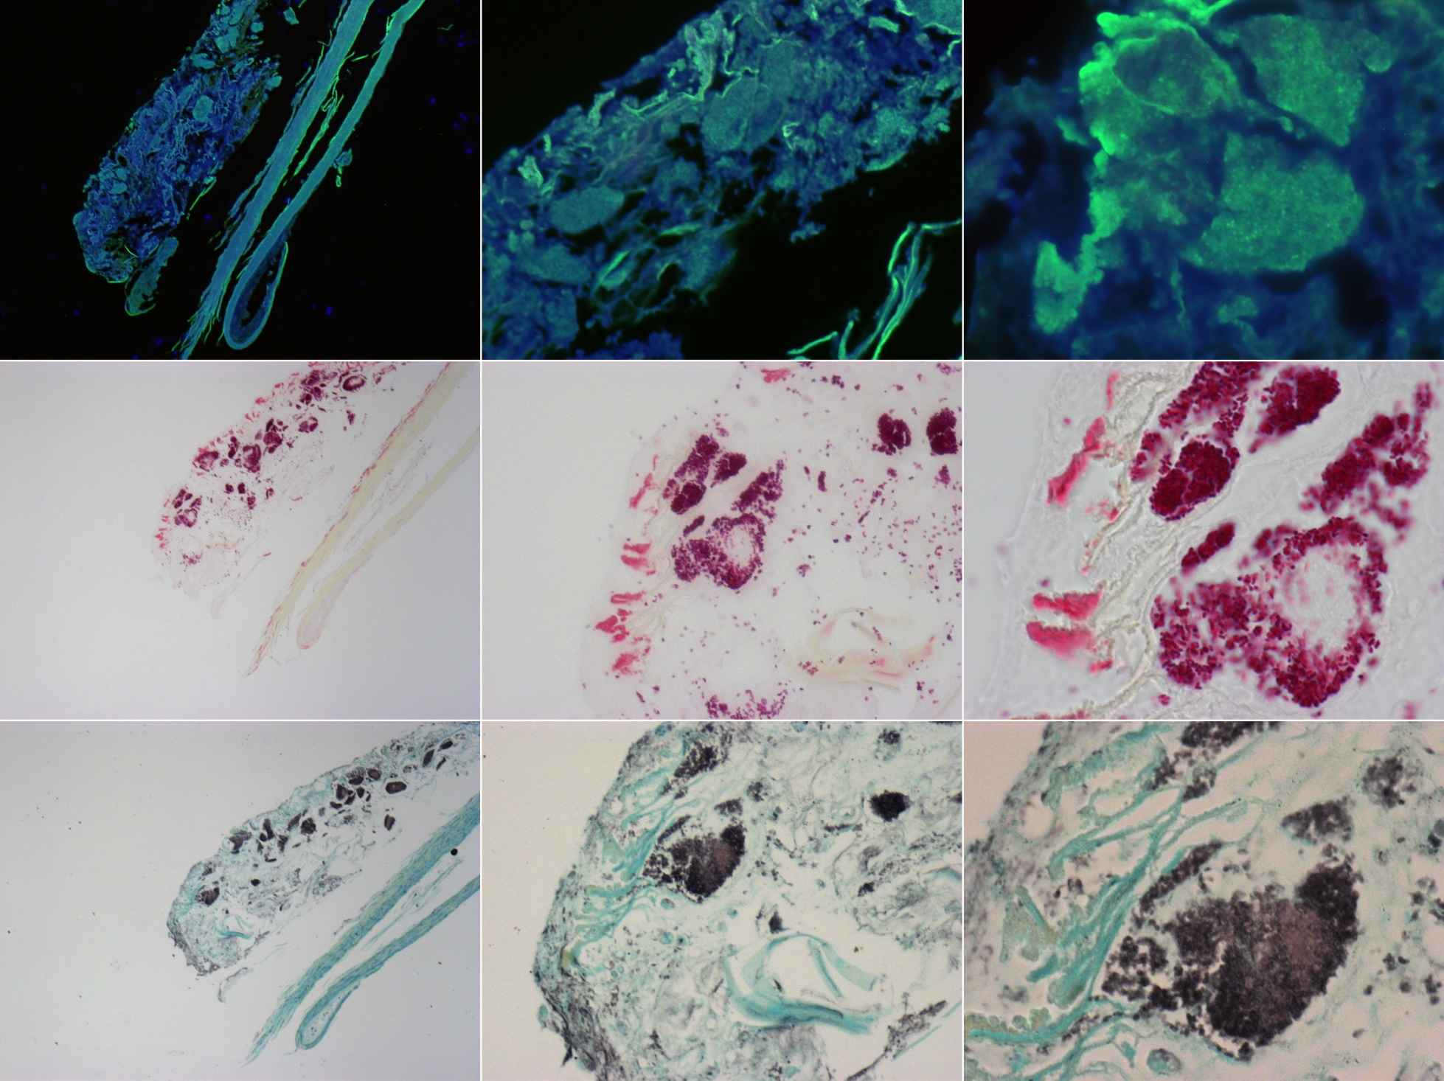

Slide 20
BIOFILM

