Slide 1
50-year-old male admitted to the hospital for left hemiparesis.
Lananh Nguyen, M.D.
Division of Neuropathology
University of Pittsburgh Medical Center

Slide 2
History
The patient had been well until five days earlier, when a right frontal headache developed with radiation to the right eye and right ear
Her physician prescribed amoxicillin, suspecting sinusitis
Four days before admission, weakness developed in the left arm, and she began to drop items that she was holding in her left hand
During the next three days, the weakness worsened
On the day of admission, she awoke with weakness in the left leg; at one point, she fell from a chair and was unable to rise or walk.

Slide 3
What more do you want to know?

Slide 4
History
Past medical history
There was a history of similar headaches associated with sinusitis
These headaches had usually been accompanied by rhinorrhea, which was absent on this occasion
Her family had noted increasing somnolence during recent days but had observed no confusion or other neurologic symptoms except for the left hemiparesis
She was in excellent health
Four dental cavities had been filled during the preceding two weeks
Social History
Noncontributory
Family History
Noncontributory
Medications
No regular medications
Allergies
None

Slide 5
What do you want to do now?

Slide 6
Physical Exam
Vitals
Temperature = 36.8°C, Pulse = 65 beats per minute, Respiratory rate = 16 breaths per minute, Blood pressure = 125/80 mm Hg
Physical examination
Well appear with no acute distress
General examination were unremarkable and no cardiac abnormality was detected
Neurologic examination
Sleepy but alert and oriented, with fluent speech. Both pupils were 3 mm in diameter and constricted to 2 mm on exposure to light. Extraocular movements and the visual fields were intact
Weakness in the central area of the left side of the face was noted. Strength was 4/5 in the left deltoid, biceps, triceps, and forearm and hand grip muscles and in the interosseous, iliopsoas, quadriceps, hamstring, soleus, and gastrocnemius muscles and was 5/5 in the same muscles on the right side. There was no pronator drift of the outstretched arms. The sensation of a light touch was preserved. The deep-tendon reflexes were ++ bilaterally, and the plantar responses were flexor.

Slide 7
What is your differential?

Slide 8
What is your broad differential?
VITAMIN ACDE: basic algorithm for differential diagnosis
Vascular
Inflammatory
Trauma/Toxic
Autoimmune
Metabolic/Medication
Infection
Neoplastic
Acquired
Congenital
Degenerative
Endocrine

Slide 9
What do you want to do now…tests to order?

Slide 10
What do you want to do now…tests to order?
All laboratory tests are negative

Slide 11
What do you want to do now…imaging to order?

Slide 12
CT imaging (not shown)
Computed tomographic (CT) scanning of the head, performed without intravenous injection of contrast material, revealed a large, complex, mass in the right lobe
No hydrocephalus, evidence of infarction, intraparenchymal hemorrhage, abnormal collection of extra-axial fluid, or osseous abnormalities were noted.

Slide 13
What do you want to do now?

Slide 14
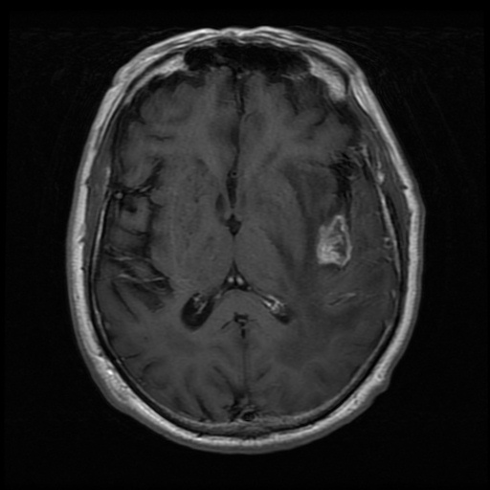
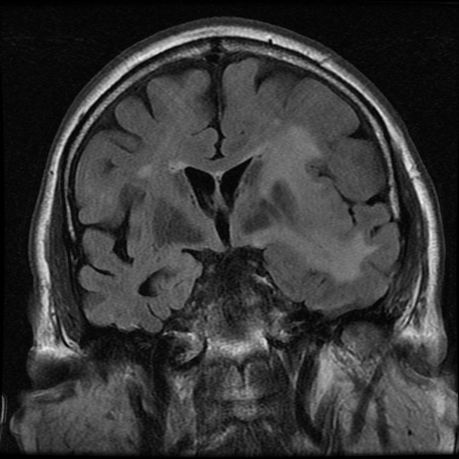
What is this test that was ordered next? Describe findings
Friedlander RM et al. N Engl J Med 2003;348:2125-2132.

Slide 15
What is this test that was ordered next? Describe findings
MRI on shows a ring enhancing mass surrounded by an area of hyperintensity, a finding consistent with edema along with a mass effect .
Friedlander RM et al. N Engl J Med 2003;348:2125-2132.

Slide 16
What would you do next to get a definitive diagnosis?

Slide 17
What would you do next to get a definitive diagnosis?
A diagnostic procedure (biopsy) was performed.

Slide 18
Biopsy Specimen of the Mass in the Right Frontal Lobe.
What do you see?
Smear (Right click on hyperlink for virtual intraoperative smear)
H&E slide (Right click on hyperlink for virtual permanent/formalin fixed section)

Slide 19
Biopsy Specimen of the Mass in the Right Frontal Lobe.
Examination of a smear revealed acute inflammatory cells, macrophages, and necrotic debris. No tumor cells were found.
Histologic sections stained with hematoxylin and eosin consisted predominantly of necrotic tissue with a neutrophilic infiltrate. Viable fragments of brain contained granulation tissue.
There was no evidence of tumor.
A Gram's stain revealed innumerable gram-positive cocci.
The findings are those of a brain abscess.

Slide 20
Discussion
The differential diagnosis in this case includes a brain abscess and a cystic neoplasm.
The imaging characteristics, particularly the presence of a central core of restricted diffusion within the lesion, point convincingly to a cerebral abscess. Possible sources of infection are suggested by the patient's several bouts of sinusitis and the recent filling of several dental cavities. Because there is no current evidence of sinusitis, an odontogenic source is more likely.
The likely organisms include one or more of the following: streptococcus (Streptococcus milleri being the most common), bacteroides, haemophilus, prevotella, and fusobacterium.
The next step in this case should be image-guided, stereotactic needle aspiration of the contents of the lesion. This procedure is both diagnostic and therapeutic. The analysis and culture of the contents would confirm the diagnosis and allow tailoring of the antibiotic regimen. Drainage of the contents would decrease the infectious burden.

Slide 21
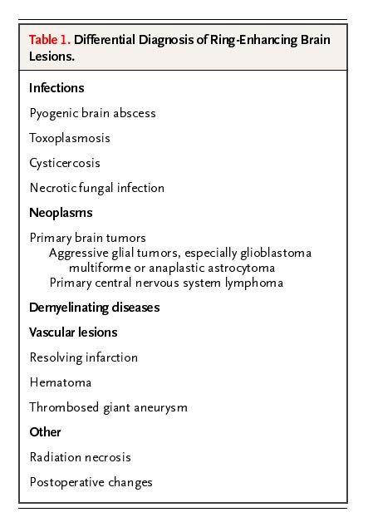
Differential Diagnosis of Ring-Enhancing Brain Lesions.
Friedlander RM et al. N Engl J Med 2003;348:2125-2132.

