Slide 1
57-year-old male with worsening dizziness and balance problems
Lananh Nguyen, M.D.
Division of Neuropathology
University of Pittsburgh Medical Center

Slide 2
History
The patient has been in his usual state of health until about a week ago when he noticed worsening dizziness, balance problems, and being unsteady on his feet.
In addition, he had headache, nausea, vomiting and very poor appetite.
These symptoms became significantly worse and he presented to Emergency Department for evaluation.

Slide 3
What other information would you like to obtain?

Slide 4
What other information would you like to obtain?
PAST MEDICAL HISTORY: He denies any diabetes, no cardiac disease, no asthma. He does not use any inhalers. He had an injury 4 years ago for which he needed an MRI, but the details are not clear.
FAMILY HISTORY: Noncontributory.
PAST SURGICAL HISTORY: None reported.
MEDICATIONS: None.
ALLERGIES: NO KNOWN DRUG ALLERGIES.
SOCIAL HISTORY: The patient is a lifelong smoker about 1 pack per day. He drinks alcohol, maybe a few beers a day, but his last drink was about 2 weeks ago.

Slide 5
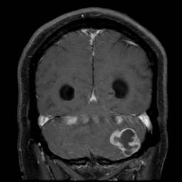
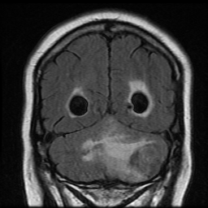
What is this imaging and the findings?

Slide 6
What is this imaging and the findings?
MRI with contrast (left) shows ring enhancing mass lesion at the left inferior cerebellum with significant mass effect on the fourth ventricle resulting in obstruction of the aqueduct with mild ventricular dilation.
MRI T2 FLAIR (right) shows extensive edema surrounding the mass lesion.

Slide 7
What other information would you like to obtain?

Slide 8
What other information would you like to obtain?
Do a biopsy

Slide 9
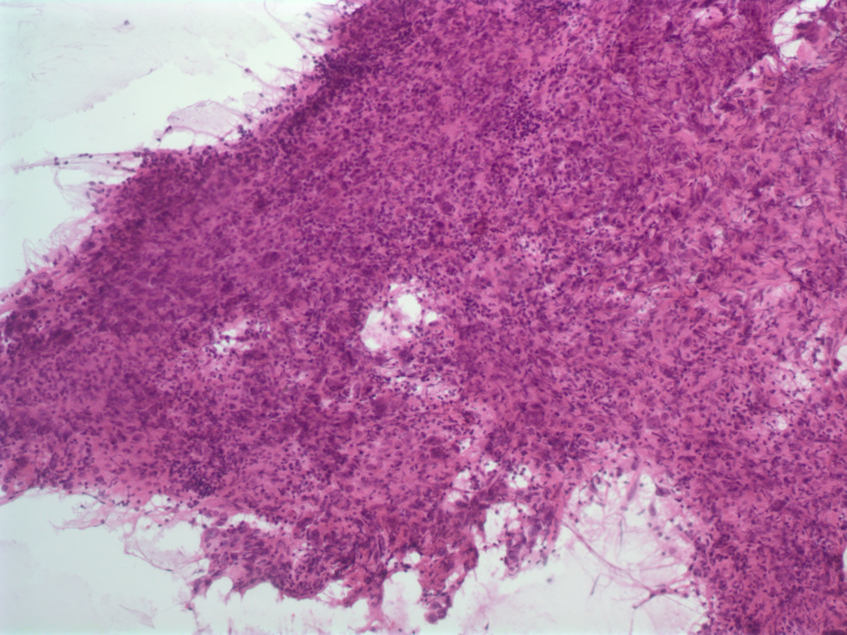
Intraoperative evaluation by the pathologist shows the following

Slide 10
What is the first question to ask yourself?

Slide 11
Lesional tissue or not i.e. did the surgeon hit the target?

Slide 12
What is the second question?

Slide 13
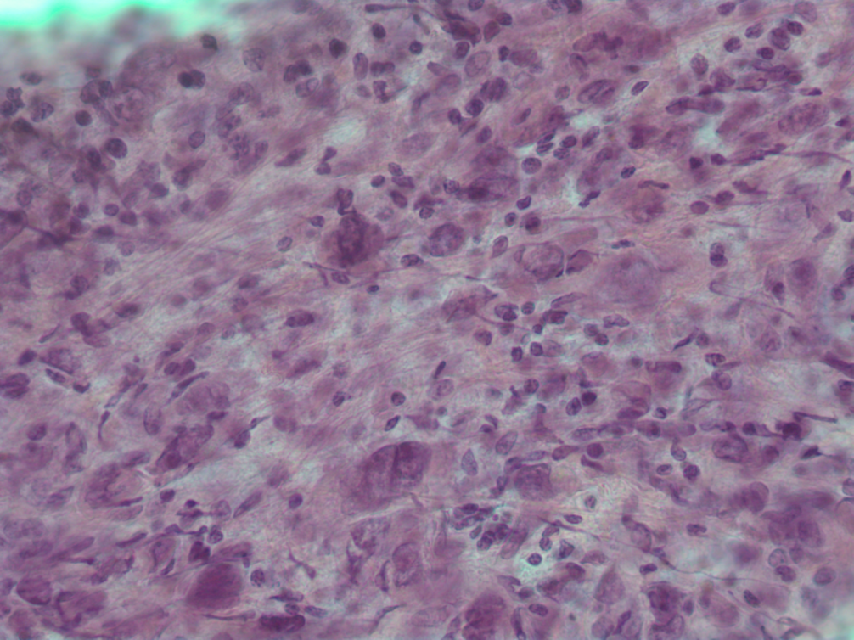
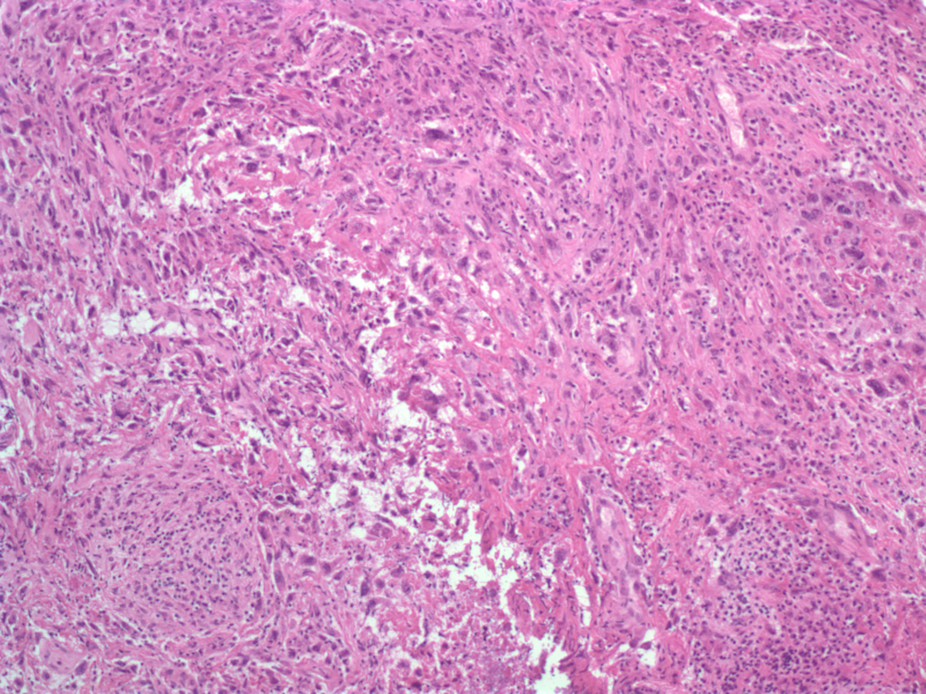
Benign or malignant? Here are more images.

Slide 14
What is the third question?

Slide 15
Primary or metastatic lesion?

Slide 16
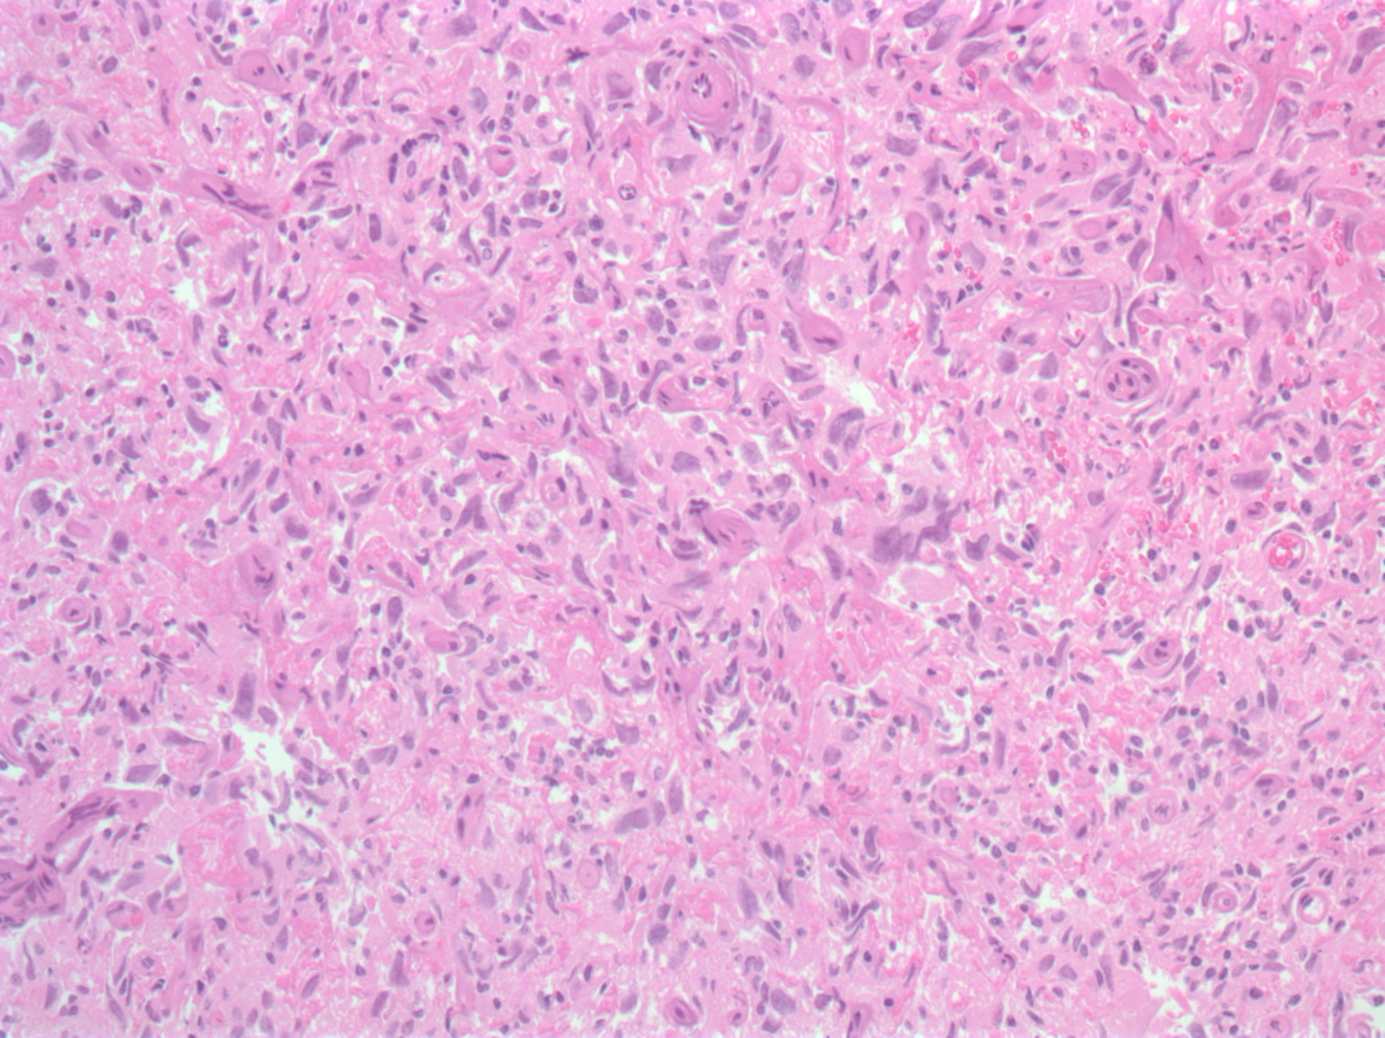
Here are the permanent slides. What do you think?

Slide 17
What stains would you order?

Slide 18
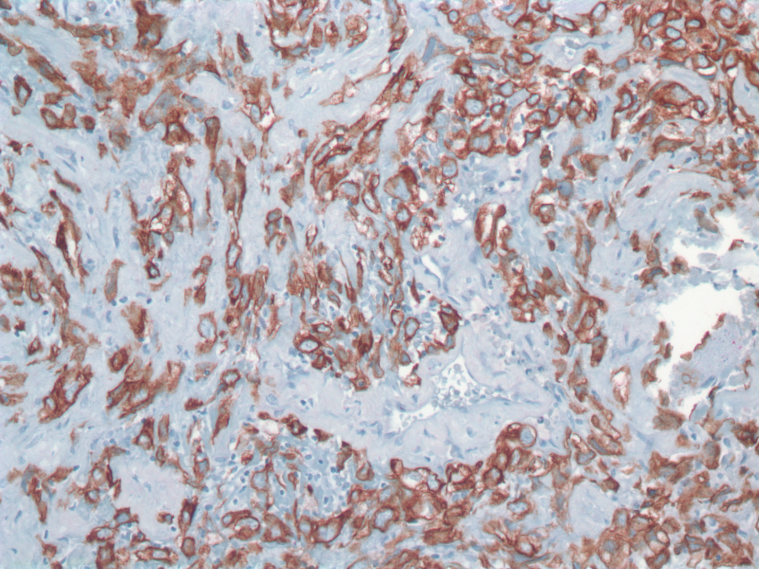
The pathologist ordered pankeratin. What is the DDx and what other stains would your order?

Slide 19
These are the results of the stains ordered. What is your final diagnosis?
CK 5/6 positive
CK7 negative
CK20 negative
TTF1 negative
S100 negative

Slide 20
These are the results of the stains ordered. What is your final diagnosis?
CK 5/6 positive
CK7 negative
CK20 negative
TTF1 negative
S100 negative
Based on the immunophenotype, this suggests a metastatic lesion from a lung primary, likely squamous cell carcinoma

Slide 21
With the final diagnosis rendered below, are you done?
Metastatic carcinoma, likely squamous cell carcinoma of lung origin.

Slide 22
With the final diagnosis rendered, are you done?
No
Send slides for molecular analysis for mutational identification which is integral to therapy and prognosis
Lung carcinomas have many oncogenes for which there is targeted therapy.
For adenocarcinomas, KRAS mutations are most common followed by EGFR, ALK, and MET, among many others
For example, EGFR mutated carcinomas are treated with tyrosine kinase inhibitors
These studies have shown an improved prognosis and survival
For squamous cell carcinomas, FGFR1 mutations are most common followed by PIK3CA and many yet unknown mutations.
Correlate with chest imaging

Slide 23
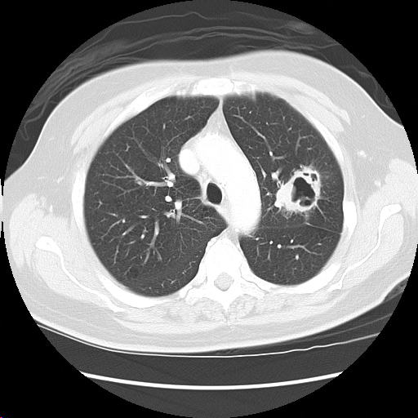
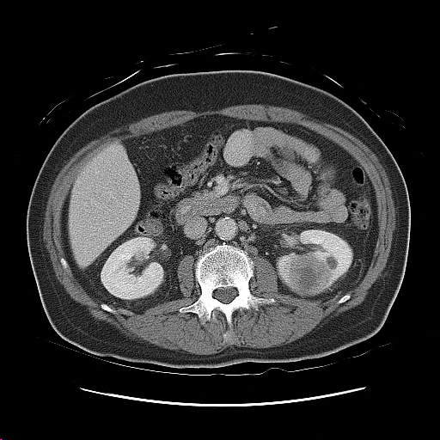
This is what was found on further imaging
Chest CT Abdomen CT
Correlates with the pathologic findings of lung carcinoma and clinical history of smoking

