Slide 1
Case Study 113 Ophthalmoplegia
Swati Laroia, DO
PGY III-Neurology

Slide 2
HPI
A 59 yr old AA F presented in March 2015 to the ED with left sided headaches, blurry vision and double vision of the left eye that began when she woke up one morning three weeks prior.
She visited her optometrist who recommended she visit the ER.

Slide 3
HPI
Review of Symptoms:
(-)Numbness
(-)Focal Weakness
(-) Ataxia
(-) Speech Changes
(-) CP
(-) Vertigo
(-) Parasthesias
(+) Headache
(+) Double Vision OS
(-) Double Vision OD
(+) Blurry Vision OS
(-) Blurry Vision OD

Slide 4
HPI
PMHx: HTN, HPL, DM type II with Peripheral Neuropathy, Morbid Obesity, Maffucci Syndrome, CKD Stage III, OSA, COPD
PSurgHx: TAH with B/L SBO, Multiple Foot Surgeries to remove Maffucci Lesions, Skin Graft RLE
FamilyHx: Bone Cancer (Maternal), MI (Paternal)

Slide 5
Physical Exam
General: morbidly obese female
Cardiac: RRR
Lungs: CTA B/L
GI: Soft, Nontender, Non Distended
Integ: Soft, Dry Intact
Neurological:
Cranial Nerves: +Ptosis of OS, PERRLA OD, Pupil unreactive to direct and consensual response OS, EOMI OD, EOMI limited OS with inability to adduct or elevate, On neutral gaze OS is abducted, depressed, intorted, Facial Expression Symmetrical B/L, Facial Sensation to Pinprick B/L Intact, Tongue Midline, Uvula Midline, Shoulder Shrug 5/5
MSK: 5/5 UE and -5/5 LE B/L
Reflexes: 2/4 UE and LE B/L, Downgoing Toes B/L
Cerebellar: FNF Intact B/L, Heel to Shin Intact B/L
Sensory: Intact to Pinprick UE and Le B/L

Slide 6
What CN is affected?

Slide 7
What CN is affected?
CN III

Slide 8
Differential Diagnosis?
Ischemic CVA
SAH
Aneurysm of PCOM
Aneurysm of ICA
Trauma
Mass
Diabetic Mononeuropathy
Lyme
Sjogrens
Sarcoid
Migraine
Myasthenia Gravis

Slide 9
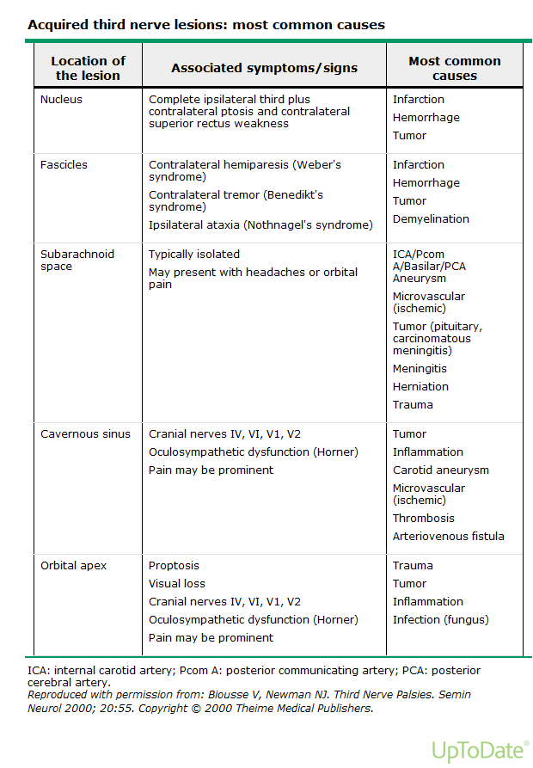

Slide 10
Work-UP
-CT and CTA head and neck
-MRI brain with and without contrast
-Echo, Carotid U/S, A1c, and Lipid panel
-ACE, ANA, RF, TSH, Lyme titer, ESR, CRP, SSA, SSB ordered
-Ophthalmology consulted

Slide 11
Results
CTA Head: Negative
MRI Brain w/ and w/o contrast: Unable to perform secondary to body habitus
Echo: EF 60%, no shunt or valvular pathology noted
Carotid US: Normal
A1c: 8.4
LDL: 83
ACE: Negative
ANA: Negative
RF: Negative
TSH: Negative
Lyme Titer: Negative
ESR: Negative
CRP: Negative
SSA: Negative
SSB: Negative

Slide 12
What next?
Cerebral Angiogram

Slide 14
Discharge
With a negative study, patient sent home. Etiology thought to be secondary to poorly controlled DM II.
Follow up at Northshore Neurology.

Slide 15
Office Visits
May 2015
CN: Right Pupil Equal, Round, Reactive to Direct and Indirect Light. Left Pupil Not reactive to Direct or Indirect Light. EOMI Right Eye only. Left Pupil is down and out. Cannot Adduct, Upgaze, Downgaze. Can only move down and out. Facial Expression Intact B/L. Facial Sensation Intact to Gross Touch B/L. Tongue Midline. Optic Discs Intact B/L.
MSK: 4/5 UE B/L, 4/5 LE B/L
Cerebellar: intact to finger to nose, finger to finger B/L
Sensory: intact to gross touch B/L
Reflexes: 1/4 ue and le B/L
MS: Alert, Oriented to time, place, self
August 2015
CN: Right Pupil < Left Pupil. Left Pupil sluggish to react, Right Pupil reacts more briskly to direct light. Left Eye is midline, Left Ptosis, Left Eye does not UPgaze, Downgaze, Adduct. ABduction is also limited today on exam. Right Eye EOMI fully. Optic Discs Visualized, no Papilledema noted. Optic discs intact. Facial Sensation intact to Gross Touch. Facial Expression Intact B/L. Tongue and Uvula Midline
MSK: 5/5 UE and LE B/L
Reflexes: 1/4 LE B/L, 1/4 UE B/L
Sensory: UE and LE intact to gross touch
Cerebellar: Intact to heel to shin, finger to nose
MRI Ordered: ABNORMAL

Slide 16
Office Visits
September/October 2015
CN: Left Pupil > Right Pupil. Left pupil is unreactive to light. Optic Discs intact. Left EOM limited to adduction, abduction, upgaze and downgaze. Intorsion intact. Right EOMI. Tongue and Uvula midline. Decreased Sensation V1-V3 Left side only. Shoulder Shrug 5/5 B/L. Facial Expression Symmetrical
Follow up with MRI results
Saw Neurosurgery in Erie, PA
Ordered repeat CTA Head: ABNORMAL
Referred STAT to UPMC Presby

Slide 17
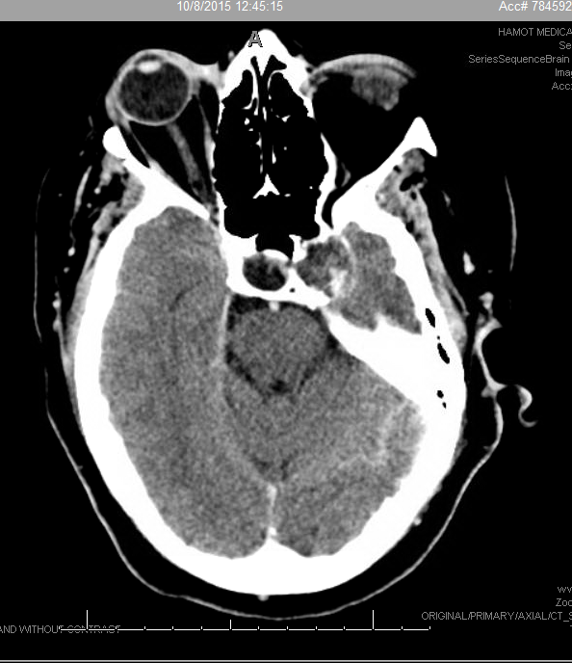

Slide 18
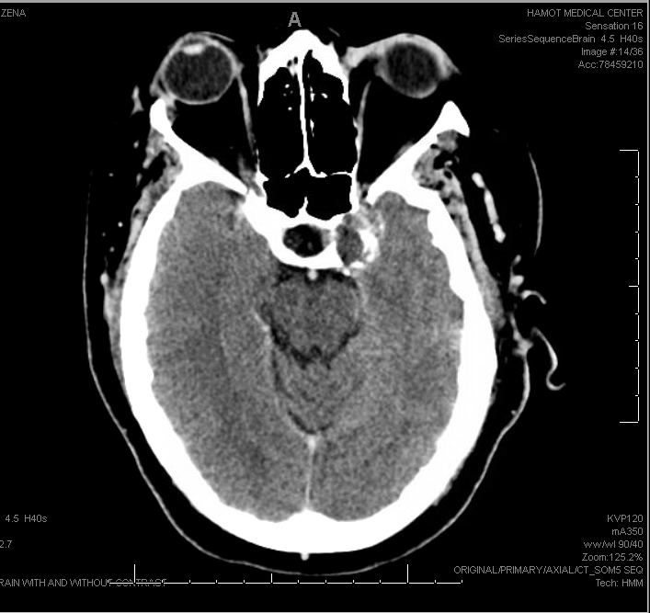

Slide 19
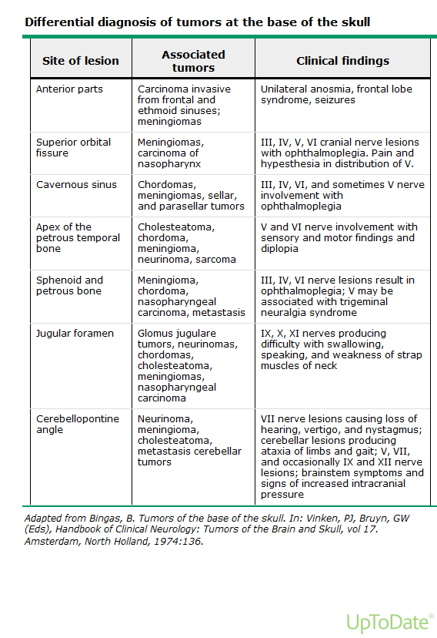

Slide 20
Cavernous Sinus

Slide 21
OR
The patient underwent a endoscopic endonasal tumor resection
Per Operative Report: Removed the Tumor from the Internal Carotid Artery, Inferior, Cavernous Sinus Compartment and Medial Wall of the Cavernous Sinus.
Post OP Diagnosis: Petroclival Chondrosarcoma with Cavernous Sinus Invasion

Slide 22
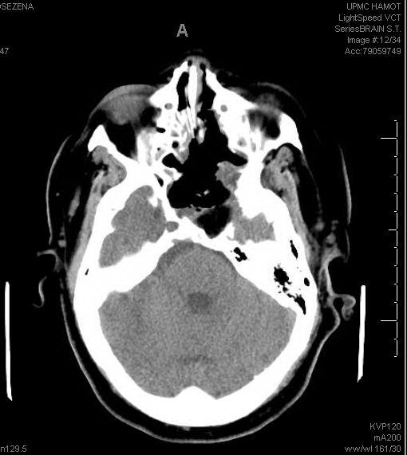
Post OP CT Scans

Slide 23
Smear

Slide 24
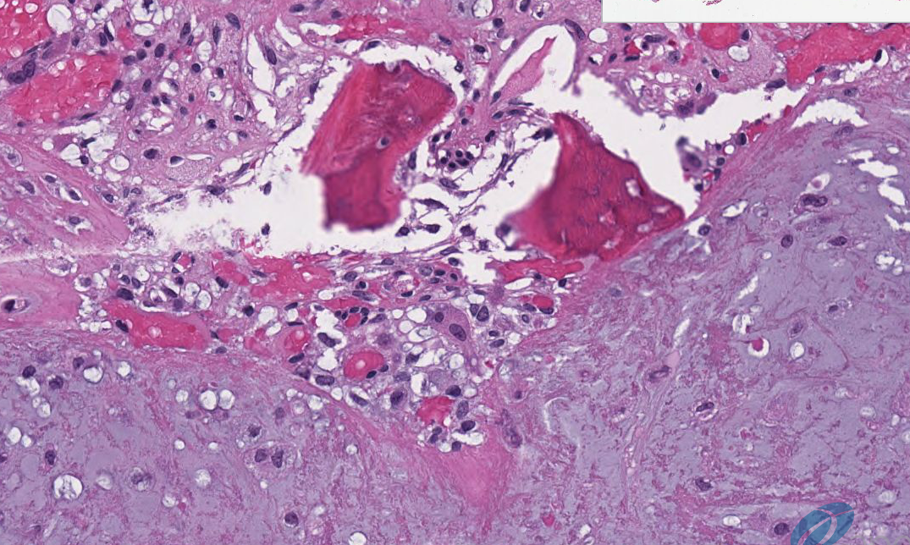
Paraffin
Left Arrow: Large Chondrocytes
Right Arrow: Binucleated Cell

Slide 25
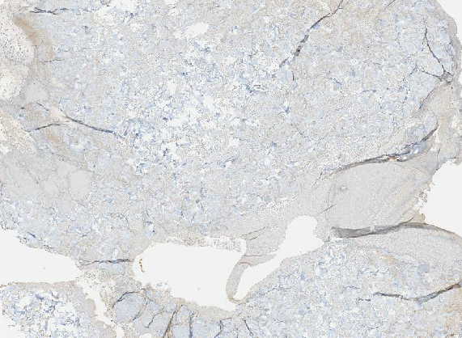
Brachyury (-)

Slide 26
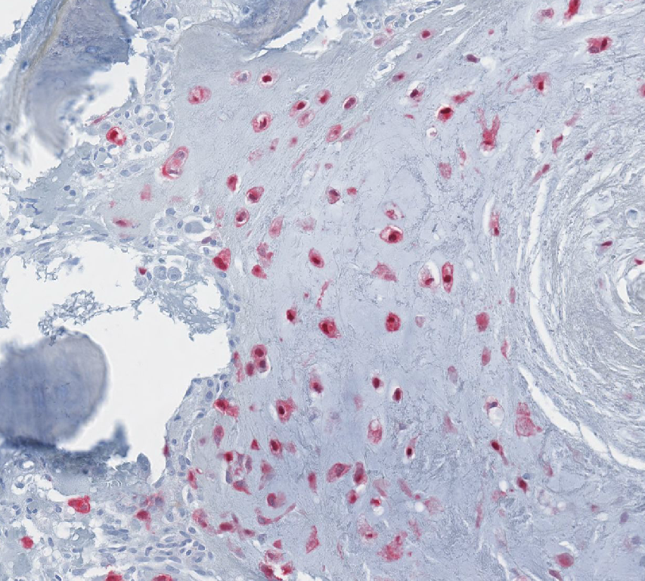
S-100 (+)
Cytokeratin

Slide 27
Gross Pathology

Slide 28
Chordoma vs Chondrosarcoma
There are no pathognomonic imaging findings that distinguish chordoma from chondrosarcoma
Chordomas are rare, slow growing, locally aggressive neoplasms of bone that arise from embryonic remnants of the notochord
On gross examination, chordomas are gelatinous, pink or gray masses with solid and cystic areas
Chordoma’s are composed of lobules that contain epithelioid cells arranged in cords or clusters and separated by fibrous strands in mucinous matrix
Chordoma:
Abundant vacuolated, soap bubble-like cytoplasm
(+) Cytokeratin
(+) S100
(+) Brachyury

Slide 29
Chondrosarcoma
Malignant tumor that produces cartilaginous material
3rd most common primary malignancy of bone
The most commonly involved skeletal sites are the proximal femur, bones of the pelvis (particularly the ilium), and proximal humerus followed by distal femur, ribs, tibia, and metacarpal and metatarsal bones
Other less frequently involved sites include the spine, the skull base, and the craniofacial bones.

Slide 30
Chondrosarcoma: Skull Base
Most patients with skull based tumors complain of headache and intermittent diplopia
Invasion of the cavernous sinus can produce diplopia and facial numbness
Chordomas tend to originate from the clivus while chondrosarcomas from the petroclival fissure
Will often seen calcifications associated with chondrosarcomas
Ring forming calcifications seen on CT scans can be correlated with the histological pattern of calcification

Slide 31
Chondrosarcoma
Biphasic pattern of spindle shaped cells
Well-differentiated cartilage
(+) S-100
(-) Brachyury
(-) Keratin

Slide 32
Chondrosarcoma
Smooth, lobulated, hard tumors
Will show binucleated pattern, not seen in chordomas
Most common are ACT/CS1 or grade 2

Slide 33
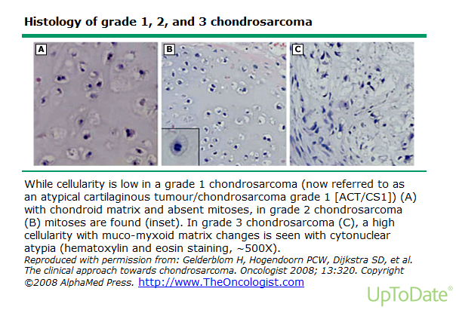

Slide 34
Maffucci Syndrome
Caused by a mutation in the gene(s) Isocitrate Dehydrogenase 1 (IDH1)/ (IDH2)
First sign usually appears in childhood, with growth of a enchondroma
Enchondromas distort and weaken the affected bones, thus presentation with a pathologic fracture is common
The more enchondromas, the higher the risk of developing chondrosarcoma
Enchondromas can transform into chondrosarcomas (15%)

Slide 35
Maffucci Syndrome
IDH1/2 mutations also cause gliomas
Maffucci patients are at an increased risk of developing glial tumors due to the IDH1/2 mutation
IDH1/2 mutations in gliomas result in specific amino acid changes that causes the enzyme to change

Slide 36
Maffucci Syndrome
The mutant enzyme loses the ability to convert isocitrate to α-ketoglutarate
The mutant enzyme then gains a new function that leads to accumulation of δ-2-hydroxyglutarate
Increased levels of δ-2-hydroxyglutarate correlate with tumourigenesis

Slide 37
Maffucci Syndrome
Intracranial chondrosarcomas are rare, with only 15 cases of skull base chondrosarcomas reported in association with Maffucci syndrome
The mean age of patients at the time of being diagnosed with an intracranial malignancy in Maffucci syndrome is 36

Slide 38
References
Amary, Fernanda M. “IDH1 and IDH2 mutations are frequent events in central chondrosarcoma and central and periosteal chondromas but not in other mesenchymal tumors.” Journal of Pathology 224 (2011): 334-343. Web. 13 June. 2016.
Burrowes, David. “Maffucci Syndrome and Intracranial Chondrosarcomas:A Case Report Featuring Spontaneous Resolution of Sixth Nerve Palsy.” Journal of Neuro-Ophthalmology 2015 35:41-44.
Ranger, Adrianna. “Do Intracranial Neoplasms Differ In Ollier Diseae and Maffucci Syndrome?” Neurosurgery-Online. 2009. 65: 1106-1115.
Stenbichler et al.: “Chondrosarcoma of the nasal cavity in a patient with Maffucci Syndrome: Case Report and Review of the Literature.” World Journal of Surgical Oncology 2014 12:387.
http://www.uptodate.com/contents/benign-bone-tumors-in-children-and-adolescents-an-overview?source=search_result&search=maffucci+syndrome&selectedTitle=1%7E3#H15
http://www.uptodate.com/contents/chondrosarcoma?source=search_result&search=maffucci+syndrome&selectedTitle=2%7E3
http://www.uptodate.com/contents/chordoma-and-chondrosarcoma-of-the-skull-base?source=see_link
http://rarediseases.org/rare-diseases/maffucci-syndrome/

