Slide 1
Case Study 111 60 yo w/ Depression
Semira Ramic, DO PGY3

Slide 2
Clinical History
60 yo F presenting to ED unresponsive and intubated s/p CPR in the field after being found in garage with her car running.
PMHx
Depression, Anxiety, Previous Psychiatric hospitalization
PSHx
C6 Discectomy, thumb, and appendectomy
Social Hx
Quit smoking 5-10yrs ago, 40 + pack year smoking history.
Family Hx
unknown
Medications
Tylenol PRN
Xanax PRN
Paxil
Allergies
NKDA

Slide 3
ROS
Unable to obtain secondary to patient’s mental status.

Slide 4
Physical Examination
Vitals: BP 78/57, HR 114, RR 26, T 36.8.
General: Intubated and on no sedation, appears in no acute distress.
Cardiac: Tachycardic, regular, no M/R/G
Resp: Crackles throughout.
Abd: BS+, no organomegally
Ext: No edema, normal bulk
Skin: Erythematous demarcated areas c/w acute pressure injuries on R hip and latera sides of BL knees.
Neuro:
GSCS- 6
Mental status- No response to loud voice or noxious stimulus
CN- PERRL, +VOR, + Cough, +Gag, No blink to threat BL
Sensory- withdraws to pain symmetrically throughout
Motor- see sensory, no spontaneous movements noted
Reflexes- +2/4 Globally, down going toes BL.
Coordination- Unable to assess due to mental status
Gait- unable to assess due to mental status.

Slide 5
What is the differential diagnosis based on the clinical data?

Slide 6
Differential Diagnosis
Vascular
Acute CVA (posterior since she has no focal weakness). Cardiac arrest and resultant Anoxic Brain injury. ICH.
Infectious
Sepsis, Meningitis, Encephalitis
Toxic/ Trauma
CO poisoning, Overdose of medications (Xanax, SSRI), Ingestion ( chemicals in garage), EtOH .
Trauma
Autoimmune
Adrenal/ Thyroid Dysfunction. Normally slowly progressing.
Metabolic
Diabetic Dysregulation, Diabetic Ketoacidosis. Electrolyte Imbalance leading to cardiac arrhythmia and arrest. Acute lactic acidosis.
Idiopathic
Seizure (Non Convulsive SE).
Neoplasm
Hx of Tobacco use but no known preceding symptoms.
Syndromes
Acute Respiratory Distress Syndrome , Depression/Suicide Attempt

Slide 7
Other Data.
Na- 141, K 4.2, Cl 108, CO2 16, BUN 16, Cr 1.3, Glu 107.
WBC 20.6, Hgb 11.7, Hct 36.3, Plt266.
ABG: pHa 7.32, PaCO2 33, PaO2 380, HCO3a 16, COHgb 24.0.
BCx –
UDS + for Benzo’s
ECG- Sinus Tachycardia. Left axis deviation, inferior infarct , age undetermined.
How do any of these data help refine the differential?

Slide 8
Other Data.
Elevated, nl between 3.8 -10.6. still concern for infection.
Nl 101-111, not concerning.
Nl 20-29, slightly low.
Na- 141, K 4.2, Cl 108, CO2 16, BUN 16, Cr 1.3, Glu 107.
WBC 20.6, Hgb 11.7, Hct 36.3, Plt266.
ABG: pHa 7.32, PaCO2 33, PaO2 380, HCO3a 16, COHgb 24.0.
BCx –
UDS + for Benzo’s
ECG- Sinus Tachycardia. Left axis deviation, inferior infarct , age undetermined.
How do any of these data help refine the differential?
Elevated because patient was oxygenated.
Nl Hgb for female is 11.6-14.6, Nl Hct for female is 34.1-43.3, no evidence of bleeding, not concerning.
Slightly low, suggesting mvery subtle acidosis, not concerning.
Significantly elevated suggestive of excessive CO.
She has rx for Benzo (Xanax), but overdose is still possible.

Slide 9
Differential Diagnosis
Vascular
Cardiac arrest and resultant Anoxic Brain injury. ICH
Infectious
Sepsis, Meningitis, Encephalitis
Toxic/ Trauma
CO poisoning, Overdose of medications (Xanax, SSRI), Ingestion ( chemicals in garage), EtOH .
Metabolic
Acute lactic acidosis.
Idiopathic
Seizure (Non Convulsive SE).
Syndromes
Depression/Suicide Attempt

Slide 10
Head CT
What are your findings?

Slide 11
Head CT
No acute findings or evidence of anoxic injury.

Slide 12
What changes could you see on unenhanced Head CT with anoxic brain injury?
Effacement of sulci
Loss of grey white differentiation
Slit like ventricles

Slide 13
Describe the MRI findings.

Slide 14
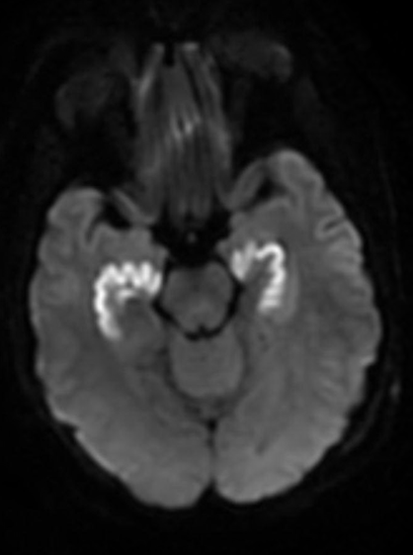
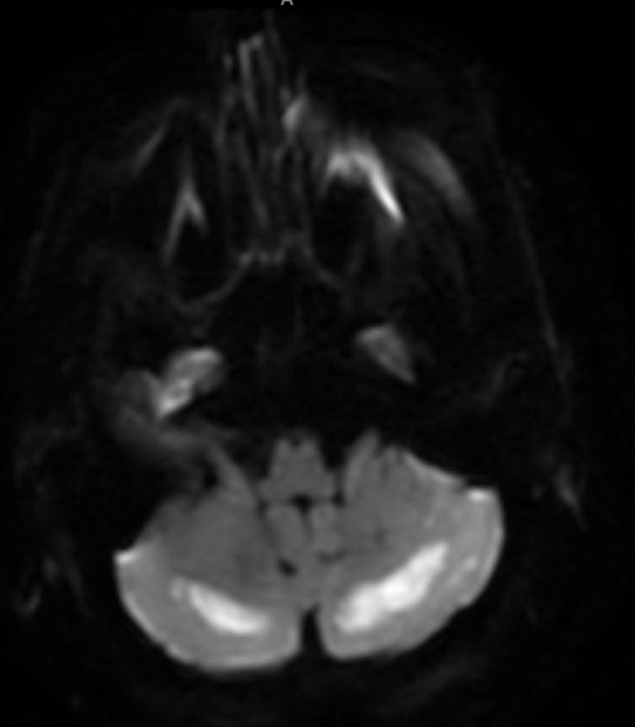
DWI

Slide 15
DWI

Slide 16
FLAIR

Slide 17
MRI Brain w/o Cont
Restricted diffusion and edema in BL hippocampi, BL Globus pallidi, and cerebellar hemispheres.
No mass effect
What does DWI measure? What does it mean?

Slide 18
DWI Measures random Brownian motion of water molecules within tissue. Simplified, a stationary water molecule retains it’s signal, a moving water molecule loses it’s signal. When cells and tissue are injured water diffusion does not occur like it did previously.
FLAIR sequence revealed Edema in these same locations.

Slide 19
What is the most likely diagnosis?
Carbon Monoxide Poisoning.
Patient was found unresponsive in a running car, history of depression, elevated carboxyhemoglobin level with characteristic ischemic changes on MRI in the BL globus pallidus. This presentation is very concerning for CO poisoning.

Slide 20
MRI reveals multiple pathologies.
Globus Pallidus is preferentially affected in CO poisoning.
Hippocampus is preferentially affected due to anoxic (perhaps during cardiac arrest in this case)
Cerebellum watershed region was affected due to hypoperfusion (patient presented hypotensive).

Slide 21
Carbon Monoxide
Colorless, odorless, poisonous gas.
Leading cause of poisoning death in the United States.^{[1,2]}
COHb level can be measured: normal range is 0-5%.
Common and early symptoms are usually nonspecific
Headache, altered mental status, dizziness, generalized weakness, N/V, CP and often attributed to viral syndrome.
Dermatologic manifestation, rare.
Cherry-red skin
Cutaneous bullae (excessive exposure).
Treatment
100% O2 via mask of ETT until patient is symptom free
Serial Neuro Exams.
Hyperbaric O2 therapy for severe cases
COHb level >25-30%, cardiac involvement, neurological impairment.

Slide 22
Carbon Monoxide
Eliminated through lungs.
Half Life
Room temp 3-4 hours
100% O2: 30-90 min
Hyperbaric O2 at 2.5 atm with 100% O2: 15-23min.
Therefore, a normal level does not rule out toxicity, especially if a few hours out or if patient received high flow O2.

Slide 23
Carbon Monoxide
Impairs oxygen delivery at the cellular level because of 230-270 times higher affinity for Hgb.
Even higher affinity to cardiac myoglobin.

Slide 24
Carbon Monoxide
This affects organs with the highest oxygen requirement most profoundly. (Brain and Heart).
After severe intoxication patient’s suffer from CNS pathology including white matter demyelination, leading to edema and focal areas of necrosis [4].
Particularly of the bilateral globus pallidi.
Lesions tend to be in watershed areas rather and not areas with high oxygen demand.
Cause is likely hypo perfusion.

Slide 25
Carbon Monoxide
Causes hypoxia by decreasing oxygen-carrying capacity of blood.
Anemic Hypoxia
If death occurs
Acute
High [Carboxyhemoglobin] produces bright red color in the brain prior to formalin fixation.
Edema as a result of diffuse hypoxia may also be seen
Subacute/Chronic
Characteristic pattern
BL cystic necrosis of globus pallidus
Grinker’s Myelinopathy may also occur
Multifocal, patchy white matter demyelination and destruction.

Slide 26
Patient dies one month after this event, what would you expect to see on gross evaluation of the brain?

Slide 28
What pathologic changes would you expect to see ?

Slide 29
Pathologic Findings of CO Poisoning
Essentially what is seen with Cerebral Hypoxia-Ischemia.
Acute Changes:
12-24 hours
Acute neuronal cell change, eosinophilic cell change.
Subacute Changes:
2 days to 2 weeks
Appearance of macrophages, capillary proliferation, astrocytes
Chronic Changes:
Months to years
Removal of necrosis tissue by macrophages
Liquefaction necrosis, cavitation of tissue.

Slide 30
H&E of Permanent
H&E
What are your findings?

Slide 32
Putamen
Extreme Capsule
Insular Cortex
Claustrum
Outer Globus Pallidus
External Capsule
Inner GP

Slide 33
How would you describe the globus pallidus?

Slide 34
Pale due to loss of background neuropil.
Edges of necrotic tissue reveals residual reactive astrocytes.

Slide 35
What Neuropathologic findings can you name on review of slides?

Slide 37
Globus Pallidus Rarefaction

Slide 39
Perivascular Macrophages

Slide 41
Residual Neurons

Slide 43
Reactive Astrocytes

Slide 44
References
US National Library of Medicine. A.D.A.M. Medical Encyclopedia. Carbon monoxide poisoning. Available at: http://www.ncbi.nlm.nih.gov/pubmedhealth/PMH0003333/ . Accessed September 30th, 2015.
Centers for Disease Control and Prevention. Carbon monoxide poisoning. Available at: http://www.cdc.gov/co/. Accessed September 30th, 2015.
Hampson NB, Piantadosi CA, Thom SR, Weaver LK. Practice recommendations in the diagnosis, management, and prevention of carbon monoxide poisoning. Am J Respir Crit Care Med. 2012 Dec 1;186(11):1095-101. PMID: 23087025
Shochat, G.N., et al. Carbon Monoxide Toxicity. Medscape. Emedicine.medscape.com. Accessed September 30th, 2015.
Prayson, R. 2012. 2nd Ed. Neuropathology. Vascular Disease. Pg 43.

