Slide 1
Case of a weak heart
Diana Mnatsakanova
03/16/2015

Slide 2
Clinical Vignette
HPI/Prolonged hospitalization
11 day old full-term neonate presented from OSH on 7/22/15 for heart transplant evaluation
Born at 39 weeks via elective c-section, cyanotic at birth
Apgars were 7 and 8, at 1 and 5 minutes respectively. Birth weight 3.89 kg
Intubated for increased work of breathing- extubated, re-intubated
TTE revealed poor EF of 15%, Ebstein’s anomaly with severe TR
Poor feeding- requiring NJ tube placement
SVT with WPW
Listed for heart transplant 1a
Neurology was consulted for hypotonia on 11/5
11/12 – decompensated heart failure – s/p L-VAD placement
11/13 – problems with L-VAD flow – VAD removed – right side not moving found to have L MCA distribution infarcts, R SDH

Slide 3
Clinical Vignette
Family History
Maternal grandfather with intellectual disability
Sibling with pulmonic stenosis
Maternal sister with spina bifida
Siblings with speech delay, no motor delays or developmental regression
Physical Exam:
MS: alert, able to track
CN: Pupils ERRL, EOM spontaneous and intact, weak cry, face symmetrical
Motor: Significantly decreased spontaneous movements.
Tone: head lag, central hypotonia, peripheral tone appeared normal.
Reflexes: depressed reflexes throughout; sucking reflex normal

Slide 4
Clinical Vignette
Lab work up:
139 |103 | 53
-----------------------<115
3.7 | 23.0 | 0.7
12.7
9.2 >--------<295
37.1
MCV: 100.8 Lactate 0.7
RDW: 16.1 CPK 301
INR 1.1 Whole gene microarray – normal
TBili 1.4 Cardiomyopathy panel - non-diagnostic
Direct bili 0.5
ALT 48
AST 102
GGTP 200
ALKP 114
NH3 38

Slide 5
Differential Diagnosis for hypotonia?
Anterior Horn Cell Disorders
Spinal Muscular Atrophy – type 1 most severe type, aka Werdnig-Hoffmann Disease
Traumatic myelopathy – trauma to high cervical spinal cord
Hypoxic ischemic myelopathy – in addition to other end organ damage, present with encephalopathy
Arthrogryposis mutiplex congenita- multiple joint contractures and degeneration of motor neurons; most cases are neurogenic
Congenital Neuropathies
Hereditary motor sensory neuropathies – CMT3 (Charcot-Marie-Tooth) aka Dejerine- Sottas Disease
Hereditary sensory and autoimmune neuropathies – most common type is familial dysautonomia aka Riley-Day Syndrome
Neuromuscular junction disorders
Congenital myasthenia
Magnesium or aminoglycoside toxicity
Botulism

Slide 6
Differential Diagnosis for hypotonia, cont.
Congenital myopathies
Nemaline rod myopathy
Central Core disease
Myotubular (centronuclear) myopathy
Congential fiber type disproportion
Multicore myopathy
Muscular Dystrophies
Dystrophinopaties
Congenital muscular dystrophies – merosin deficiency, brain malformations (muscle-eye-brain disease, Walker-Warburg syndrome, Fukuyama type)
Facioscapularhumeral muscular dystrophy
Congenital myotonic dystrophy
Inborn Errors of Metabolism
Disorders of glycogen metabolism
Primary Carnitine deficiency – disorder of fatty acid oxidation
Peroxisomal disorders
Mitochondrial myopathies
Disorders of creatine metabolism

Slide 7
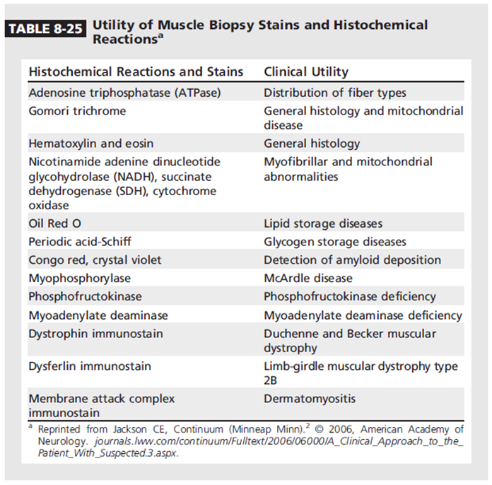

Slide 8
Multiple Choice Questions
Normal Muscle Anatomy
H&E
Notes:
Rectus muscle

Slide 9
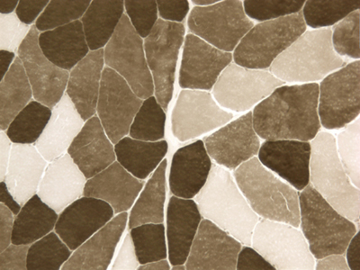
Which 2 statements are true?
Type 1: Slow twitch, fatigue prone, glycolytic metabolism
Type 1: Slow twitch, fatigue resistant, oxidative metabolism
Type 2: Fast twitch, fatigue prone, glycolic metabolism
Type 2: Fast twtich, fatigue prone, oxidative metabolism

Slide 10
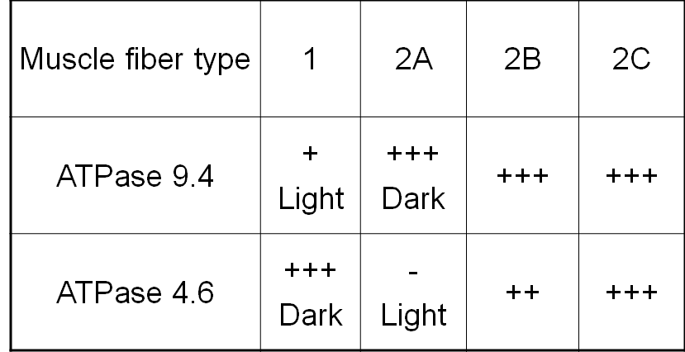
ATPase stain

Slide 11
ATPase stain
ATPase 4.6
ATPase 9.4

Slide 12
What is the pattern of muscle disease?
Fiber type grouping
Group atrophy
Inflammation
Fibrosis

Slide 13
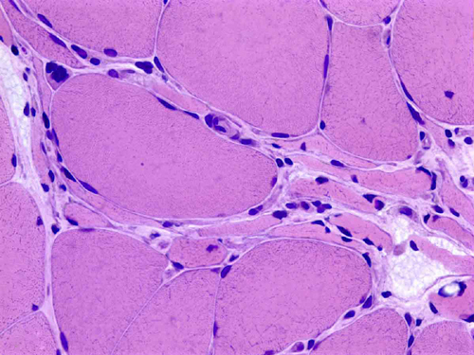
Neuropathic changes
Motor units exert trophic influence on muscle (contractions, chemical substances)
Denervation atrophy is caused by peripheral neuropathies and motor neuron diseases.
Myofibers that loose their innervation become angular and shrink
In the process of denervation, there is loss and disarray of myofilaments but no myonecrosis occurs

Slide 14
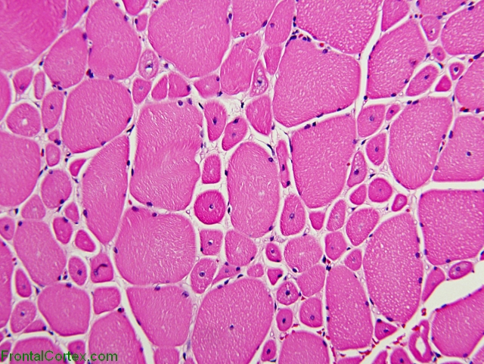
What does biopsy specimen show?
a) Myopathic muscle
b) Normal muscle
c) Neuropathic muscle

Slide 15
Myopathic changes
Classic myopathic changes are seen in this image: fiber size variability, rounding of muscle fibers, and centrally located nuclei.
Fiber Size Variability - muscle fibers are varied in size - some are quite large, some are very small. In a biopsy of normal muscle, most muscle fibers would appear to be about the same size.
Rounded Fibers – normally, muscle fibers cut in cross-section have a polygonal appearance. In neuropathy, the angulation of the fibers becomes exaggerated. In myopathy, the fibers become more rounded.
Centrally Located Nuclei -muscle fibers are polynuclear rather than cells with a single nucleus. The nuclei in normal muscle fibers are located on the periphery, close to the cell membrane. In myopathy, the muscle fibers get more centrally located.
This is centronuclear myopathy

Slide 16
Centronuclear myopathy
Small myofibers with central nuclei
Central areas without contractile filaments, like immature fetal muscle.
X-linked CM, caused by mutations of MTM1 on Xq28; autosomally inherited CMs.
Severe/classic X-linked form of CM presents with severe hypotonia and weakness at birth or prenatally and may be fatal in infancy.
Severe congenital myotonic dystrophy may have a similar appearance to CM

Slide 17
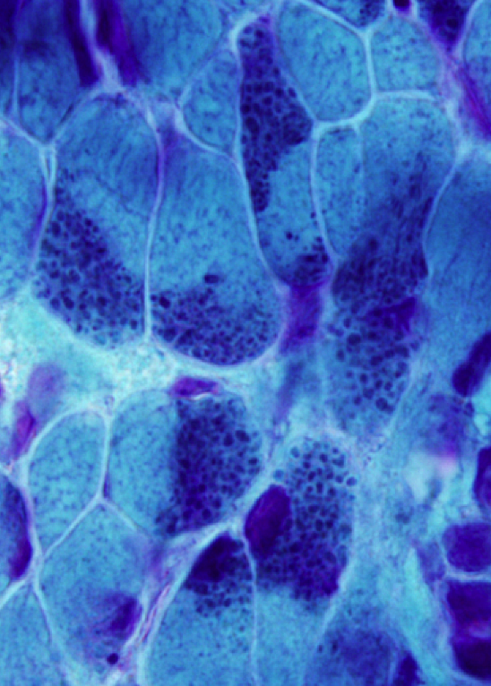
The Gomori trichrome stained muscle biopsy shown above is most consistent with which of the following disorders?
a) Central core disease
b) Nemaline myopathy
c) Becker muscular dystrophy
d) Pompe disease
Nemaline rods: Intracytoplasmic thread-like rods derived from Z-bands (alpha actinin).

Slide 18
Nemaline Myopathy
Infantile hypotonia; sporadic late onset nemaline myopathy (4%)
Facial and respiratory weakness in infants
Six different mutations
autosomal dominant or recessive mutations of several genes that encode components of thin filaments

Slide 19
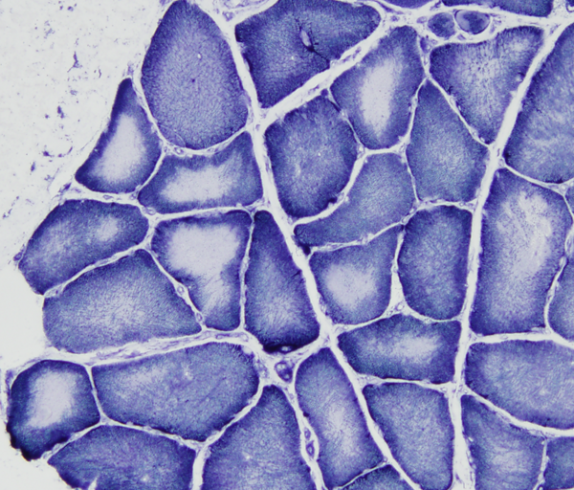
What type of changes are seen in these myofibers?
Angular myofibers
Large myofibers
Lacking oxidative enzymes

Slide 20
Central Core Myopathy
On NADH stain myofibers have a central area lacking oxidative enzyme activity
The cores consist of disorganized contractile filaments without mitochondria
Type I myofiber predominance
Caused by autosomal dominant or recessive mutations of RYR1 – calcium channel
Hypotonia and weakness at birth; can be fatal in severe cases
Mutations of RYR1 confer susceptibility to malignant hyperthermia

Slide 21
Patient’s muscle biopsy results
H&E
Gomori Trichrome
NADH
ATPase 9.4
ATPase 4.6
PAS
Cyto Ox
HSEST

Slide 22
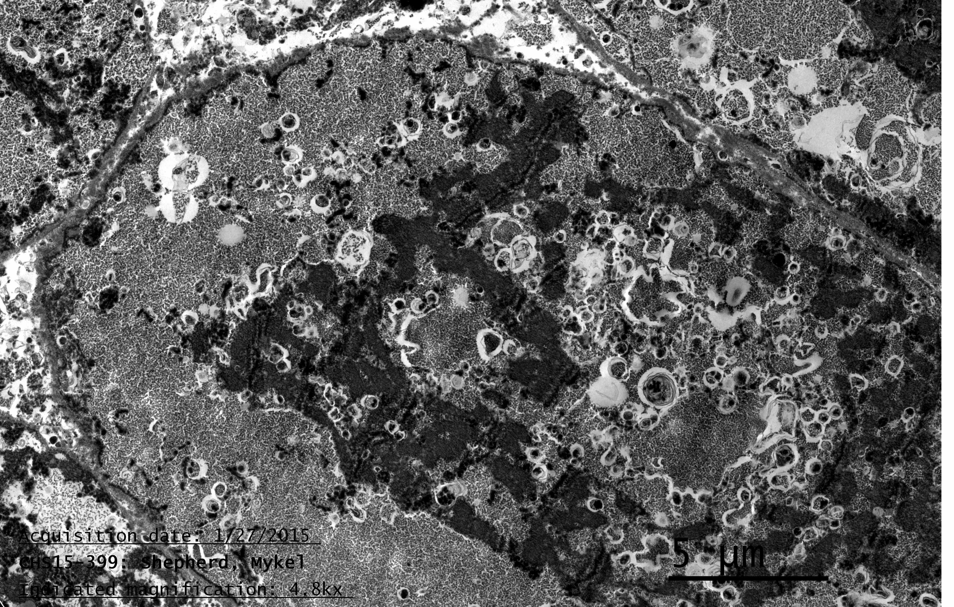
Electron microscopy

Slide 23
Pompe Disease
Lysosomal acid maltase deficiency, aka Pompe Disease
Autosomal recessive disorder with considerable allelic heterogeneity
Due to mutations in the gene encoding lysosomal α-1,4-glucosidase; >200 mutations have been recorded
Glycogen is most abundant in liver and muscle and serves as a buffer for glucose needs
Glycogen stored in liver releases glucose to tissues that are unable to synthesize glucose during fasting
deficiency results in hypoglycemia and hepatomegaly
Glycogen stored in muscle provides ATP for high intensity muscle activity
Deficiency results muscle cramps, exercise intolerance, easy fatigability, and progressive weakness
Infantile and Juvenile/Adult forms

Slide 24
Pompe Disease
Infantile form
most severe form of glycogenosis and is usually fatal in infancy
Typically present during first few months of life
Characterized by cardiomyopathy and severe generalized muscular hypotonia
Hepatomegaly may be presents usually due to heart failure
Median age of death without treatment is about 9 months
Juvenile and adult forms
Late onset acid maltase disease may present at any age
Primary clinical finding is skeletal myopathy with eventual respiratory failure
Affected children present with delayed gross-motor development and diaphragmatic weakness
respiratory failure leads to death in 2nd and 3rd decades of life.
Affected adults present with progressive proximal weakness in limb-girdle distribution with associated diaphragmatic involvement.
The heart and liver are not involved
Overall, disease severity was related to disease duration rather than age

Slide 25
Pompe Disease
Diagnosis
Should be suspected in an infants with profound hypotonia and cardiac insufficiency
Serum CPK is typically elevated, leukocyte acid maltase activity is decreased
Muscle biopsy
vacuolar myopathy with glycogen storage within lysosomes and free glycogen in cytoplasm by EM
Vacuoles are periodic acid-Schiff (PAS) positive, digestible by diastase, positive for acid phosphatase.
Prenatal diagnosis – possible by DNA analysis if the mutation in the family is known

Slide 26
Pompe Disease
Muscle biopsy findings
The accumulation of glycogen is due to a deficiency of lysosomal acid maltase (α-1,4-glucosidase) which hydrolyses maltose, linear oligosaccharides and the outer chains of glycogen to glucose
Muscle biopsies have a pronounced vacuolar appearance and periodic acid-Schiff (PAS) staining shows large deposits of glycogen in most fibers
The vacuolation may be extensive, or minimal, or may only be apparent in some fibers, mainly type 1 fibers or sometimes both fiber types
The glycogen is digested by diastase; abundant acid phosphatase activity
There is also abundant MHC class I labeling associated with the vacuoles and on the sarcolemma of some fibers

Slide 27
Pompe Disease
Therapy
Enzyme replacement therapy (ERT) with recombinant human acid maltase derived from Chinese hamster ovary cells (alglucosidase alpha) was approved by FDA in 2006
Outcome ~80% reduction in risk of death for up to 3 years of therapy
Treatment outcome is affected by cross reactive immunologic material (CRIM) status.
CRIM negative status (lacking any residual GAA expression) was associated with increased risk of death.
High protein and low carbohydrate diet combined with exercise therapy may be helpful in adult onset disease
Gene therapy strategies are under investigation

