Slide 1
HOW TO PROCESS A MUSCLE BIOPSY
David Lacomis, MD

Slide 2
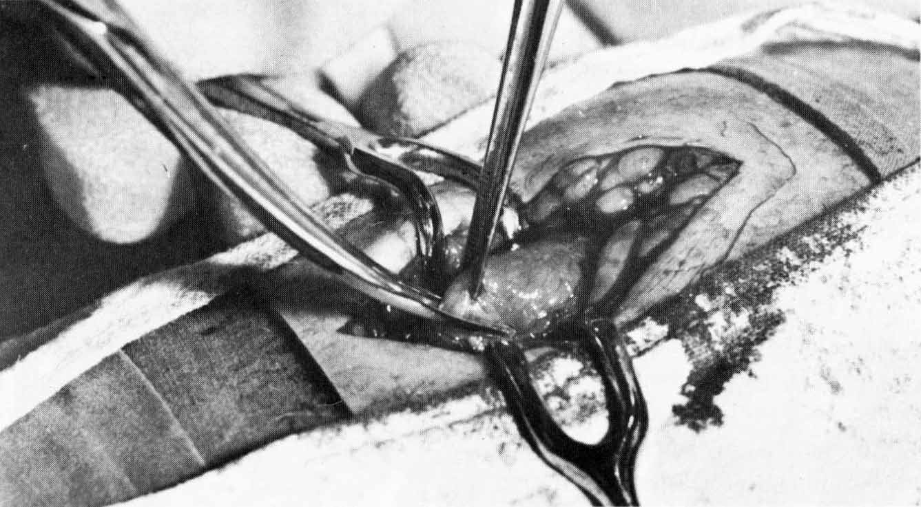
ORIENTATION OF MUSCLE FIBERS

Slide 3
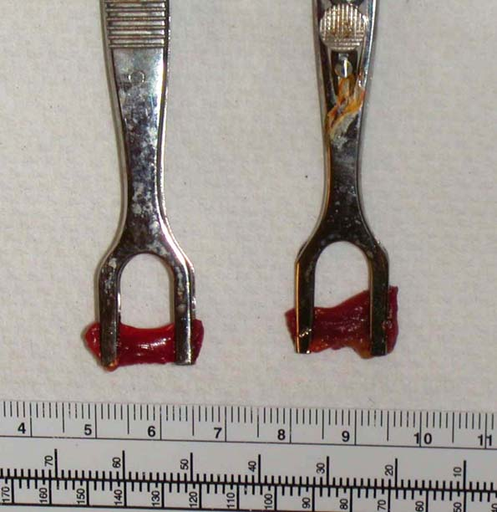
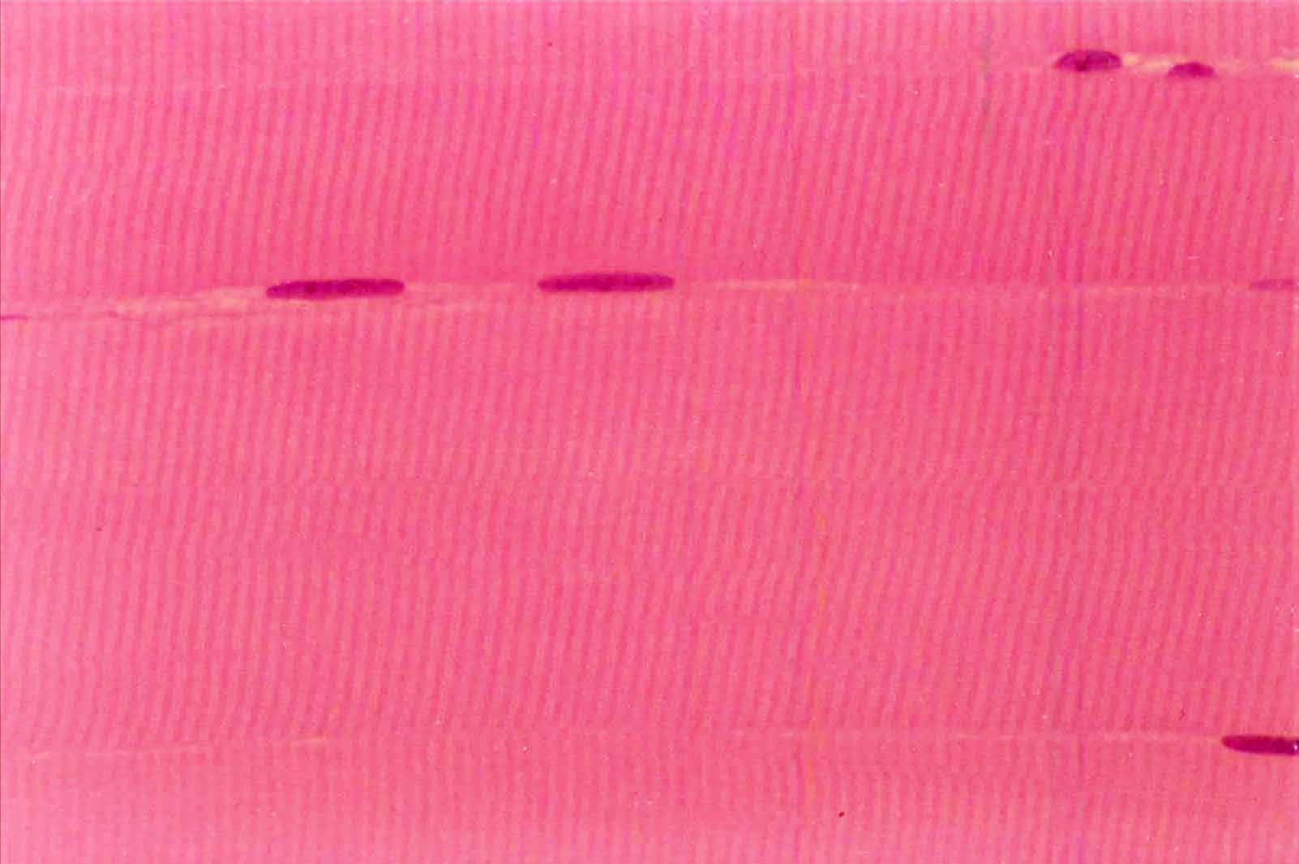
Surgeon should
Provide 2 – 3 pieces
of muscle of at least
1 x 1 cm.
The piece on the L
is a little small.
At least one piece
Should be on a clamp
(preserves cross-
striations)
normal paraffin

Slide 4
Dividing the Specimen
Cut 3 mm off one of the clamped pieces and place immediately in EM fixative (e.g, Karnovsky’s)
Take the rest from the clamped piece and place in formalin to be later embedded in paraffin (cross section and longitudinal)
EM
Formalin/Par
Freeze

Slide 5
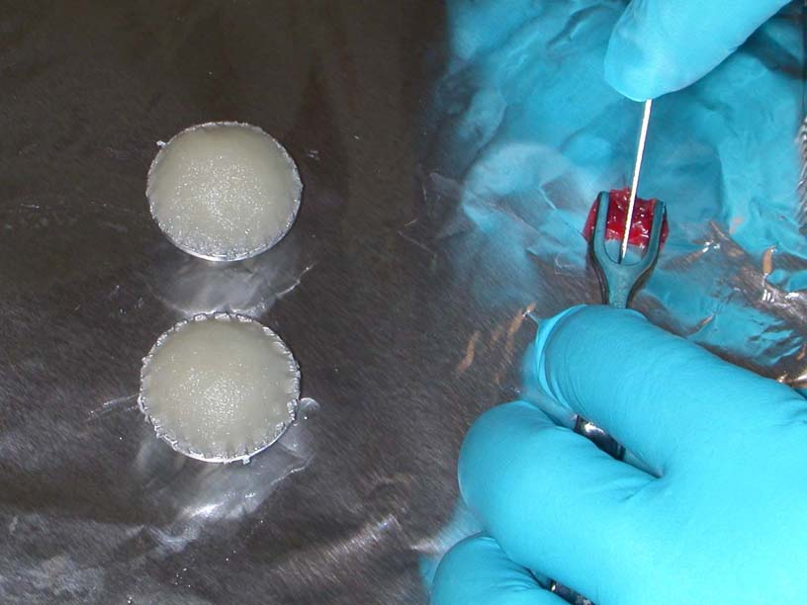
Processing the Biopsy: Cryostat Sections
Orienting the specimen
Mounded gum tragacanth on a chuck
Use dissecting
Scope to confirm
Orientation of
Myofibers if you
Are uncertain

Slide 6
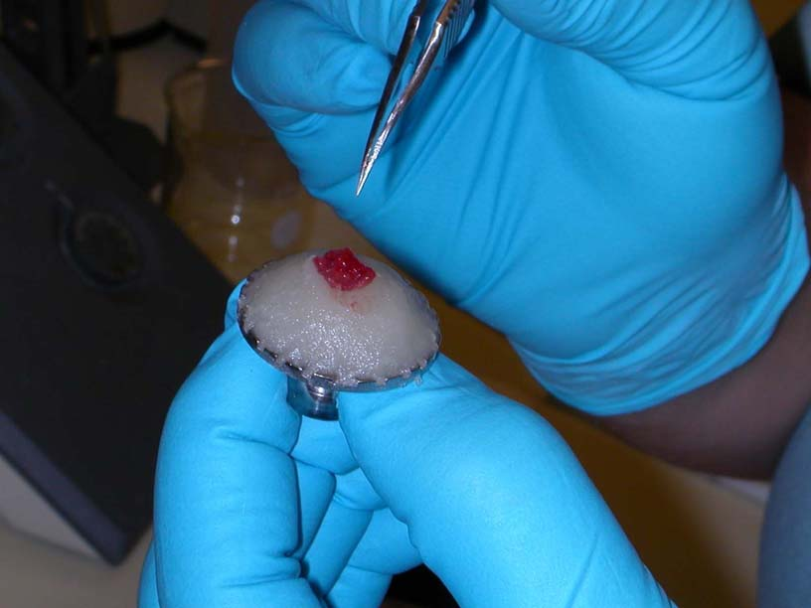
Processing the Biopsy: Cryostat Sections
Mounting the specimen
Perpendicular to gum

Slide 7
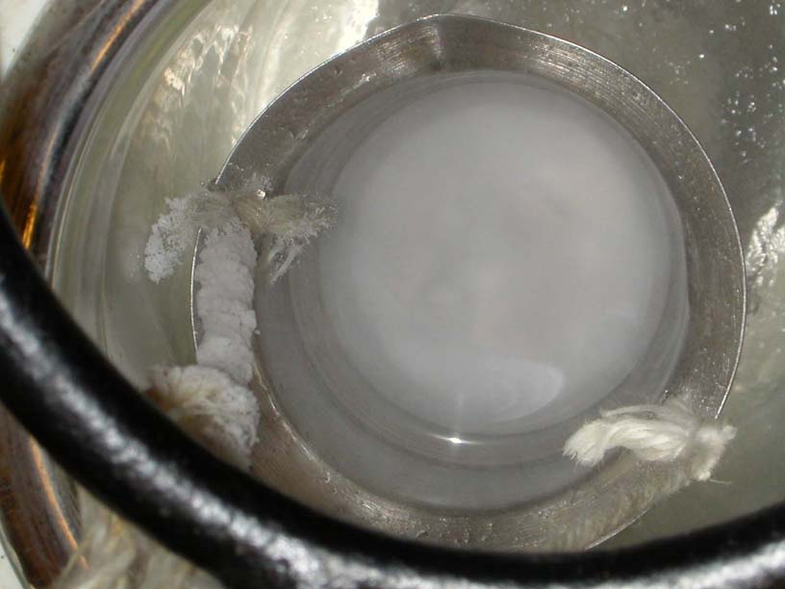
Processing the Biopsy: Cryostat Sections
Freezing the specimen – 160 deg C
Inner flask with isopentane or methylbutane
Outer flask with liquid nitrogen
Grab chuck with tongs, turn upside down
and plunge into center flask and swirl for about a minute

Slide 9
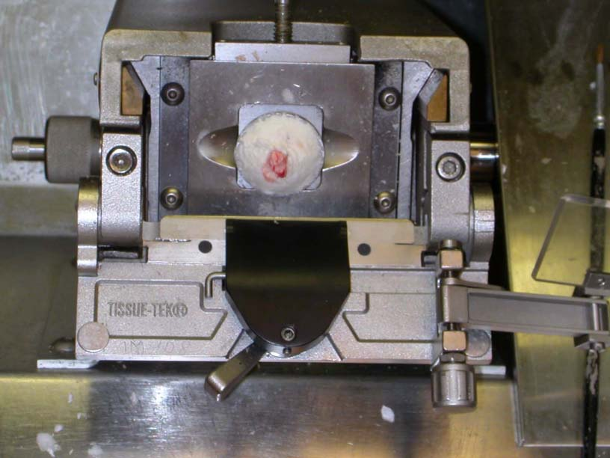
Processing the Biopsy: Cryostat Sections

Slide 10
Shipping Muscle Specimens
If it will arrive within a few hrs, send one piece on saline MOISTENED, not soaked, gauze or a telfa pad, place in a ziplock bag, and keep cool (use cooler with icewater) but do not freeze.
Send overnight specimens after freezing in plenty of dry ice
Send the other piece in formalin or divide for EM too if possible
If there is a 3rd piece, send it fresh with the cooled specimen (or frozen for overnight)
http://neuro.pathology.pitt.edu/webstuff/NeuromuscularProcess.html

