Slide 1
Neuropathology Update for Physician’s Assistants: Autopsy Neuropathology
Julia Kofler and Kate McFadden

Slide 2
Outline
The CNS Autopsy
  Dura removal
  Spinal cord squeeze
Basic Neuroanatomy
Gross Neuropathology
  Bloody brain

Slide 3
The CNS Autopsy
Examination of the brain and spinal cord at autopsy is performed to diagnose diseases affecting the CNS and to correlate lesion type/ patterning with premortem clinical and neuroradiologic findings
Know the goals of the CNS part of the autopsy before you start
  this is not only the responsibility of the attendings and residents

Slide 4
The CNS Autopsy
Review the neuro-relevant clinical history/data before the brain is removed
  Are the surrounding tissues relevant to the clinical picture?
    E.g. intracranial hemorrhage, skull based tumor, sellar mass, aneurysm, cranial neuropathy etc
  Sampling of additional sites – e.g. dura, sinus, specific vertebral levels (fractures or mets), ganglia, peripheral nerve

Slide 5
The CNS Autopsy
It is also crucial to review the clinical history/data before the brain is fixed:
  fresh CSF or tissue samples for microbiologic culture, frozen tissue for biochemical or molecular studies, or specially fixed tissues for EM

Slide 6
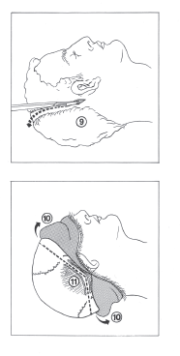
Brain Removal
Elevate shoulders on block or stand (unlike this diagram)
Separate hair and incise scalp across the vertex, beginning behind the right ear
Reflect the scalp down to the hairline
Incise and slightly reflect the temporalis muscles
Cut calvarium with an oscillating saw

Slide 7
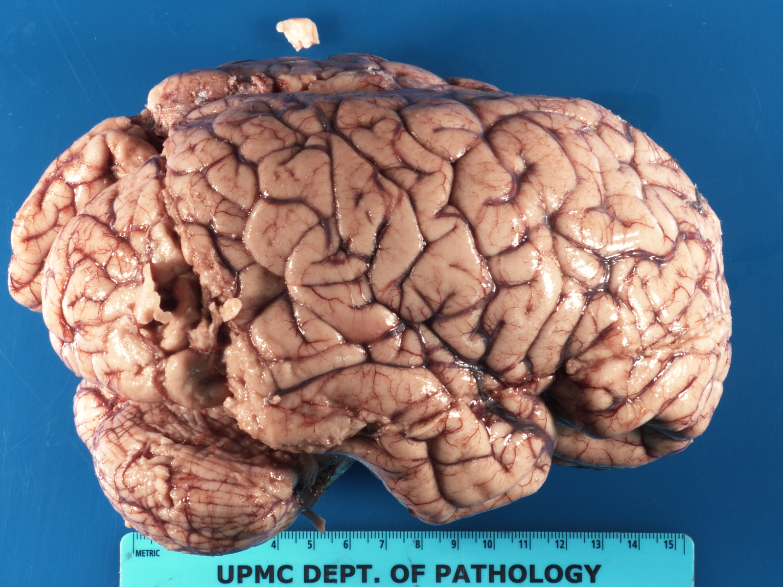
Brain Removal
Try not to transect temporal lobe with said oscillating saw!!!

Slide 8
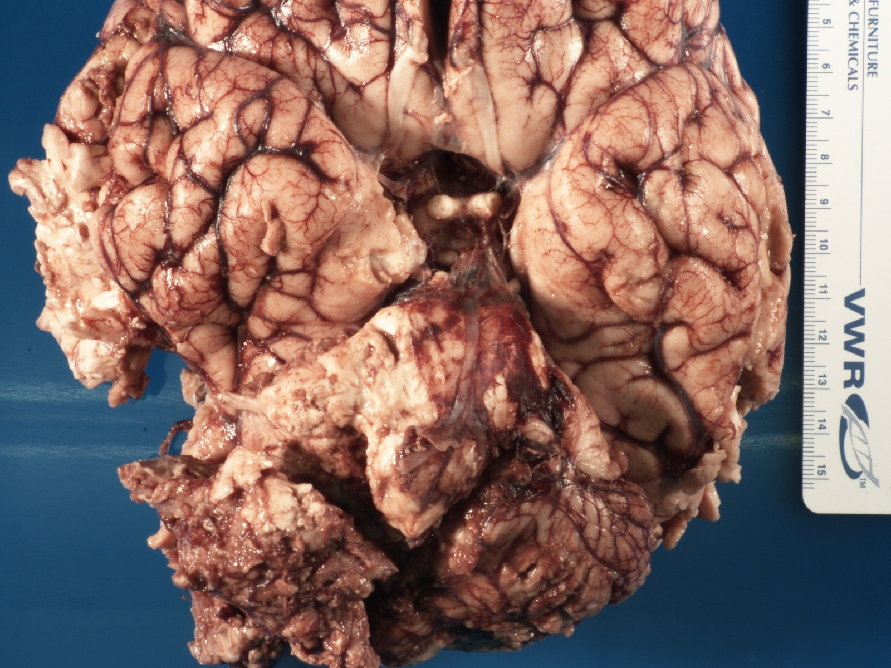
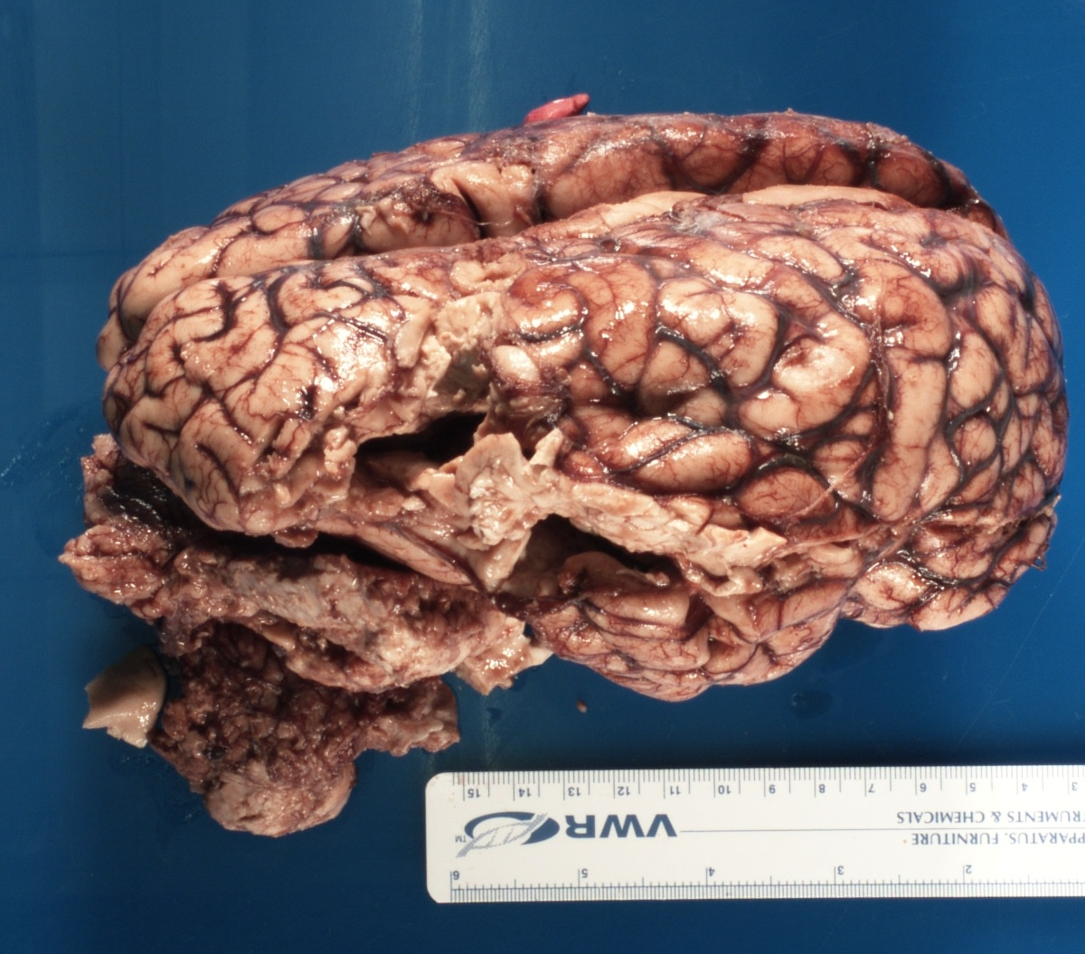
Brain Removal
However, the globally edematous brain will jump out and impale itself on the saw
Not much you can do about it
Edematous brain with uncal and cerebellar tonsillar herniation – saw marks right into ventricle

Slide 9
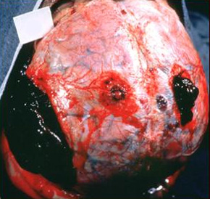
Brain Removal
Detach the skull cap from the dura
The brain maintains an intimate relationship with dura and cranial bone
This relationship can only be examined during the autopsy
When the funeral director gets the body - it is gone for good
  So carefully examine the dura and cranial bone!!
This will also hold for the vertebral column

Slide 10
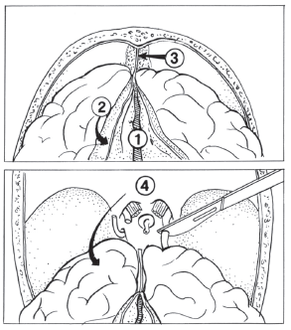
Brain Removal
Open superior longitudinal sinus
Cut dura along the line of skull cut and reflect towards midline.
Retract frontal poles and cut anterior attachments of falx
Elevate olfactory bulbs, retract brain, and cut optic/cranial nerves and carotid arteries

Slide 11
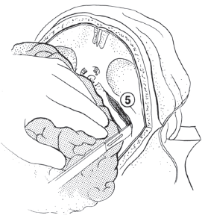
Brain Removal
Retract brain medially and cut tentorium along petrous ridges

Slide 12
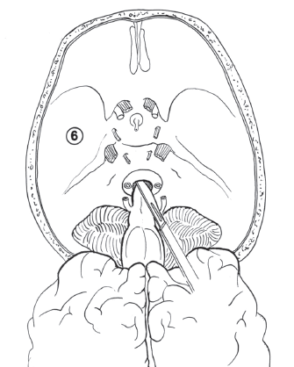
Brain Removal
Retract brain posterioly and cut rest of cranial nerves as close to the cranium as possible
Cut vertebral arteries and spinal cord as distally within the spinal canal as possible

Slide 13
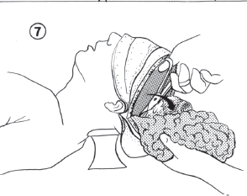
Brain Removal
Gently retract cerebellum and brainstem
While supporting the brain, cut remaining dural attachments

Slide 14
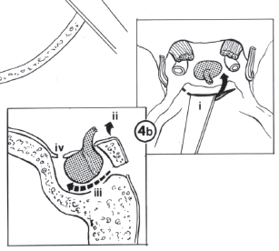
Pituitary Removal
Remove pituitary from sella turcica
  Chisel off posterior clinoid process
  Elevate
  Blunt dissect pituitary
  Cut anterior dura

Slide 15
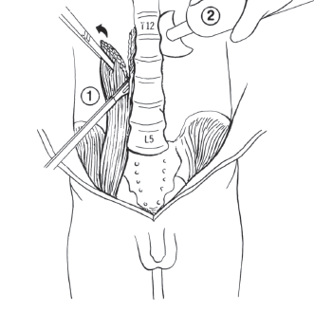
Spinal Cord Removal
Remove psoas muscle
Expose spinal cord with oscillating saw

Slide 16
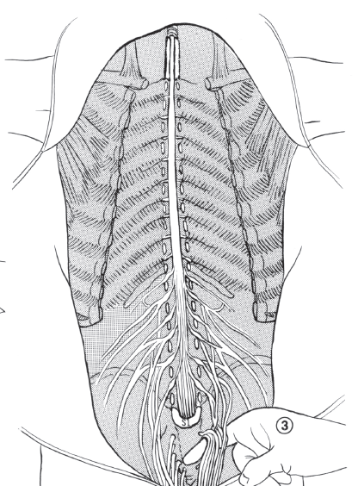
Spinal Cord Removal
Beginning caudally, lift the vertebral column while detacking anterior ligamentous connections to cord

Slide 17
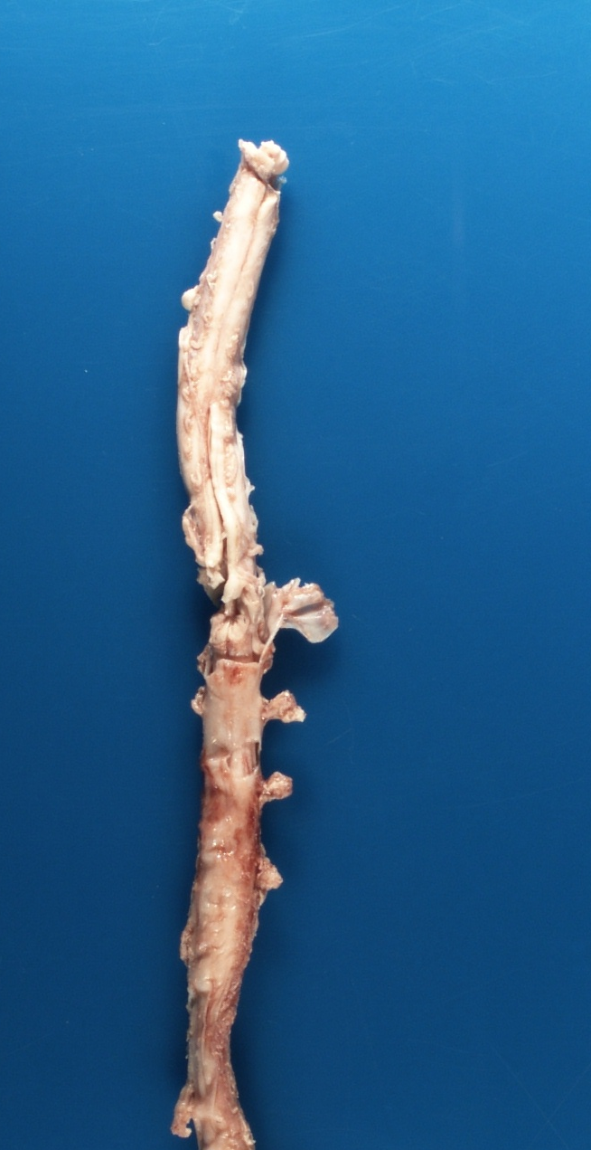
Spinal Cord Removal
Please be sure to free up the spinal cord properly or we end up with this
Diagnoses?
  Shaken baby?
  MVA?
  Shark attack?

Slide 18
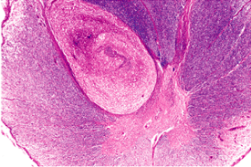
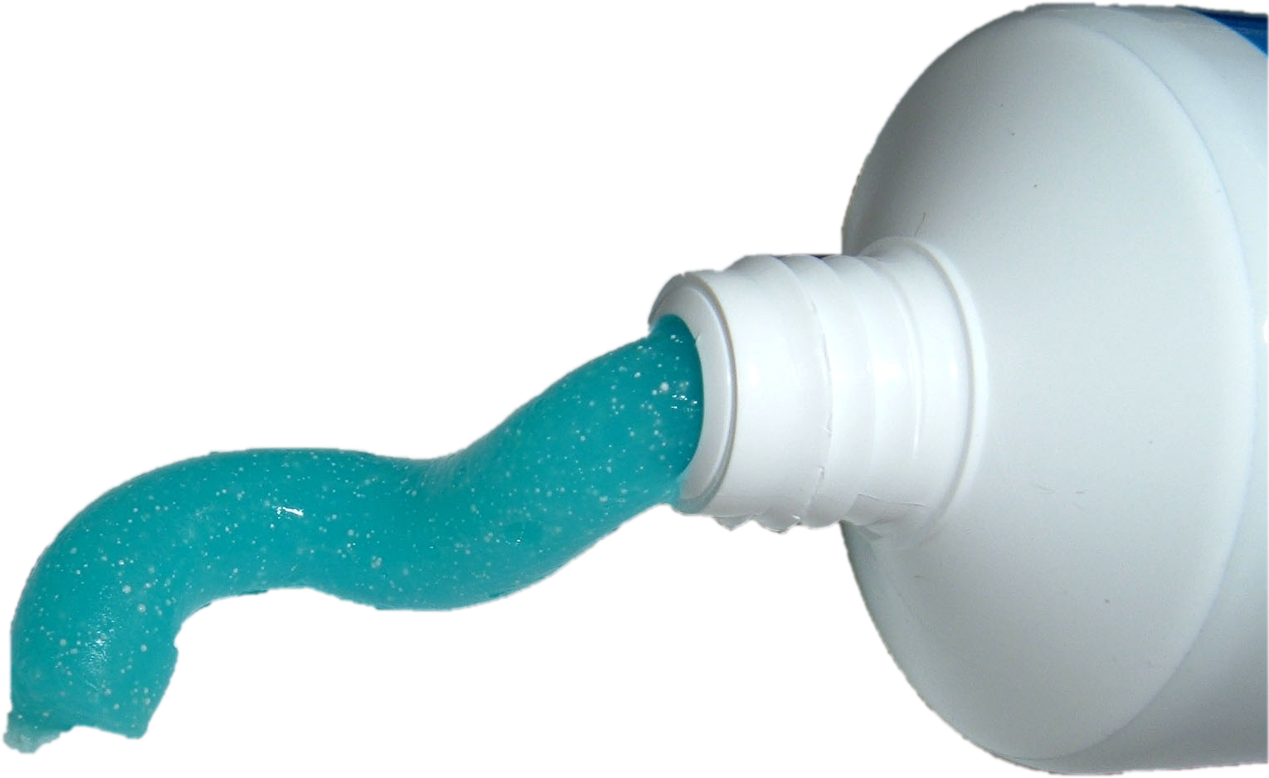
Spinal Cord Removal
Try not to pull
  Even in the absence of shark sign we can end up with toothpaste artefact
Tumor??

Slide 19
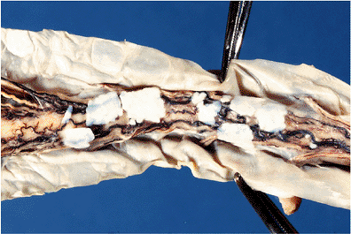
Spinal Cord Removal
Do not be alarmed
These are only hyaline plaques of the spinal leptomeninges
Common incidental findings
Occasionally are seen in the cerebral leptomeninges as well
http://flylib.com/books/en/2.953.1.17/1/

Slide 20
Basic Neuroanatomy

Slide 21
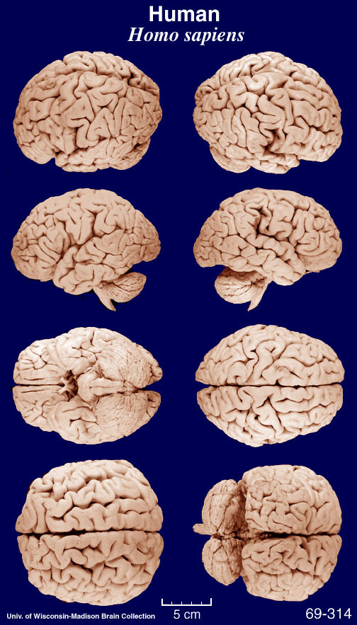
Notes:
The mature neocortex is partitioned into well-defined structurally and functionally distinct “areas” that are differentiated by their cellular organization and patterns of neuronal connectivity. Initial patterning of neocortex into cortical areas results from different molecular signals present in different regions of the neocortical proliferative zone. Some parts of the cortex that are of very ancient origin, such as the hippocampus, contain only a single layer of cells. Others, such as the olfactory cortex, contain two layers. But the most elaborate cortex, the neocortex, contains at least six well defined main layers, which are often divided into sublayers. In the course of evolution, the neocortex appeared only with the mammals. In humans and other primates, the neocortex is so dominant that the term "cortex" is often used to refer to the neocortex alone.
The cellular architecture differs sufficiently from one part of the neocortex to another to be used as a criterion for defining cortical areas that are functionally distinct. That is what the German anatomist Korbinian Brodmann did in the early 20th century, when he developed a map of the brain based on the differences in the cellular architecture of the various parts of the cortex. Brodmann assigned each part of the cortex that had the same cellular architecture a number from 1 to 52.
Brodmann's intuition, whose accuracy has been confirmed many times since, was that a particular anatomical structure corresponded to a particular function.
For example, Brodmann's area 17, which receives information from a nucleus of the thalamus that is connected to the retina, turns out to correspond precisely to the primary visual cortex. And Brodmann's area 4, from which the axons of the large pyramidal cells project to the motor neurons of the spinal cord, corresponds broadly to the motor cortex.

Slide 22
Gross Pathology
The Softened/Gooey Brain
The Bloody Brain
The Herniated Brain

Slide 23
Softened/Gooey Brain

Slide 24
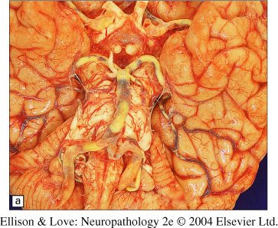
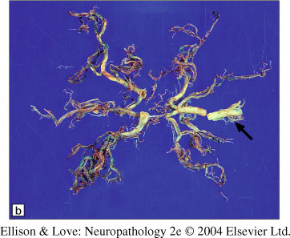
Ischemic Stroke
The “gooey” brain is usually the result of focal ischemic stroke or infarct
Ischemic = loss of blood supply
Infarct = a circumscribed volume of (brain) tissue within which all cellular elements have died
  cerebral atherosclerosis/ thrombosis

Slide 25
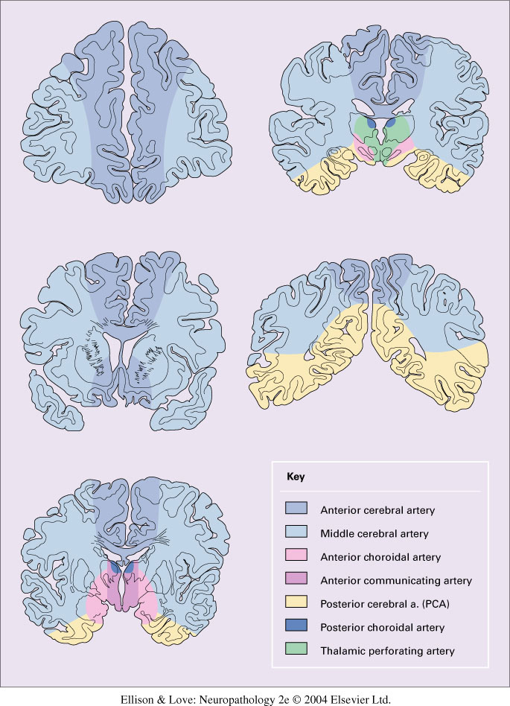
Ischemic Infarcts
A destructive lesion or area of softening corresponding to one of these discrete regions, it is likely to be an ischemic infarct resulting from occlusion of a major cerebral artery

Slide 26
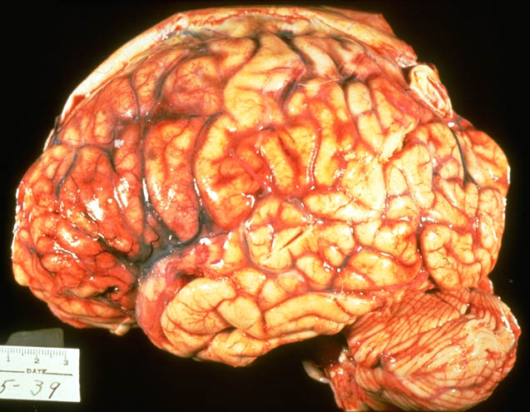
Acute Infarct
6-48 hours post insult
  Pale, soft, swollen (edematous)
Courtesy of Dr. Julio Martinez

Slide 27
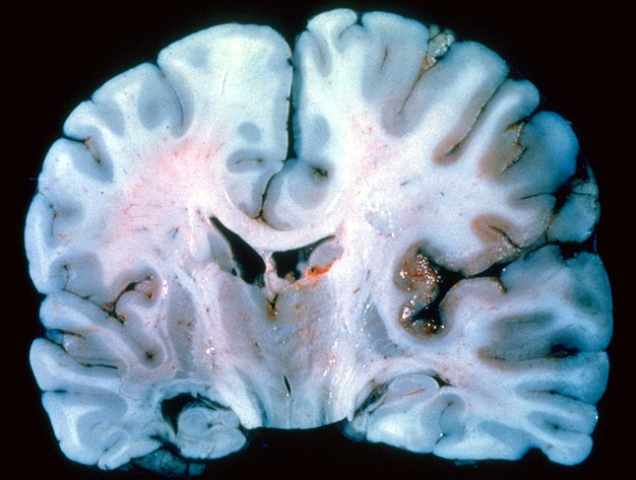
Acute Infarct
Indistinct infarct border
Blurred gray-white junction
Okazaki & Scheithauer, Slide Atlas of Neuropathology, 1998

Slide 28
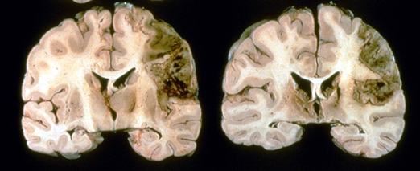
Subacute Infarct
2 days -3 weeks
Gelatinous, friable, distinct border, tissue liquifaction
Courtesy of Dr. Julio Martinez

Slide 29
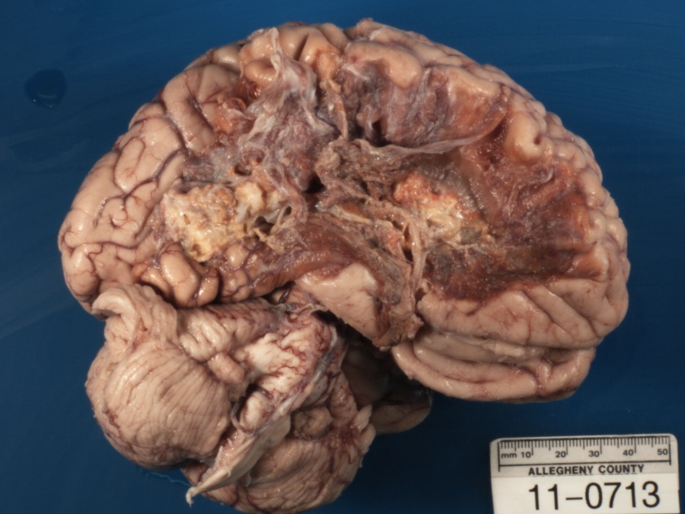
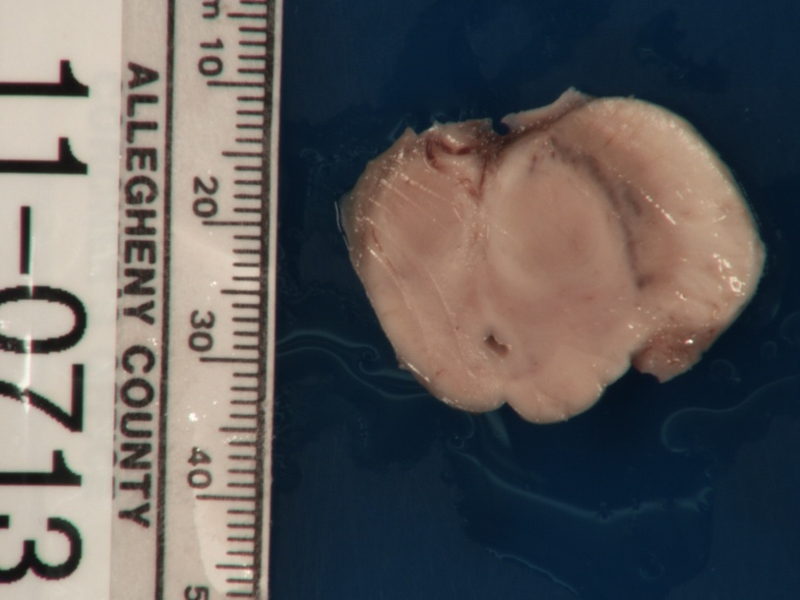
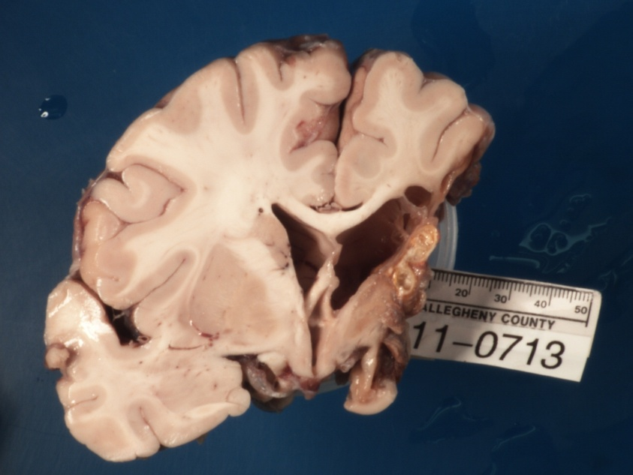
Chronic/Remote Infarct
More than 3 weeks
Remote MCA infarct with
  Cystic
  +/- hemosiderin staining
  secondary degeneration

Slide 30
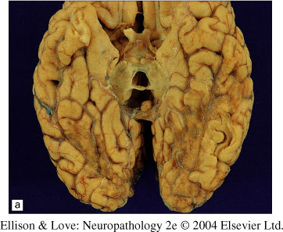
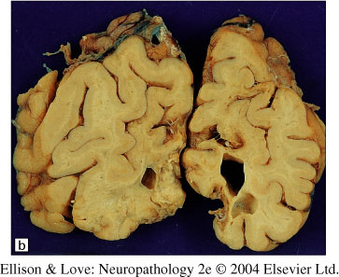
Chronic/Remote Infarct

Slide 31
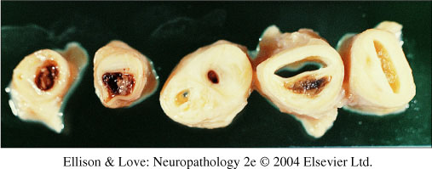
Embolic Infarcts
When solid material travels through the arterial circulation to occlude a downstream vessel
  Usually the result of complicated atherosclerotic plaques of aorta and its branches – particularly the carotid in the case of the brain
Modified from

Slide 32
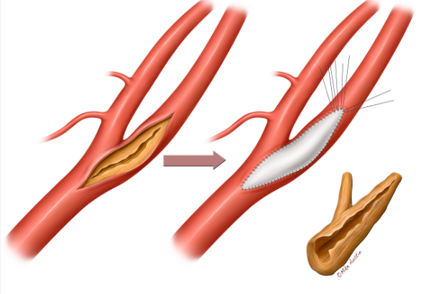
Carotid Endarterectomy
Azheart.com

Slide 33
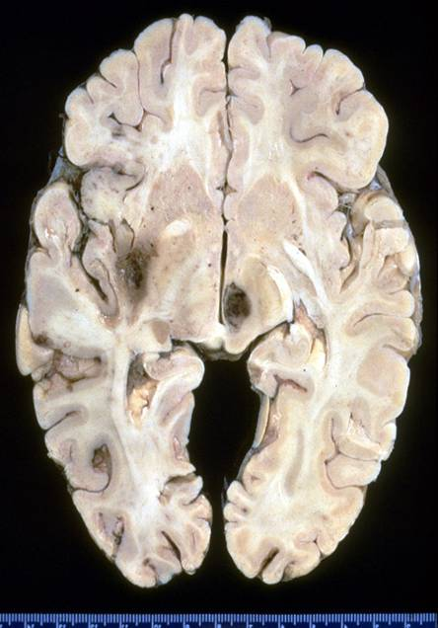
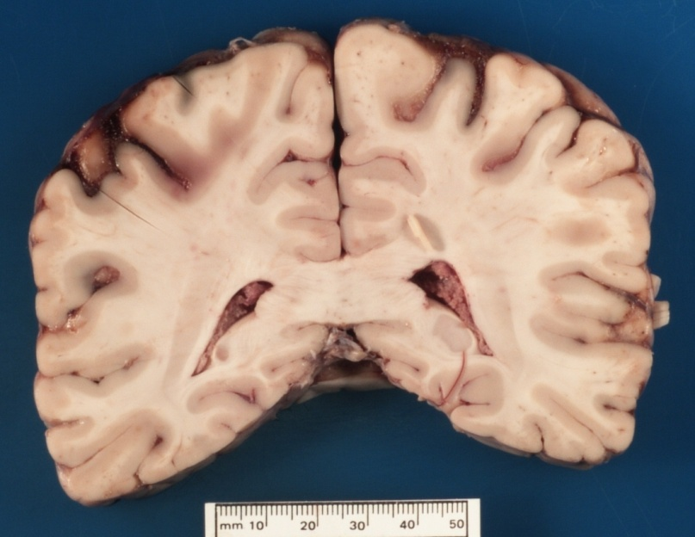
Embolic Infarcts
Smaller
Centered on gray-white junction
Single or multiple
MCA most common
More than one vascular territory
Courtesy of Dr. Christine Hulette

Slide 34
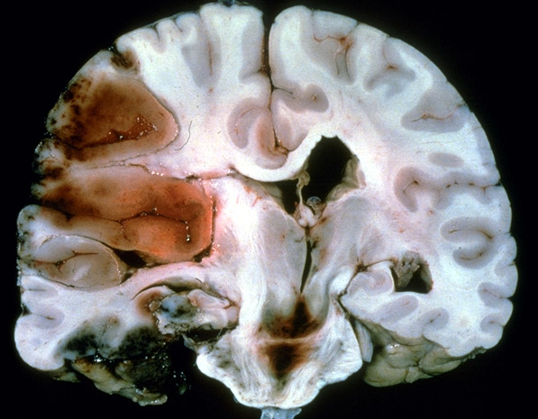
Embolic Infarcts
Usually hemorrhagic
Probably due to dissolution of the clot and reperfusion into a necrotic vessel
Have to differentiate from bleeding into icshemic infarct or cerebral hemorrhage
Courtesy of Dr. Christine Hulette

Slide 35
Watershed Strokes
A destructive lesion or area of softening corresponding overlapping 2 or more discrete regions is likely to be a watershed infarct resulting from reduced cerebral perfusion presure

Slide 36
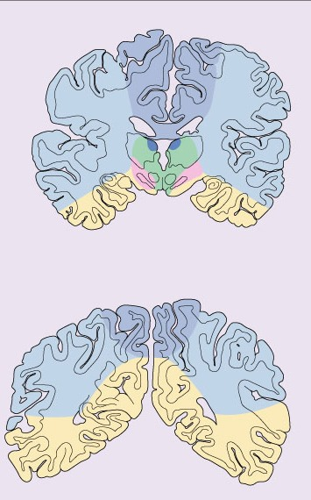
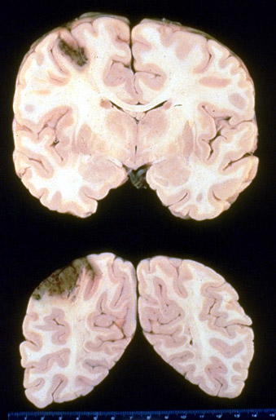
Watershed Infarcts
ACA/MCA
ACA/MCA/PCA
Modified from Ellison and Love 2004
Courtesy of Dr. Christine Hulette

Slide 37
Bloody Brain

Slide 38
Hemorrhagic Stroke
Traumatic vascular neuropathology
  Epidural and subdural hemorrhage
Caused by cerebrovascular disease
  Subarachnoid hemorrhages
    Aneurysms
    Arteriovenous malformations (AVMs)
  Intraparenchymal hemorrhages
    Hypertension
    Amyloid angiopathy
    AVMs

Slide 39
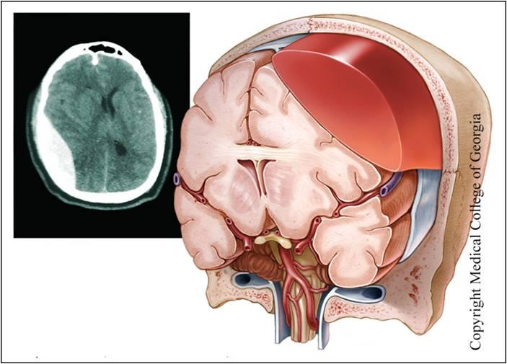
Epidural Hemorrhages
Less common than SDH (often occur together)
Usually results from skull fracture with tear of dural artery
  middle meningeal artery
  under arterial pressure so often rapidly expanding
Localized, biconvex accumulation of blood between skull and dura

Slide 40
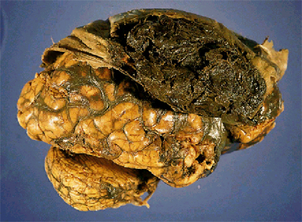
Epidural Hematoma
Dense dark-red clot adherent to outer surface of dura
Courtesy of Dr. Bennet Omalu

Slide 41
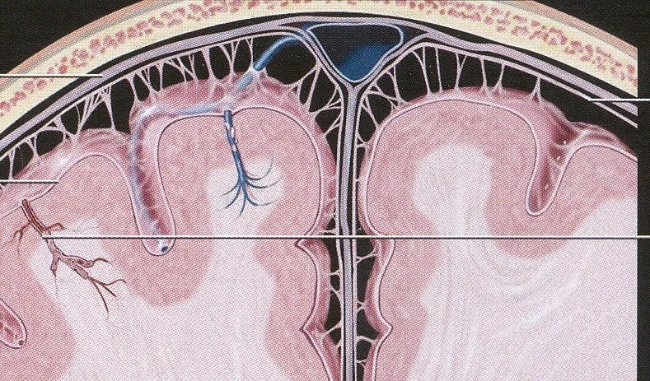
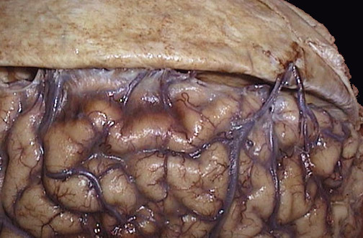
Subdural Hematoma (SDH)
More diverse etiology and presentation than EDH
Not necessarily associated with significant head trauma
Due to rupture of “bridging” veins between dura and brain usually around superior sagittal sinus
Harnsberger et al. 2006
Modified from http://library.med.utah.edu/WebPath/

Slide 42
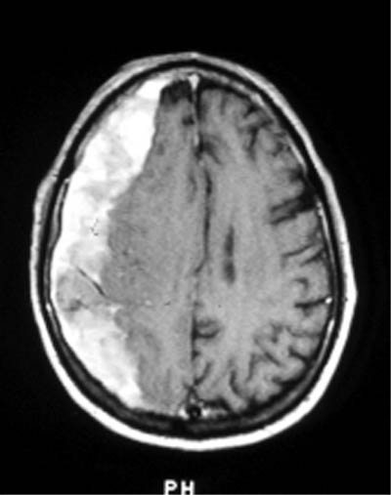
SDH
Two major flavors with distinct clinical and pathologic features
  Acute – usually traumatic rapid acceleration or deceleration
  Chronic – less severe cycles of organization and re-bleeding
www.uiowa.edu

Slide 43
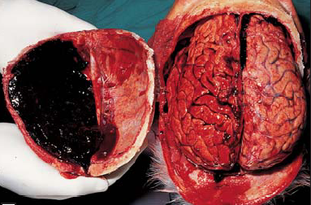
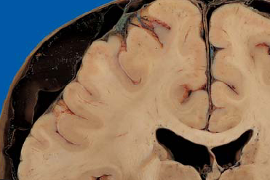
Acute SDH
Severe tearing of bridging veins, usually around superior sagittal sinus.
Subdural space less constrained than EDH - can spread relatively freely, often over whole hemisphere.

Slide 44
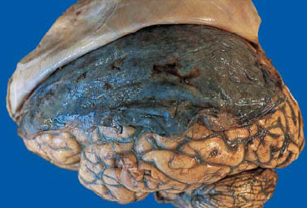
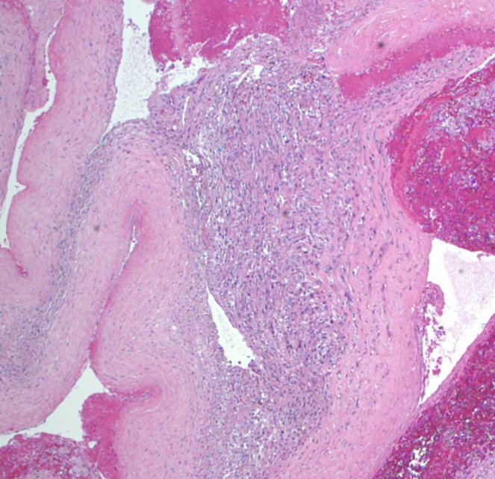
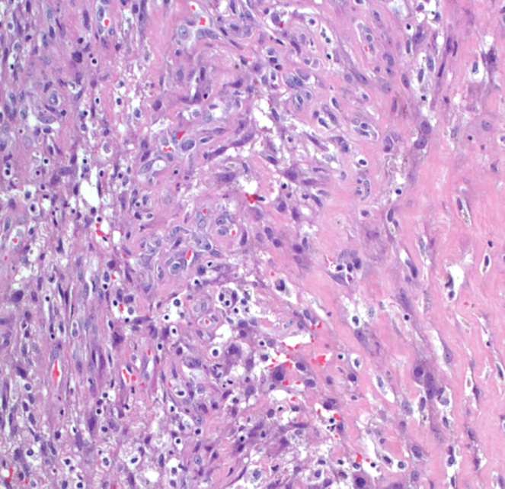
Chronic SDH
Trauma much less severe – often trivial or unnoticed
Hematoma thinner, has a chance to organize into a membrane of granulation tissue
Large, thin walled vessels within granulation tissue often re-bleed in cyclical fashion
Notes:
Get a smaller bleed that may not occupy as much space and causes less symptoms.

Slide 45
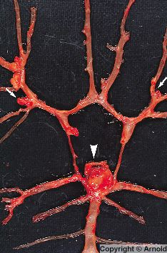
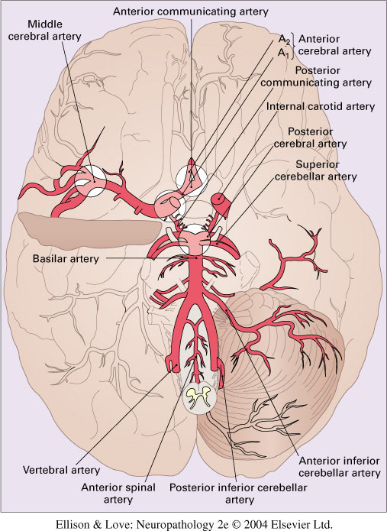
Saccular (Berry) Aneurysms
1.8% of autopsies
Most are asymptomatic until rupture
95% in anterior circulation
Modified from Graham & Lantos, Greenfield’s Neuropathology, 2002, Arnold

Slide 46
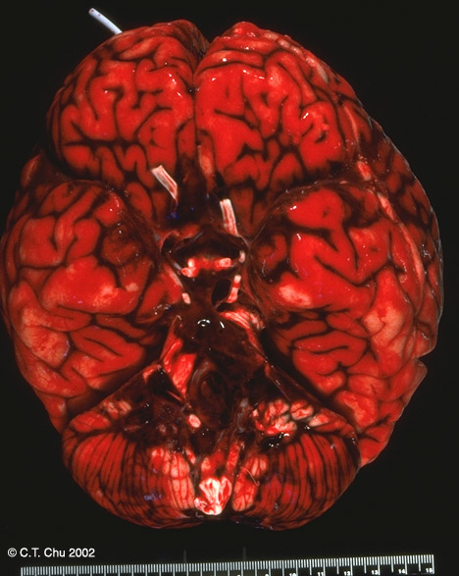
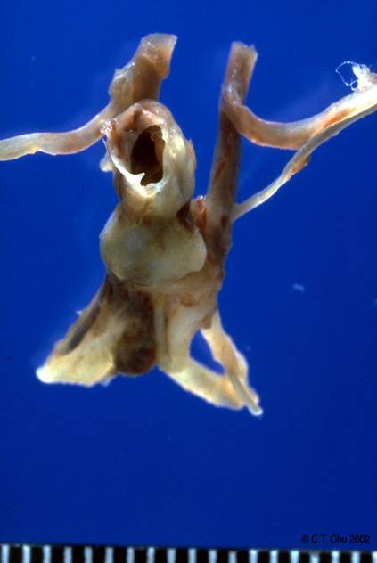

Slide 47
The Herniated Brain

Slide 48
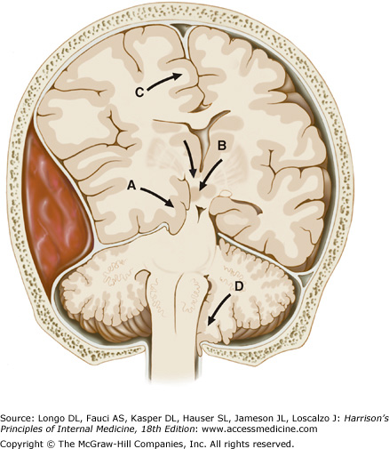
Brain Herniation
Uncal herniation
Central Herniation
Subfalcine herniation

Slide 50



Slide 51

Oculomotor nerve compression due to uncal herniation
Close-up view of herniating uncus shows compression of the third cranial nerve
Clinically there was ipsilateral pupillary dilatation and paresis of all of the extraocular muscles except the lateral rectus (CN6) and superior oblique (CN4) – lateral deviation.

Slide 52


Duret hemorrhages secondary to traction on the extramedullary segments of penetrating arteries and compression of the intramedullary segments.

Slide 53
Infarction due to compression of posterior cerebral artery against edge of tentorium.
Primary visual cortex at greatest risk.

Slide 54



Slide 55
Thank You

